Slide 1
Legislative Session Update Trent Fox, JD Vice President, Government Relations

Slide 2
Session Status
The “second half” started this week
Bills passed by the first house are now being considered in a series of committee hearings by the opposite chamber
House passed 111 of the 442 filed bills
Senate passed 110 of the 297 filed bills
Conference committees will begin soon
Must adjourn by March 14

Slide 3
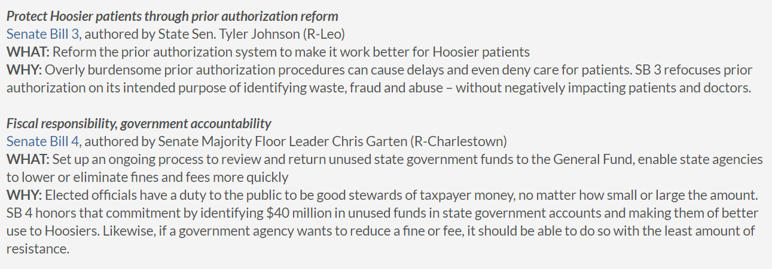
Legislature’s Priorities for 2024

Slide 4
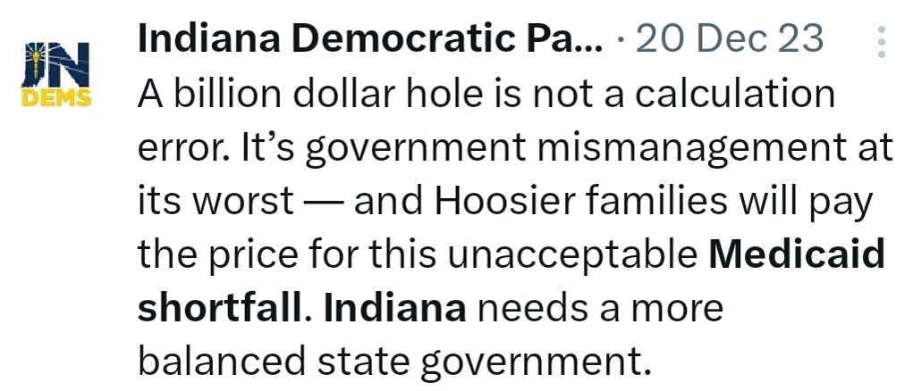
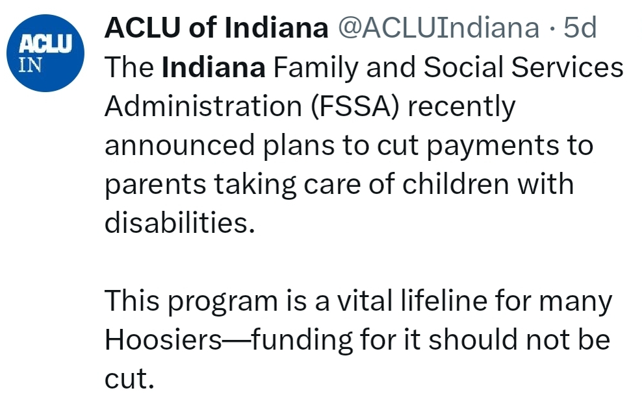
Impact of Medicaid Shortfall
Non-budget session
Significant Medicaid shortfall
Chilling effect on any bill related to Medicaid
Tension between LG Crouch and legislature
Bracing for contentious 2025 budget session

Slide 5
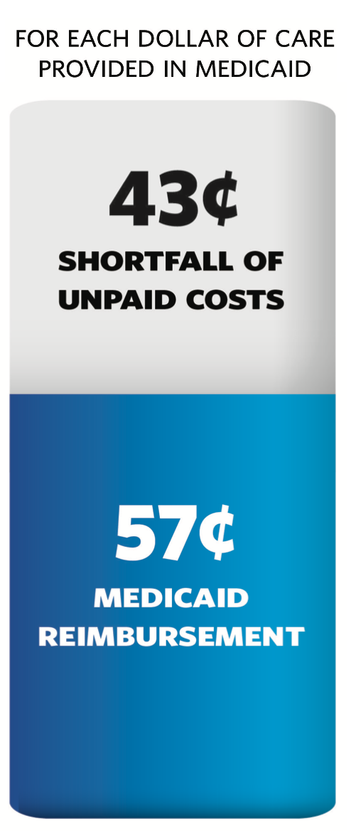
Medicaid Underpayment
Indiana has not increased hospitals’ base Medicaid rates in over 30 years.
Indiana Medicaid covers only 57 cents for every dollar of hospitals’ cost to provide care under the program.
Indiana’s low Medicaid reimbursement results in as much as $2.7 billion in unpaid statewide health care costs each year.

Slide 6
IHA Priority Legislation: HAF Modernization
HB 1393 (Rep. Barrett)
Allow hospitals to be assessed up to the federally allowable maximum (termed a “State Directed Payment Program”) to increase the overall benefit of the HAF, without an impact to the General Fund, and reduce the cost shift to commercial payors
40 states, including Kentucky, Ohio, and Illinois, already have State Directed Payment Programs, and Michigan is moving ahead with a plan; Indiana is leaving its federal tax dollars on the table
Infuse quality metrics into the HAF program, which are not currently present
Redesign the HAF to minimize net contributors and lift all boats to the extent possible
Enact a managed care assessment fee (MCAF) to eliminate the state administrative fee, provide further HAF relief, and fund initiatives such as a high-risk pool to reduce premiums
Status: HB 1393 received hearing in the first half but no vote; IHA continues working with legislative leadership on a possible solution

Slide 7
Concerning Legislation
HB 1200 (Price caps for State Employee Health Plan) DEAD
SB 9 (Merger and acquisition notification)
HB 1327 (Ownership disclosure and employer access to claims data)
SB 45 (Trauma informed care)
SB 168 (Additional 340B reporting) DEAD
SB 276 (Charity care requirements and medical debt reporting) DEAD
SB 258 (Additional restrictions on physician referrals)

Slide 8
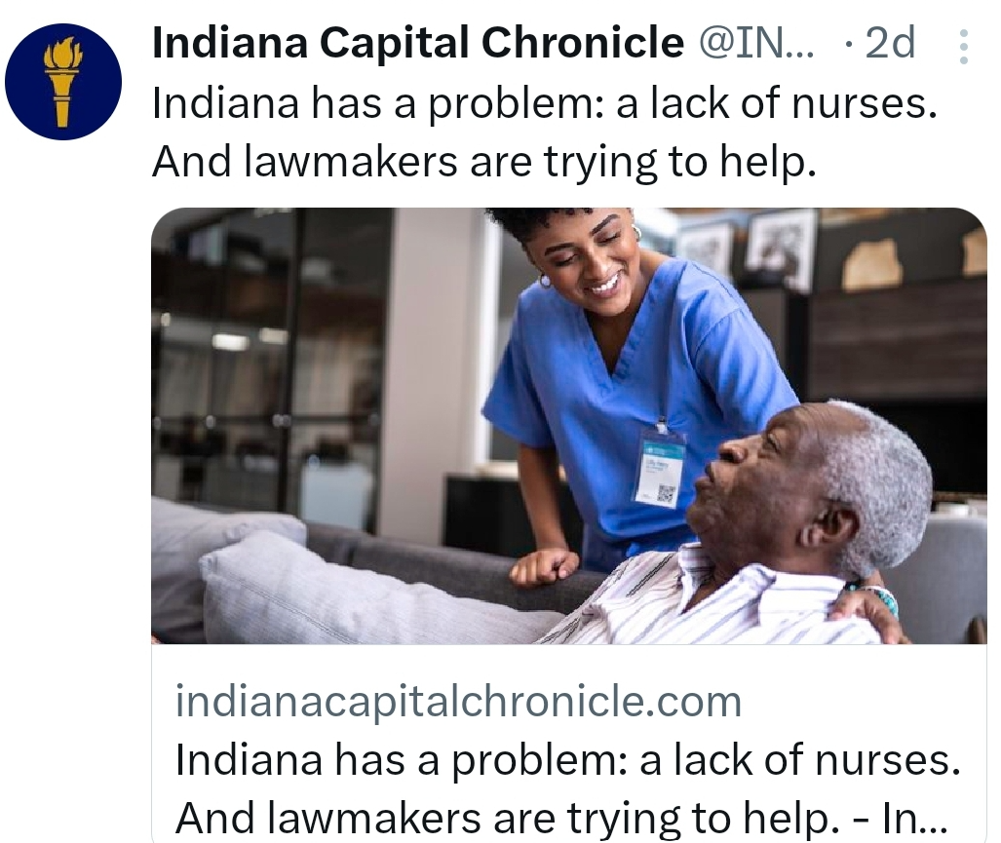
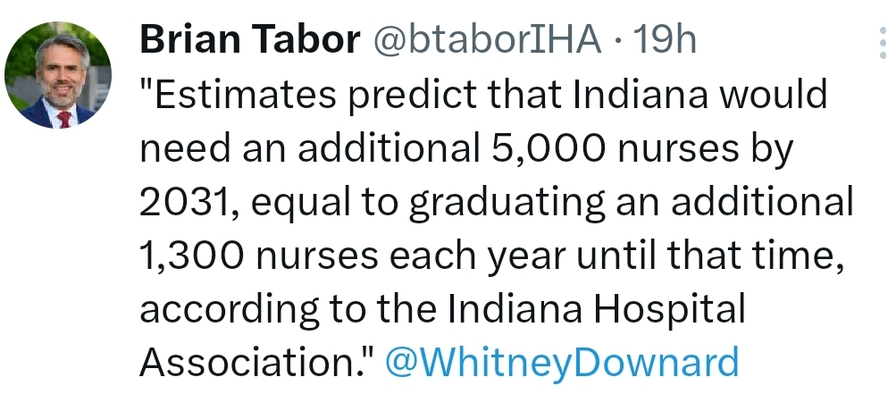
Health Care Workforce Legislation
HB 1259 (Nursing licensure)
- Authored by Representative Barrett, Chair of the Public Health Committee
- Builds on work done in 2022 (Nursing Indiana Back to Health)
- Allows Foreign Educated Nurses to benefit from all licensure avenues

Slide 9
More Bills Impacting Hospitals
HB 1414 (MCO reimbursement)
- Value based arrangements, any willing provider, and stopping rate changes by notice
- IHA expects significant changes in the Senate
HB 1359 (Provider contract termination notice)
- Notice required by Sept 1 for termination the following January
- IHA is monitoring and in communication with author and sponsor
HB 1426 (Long-acting reversible contraceptives)
- Requires LARC to be offered to Medicaid recipients after delivery before discharge
- IHA is monitoring; unsure if Senate will consider currently

Slide 10
2025 Budget Session Outlook
Medicaid will be a top priority from all angles
- Medicaid base rates
- Further discussion on HAF and MCAF
Anticipating aggressive policy proposals targeting hospitals and insurers
- Legislature will have first price benchmarking report from HEA 1004 (2023)
- Likely to see “price control” proposals such as HB 1200

Slide 11
QUESTIONS?
Trent Fox, JD
VP, Government Relations
tfox@ihaconnect.org

