Slide 1
Kentucky HFMA 2024 Annual Conference Accounting & Auditing Update
Jennifer Williams, Partner
Bill Leachman, Managing Director
February 21, 2024
FORVIS is a trademark of FORVIS, LLP, registration of which is pending with the U.S. Patent and Trademark Office

Slide 4
AGENDA
FASB Update –Recently Adopted and Emerging Pronouncements
FASB Lease Common Errors & Misunderstandings
GASB Update
Auditing Update

Slide 5
FASB Update

Slide 6
Credit Losses (CECL)

Slide 7
Credit Losses
The following ASUs relate to the accounting for credit losses:
2022-02, Financial Instruments – Credit Losses: Troubled Debt Restructurings & Vintage Disclosures
2019-11, Codification Improvements to Topic 326, Financial Instruments – Credit Losses
2019-05, Financial Instruments – Credit Losses: Targeted Transition Relief
3 separate Codification Improvements related to Topic 326
2016-13, Financial Instruments – Credit Losses: Measurement of Credit Losses to Financial Instruments

Slide 8
Why Should I Care?
Impacts all FASB entities
Impacts all assets held at amortized cost
Effective starting for December 31, 2023 year-ends
Magnitude of impact depends on:
Materiality of assets held at amortized cost
Longevity of the assets
Significance of the future changes in the environment

Slide 9
What’s Changed?
Previous U.S. GAAP | CECL Model
Amount of probable loss based on events that have occurred to the measurement date | Current estimate of lifetime cash flows not expected to be collected discounted at the effective rate

Slide 10
Financial Statement Impact
Balance Sheet
Assets show net of allowance
Income Statement
Provision for credit losses
Day One Impact
As of beginning of year – impact to equity/net assets
Significant footnotes, if material

Slide 11
How to determine a loss
Start with historical losses
Adjust for future impacts for periods that can be estimated by reasonable and supportable data**
Revert to historical losses for periods unable to be estimated
** Per ASC 326-20-30-7 “… When financial assets are evaluated on a collective or individual basis, an entity is not required to search all possible information that is not reasonably available without undue cost and effort…”

Slide 12
Potential Factors for Future Changes
Expected changes to the economy
Expected changes in unemployment rates
Expected changes in the industry
Expected changes in GDP

Slide 13
Impacted Assets
Loans held for investment
Held-to-maturity debt securities
Trade receivables
Sales-type leases
Direct financing leases
Reinsurance recoverables
Off-balance sheet credit exposures
Anything where there is a contractual right to receive cash (that is not explicitly excluded)

Slide 14
Excluded Assets
Financial assets measured at fair value through net income
Available for sale (AFS) debt securities – included in this document as credit losses for AFS debt securities are addressed in ASC Topic 326-30
Loans made to participants by defined contribution employee benefit plans
Policy loan receivables of an insurance entity
Loans & receivables between entities under common control
Receivables arising from operating leases
Promises to give (pledges receivable) of a not-for-profit entity

Slide 15
Healthcare Industry Impact
Notes receivable & physician receivables
Held-to-maturity debt securities – for-profit only
Patient accounts receivable
Sales type and financing leases
Guarantees

Slide 16
FASB Lease Common Errors & Misunderstandings

Slide 17
Initial Measurement of Lease Payments
At the commencement date, the lease payments shall consist of the following payments relating to the use of the underlying asset during the lease term:
Fixed payments, including in substance fixed payments, less any lease incentives paid or payable to the lessee (see paragraphs 842-10-55-30 through 55-31).
Variable lease payments that depend on an index or a rate (such as the Consumer Price Index or a market interest rate), initially measured using the index or rate at the commencement date.
……..(and others)

Slide 18
Renewal Periods & Reasonably Certain Criteria
At the commencement date, an entity assesses whether the lessee is reasonably certain to exercise or not to exercise an option by considering all economic factors relevant to that assessment—contract-based, asset-based, market-based, and entity-based factors. An entity's assessment often will require the consideration of a combination of those factors because they are interrelated. Examples of economic factors to consider include, but are not limited to, any of the following:
Contractual terms and conditions for the optional periods compared with current market rates, such as:
The amount of lease payments in any optional period
The amount of any variable lease payments or other contingent payments, such as payments under termination penalties and residual value guarantees
The terms and conditions of any options that are exercisable after initial optional periods (for example, the terms and conditions of a purchase option that is exercisable at the end of an extension period at a rate that is currently below market rates).

Slide 19
Renewal Periods & Reasonably Certain Criteria
Significant leasehold improvements that are expected to have significant economic value for the lessee when the option to extend or terminate the lease or to purchase the underlying asset becomes exercisable.
Costs relating to the termination of the lease and the signing of a new lease, such as negotiation costs, relocation costs, costs of identifying another underlying asset suitable for the lessee's operations, or costs associated with returning the underlying asset in a contractually specified condition or to a contractually specified location. The importance of that underlying asset to the lessee's operations, considering, for example, whether the underlying asset is a specialized asset and the location of the underlying asset.

Slide 20
Discount Rate
A lessee should use the rate implicit in the lease whenever that rate is readily determinable. If the rate implicit in the lease is not readily determinable, a lessee uses its incremental borrowing rate. A lessee that is not a public business entity is permitted to use a risk-free discount rate for the lease instead of its incremental borrowing rate , determined using a period comparable with that of the lease term, as an accounting policy election made by class of underlying asset.
Incremental Borrowing Rate:
The rate of interest that a lessee would have to pay to borrow on a collateralized basis over a similar term an amount equal to the lease payments in a similar economic environment.

Slide 21
Best Practices & Reminders on Lease Accounting Maintenance
Routine Process During the Year
Add new leases
Updates for extensions, renewals, modifications
Journal entries
Discount Rates and Updates to Incremental Borrowing Rate
Follow Lease Capitalization Policy
Lease Accounting Policy Elections
Separation of Lease & nonlease component elections
Short-Term Leases (exclude or include)
Completeness of Population / Controls over Contracting

Slide 22
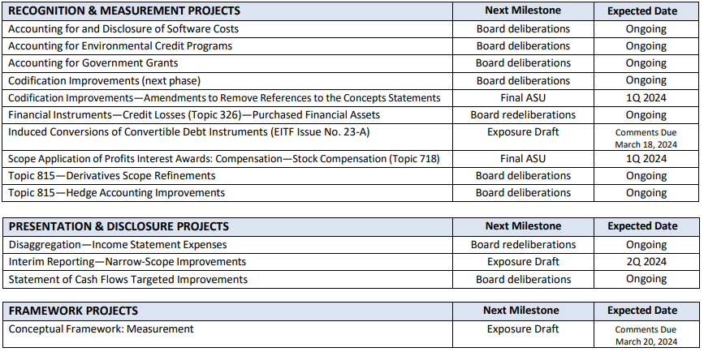
FASB Technical Agenda Additions and New Research Projects

Slide 23
FASB Technical Agenda Additions and New Research Projects

Slide 24
GASB Update

Slide 25
GASB Upcoming Effective Dates
Fiscal Years Beginning After June 15, 2022
GASB 94, Public-Private and Public-Public Partnerships and Availability Payment Arrangements
GASB 96, Subscription-based Information Technology Arrangements (SBITA)
GASB 99, Omnibus 2022 (partial)
Implementation guide 2021-1 (partial)
Fiscal Years Beginning After June 15, 2023
GASB 99, Omnibus 2022 (partial)
GASB 100, Accounting Changes and Error Corrections – An Amendment of GASB Statement NO. 62
Implementation guide 2023-1
Fiscal Years Beginning After December 15, 2023
GASB 101, Compensated Absences

Slide 26
GASB 96 - SBITA
Defines subscription-based IT arrangement (SBITA)
A contract that conveys control of the right to use a vendor’s IT software, alone or in combination with underlying IT capital assets, for a period of time
Requires an entity to recognize a right-to-use subscription asset—an intangible asset—and a corresponding subscription liability
Follows lease accounting guidance (GASB 87) re: initial & subsequent measurement, term, discount rate, etc.
Short-term exception for contracts < 12 mos.
Accounting for associated activities similar to internal-use software guidance
Preliminary project stage – expense as incurred
Initial implementation stage – capitalize as addition to the subscription intangible asset
Operation & additional implementation stage – expense as incurred unless specific capitalization criteria met

Slide 27
GASB 100 – Accounting Changes & Error Corrections
Accounting changes
Change in accounting principle
A change from one generally accepted accounting principle to another
Implementation of new pronouncements
Reported retroactively by restating prior periods presented, if practical
Change in accounting estimate
Occurs when changes to inputs or change in measurement methodology
Reported prospectively and recognized in current-period flows
Change to or within the financial reporting entity
Addition or removal of a fund, change in the fund presentation as major or nonmajor, addition/removal of component unit or change in presentation of component unit
Reported by adjusting current period beginning balances

Slide 28
GASB 100 – Accounting Changes & Error Corrections
Correction of an error in previously issued financial statements is an error:
Resulting from mathematical mistakes
Mistakes in the application of accounting principles
Oversight or misuse of facts that existed at the time financial statements were issued
Correction of error is reported retroactively by restating prior periods presented
Disclosures for accounting changes & errors corrections vary on the type of item, but common disclosures include:
The nature of the change or error and its correction
Reason for the change
The effects on beginning net position, fund balance, or fun net position, as applicable, presented in a tabular format

Slide 29
GASB 101 – Compensated Absences
Definition, leave for which employees may receive one or more
Cash payments when the leave is used for time off
Other cash payments, such as payment for unused leave upon termination of employment which includes voluntary resignation or retirement
Noncash settlements, such as conversion to defined benefit postemployment benefits
Examples include, vacation & sick leave, paid time off (PTO), parental leave & certain types of sabbatical leave
GASB 101 provides guidance recognition criteria for both of the following situations:
Leave used but not paid or settled
Unused leave

Slide 30
GASB 101 – Compensated Absences
Recognition – leave used but not paid
A liability should be reported when leave is used for time off but has not yet been paid in cash or settled through noncash means – including unlimited leave & date-specific holiday leave. The liability should be measured at the amount of the cash payment or noncash settlement to be made for the use of the leave.
Pay rate – generally, the employees’ pay rate at financial reporting date
Salary-related items, directly & incrementally related, DC pension or OPEB recognized as related leave is earned, DB pension or OPEB excluded
Recognition – unused leave should be recognized if all criteria are met:
Leave is attributable to services already rendered
Leave accumulates
Lease is more likely than not to be used for time off or otherwise paid or settled

Slide 31
Auditing Update

Slide 32
SAS 143 – Auditing Accounting Estimates and Related Disclosures
Addresses auditor responsibilities related to accounting estimates, including fair value estimates and related disclosures in an audit of financial statements
What is changing:
Requires separate assessment of inherent risk and control risk and includes enhanced risk assessment to address challenges auditors face when auditing accounting estimates
Requires review of outcome of the previous estimate, if applicable
Requires further audit procedures to include one or more of the following:
Obtaining audit evidence from events occurring up to the auditor’s report date
Testing how management made the accounting estimate including:
Method
Significant assumptions
Data
Developing an auditor’s point estimate or range

Slide 33
Single Audit Changes Resulting from SAS 145/148
SAS 145 is required to be implemented for Single Audit testing
What is changing:
Changes to risk assessment process
Changes to some control & compliance testing
Consideration of “risks arising from the use of IT”
More changes to come as AICPA GAQC task force continues work & A&A Guide gets updated
What can I expect for my single audit:
Additional key controls to be tested
Larger sample sizes for each compliance requirement due to nonhomogeneous populations

Slide 34
Thank you!
Jennifer Williams, CPA
Partner
jennifer.williams@forvis.com
Bill Leachman, CPA, FHFMA
Managing Director
bill.Leachman@forvis.com

