Slide 1

Pennsylvania Medicaid Unwinding Update:
What You Need to Know
Central Pennsylvania HFMA 2024 Winter Meeting
January 26, 2024
Denise McMasters
Director of Operations
Elevate Patient
Financial Solutions®

Slide 2
INTRODUCTION
Agenda
Introduction
Pennsylvania Medicaid Unwinding Update
Proactive strategies for Medicaid Redeterminations
Q & A

Slide 3


A Proven Revenue Cycle Management Partner
INTRODUCTION
For over 40 years we’ve served hospitals and health systems across the nation.
Identified as a top performer in KLAS Research’s 2023 Eligibility & Enrollment Services Report
1,700+
2,300+
Client Sites
Employees
98%
300+ Years
Client
Executive Leadership’s
Retention
RCM experience
100% of clients surveyed agreed that we exceed expectations
Based entirely on what current employees say about working at ElevatePFS

Slide 4
INTRODUCTION
Our Services
We address the most complex challenges of the revenue cycle.
Eligibility & Enrollment
Medicaid, Charity, Local, State, and Federal Programs, Disability Advocacy
Complex
Claims
OOS, TPL, WC,
COB Denials, VA
A/R
Services
High & Low Balance
A/R Projects,
Zero Balance Payment Recovery,
Legacy Receivables, EBO
Self-Pay/
Early Out
Self-Pay Billing & Follow-Up Services

Slide 5
INTRODUCTION
Our Motto:
Make a difference.
Be the difference.
Mission, Vision, Values
MISSION
VISION
Everything we do is with the pursuit of excellence to ensure every client, patient and team member has an elevated experience.
We are a trusted partner who delivers superior solutions to hospitals, health systems, and health providers. We address the most complex challenges of the revenue cycle with compassion, integrity and experience. Our commitment is to deliver on our promises, seek continuous improvement, and the pursuit of excellence to deliver results for our clients.
VALUES
Gratitude
Compassion
Honor
Teamwork
Exceptionalism

Slide 6

Pennsylvania Updates You Need to Know
MEDICAID UPDATE
A recent article provides some insight on PA Medicaid Unwinding:
Bad tech, staffing shortages hinder Pa. as it reassesses health care coverage for 1000s
Pennsylvania has among the lowest rates of ex parte renewals for Medicaid in the nation. Ex parte renewals are a process of automatically renewing coverage using data sources already available to the State Medicaid system. Since the unwinding began, just 4% of Medicaid renewals have been done through the ex parte process, higher than only Texas and Wyoming.
Patrick Keenan — policy director at the Pennsylvania Health Access Network, which advocates for people in the benefits system — said these problems aren’t new, and he’s optimistic that the current administration is trying to solve them.
The system, he said, “has underperformed for a very long time now.”
Another issue with Pennsylvania’s ex parte process was spotlighted in late August when federal officials sent letters to state Medicaid directors flagging that “multiple states” were conducting automatic reassessments in a way that “may be resulting in eligible individuals being improperly disenrolled.”
They asked states to assess the damage and in September, released data showing that Pennsylvania was among the states using a faulty process and was one of just two that may have wrongly disenrolled more than 100,000 people as a result.

Slide 7

PA Medicaid Renewal Data
MEDICAID UPDATE
All Renewals Due
Completed Renewals Only
Disenrollments: Ineligible vs. Procedural
Data as of December 21, 2023, Source: Georgetown University

Slide 8
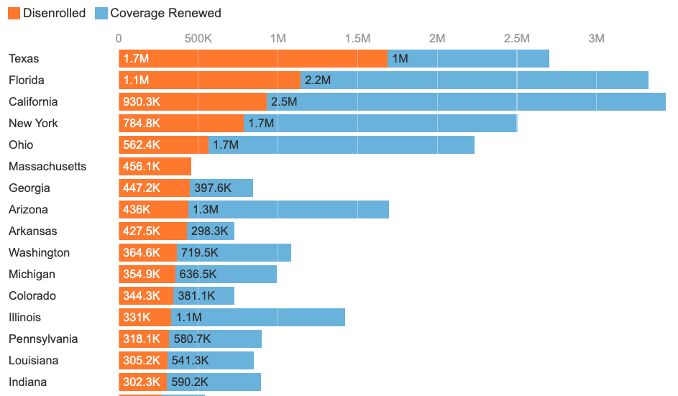
How does PA disenrollment compare to other states?
MEDICAID UPDATE
Data as of December 20, 2023, Source: KFF.org

Slide 9
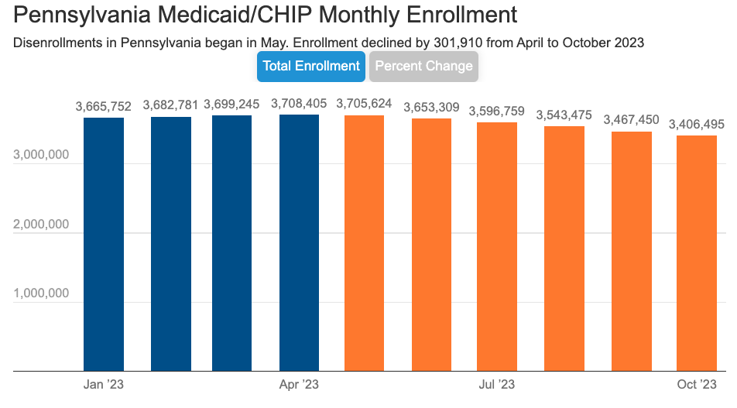
PA Medicaid Enrollment Monthly Trends
MEDICAID UPDATE
Source: www.kff.org
Notes:
As of November 6th, no more current data for this on KFF.org

Slide 10
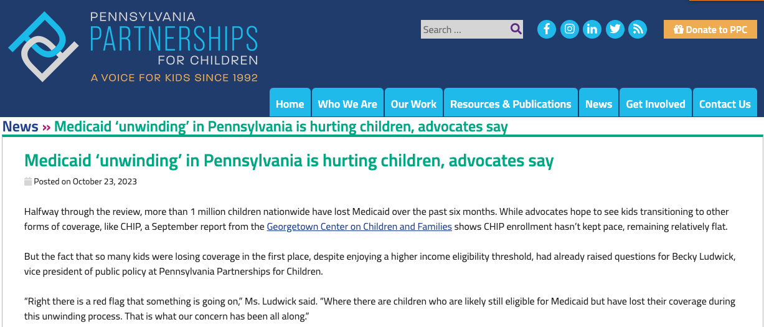
Effect of PA Medicaid Unwinding on Children
MEDICAID UPDATE
Source: https://www.papartnerships.org

Slide 11
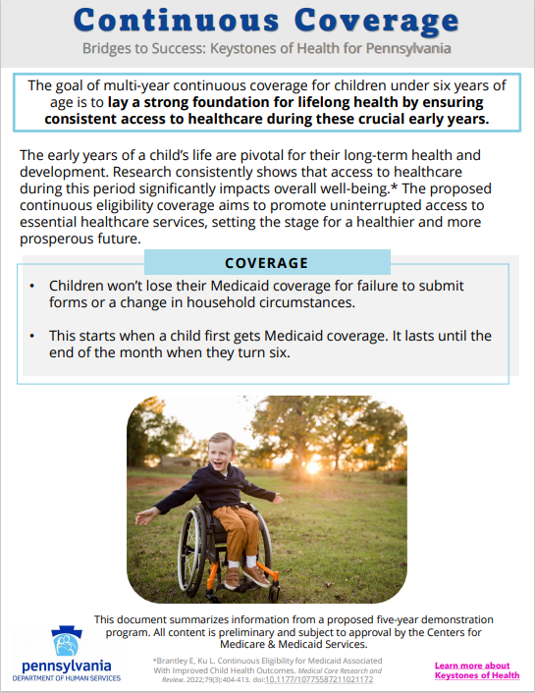
Continuous Coverage for Children
MEDICAID UPDATE
Pennsylvania has proposed continuous coverage for children ages 0-6 as part of its draft 1115 waiver application, currently up for public comment.

Slide 12
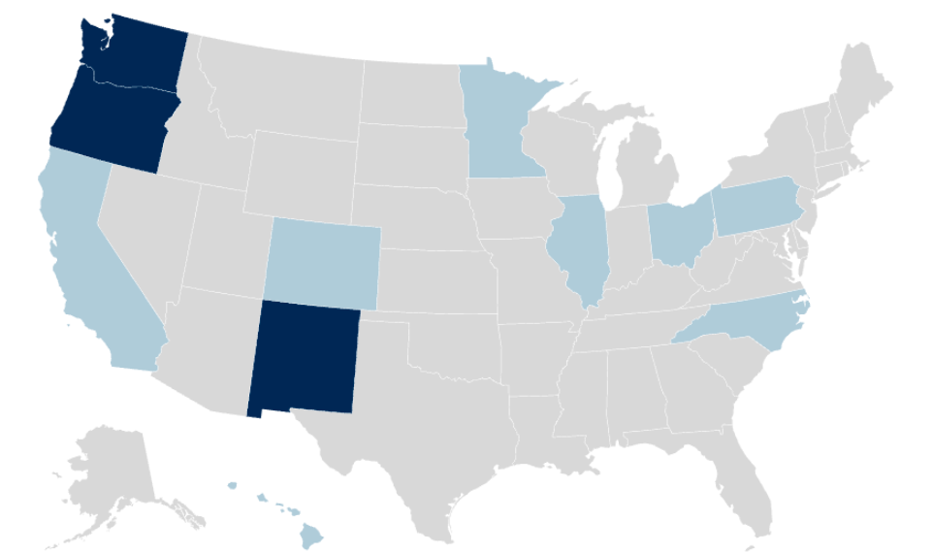


PA is one of 11 states pursuing continuous Eligibility for Children
MEDICAID UPDATE
Data as of December 2023, Source: Georgetown University

Slide 13
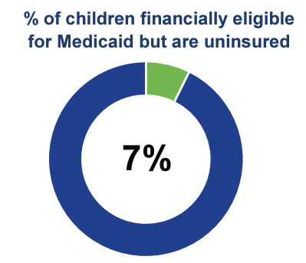
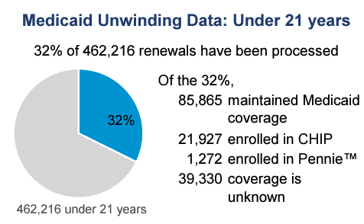
PA has the 5th highest count of uninsured children in the nation
MEDICAID UPDATE
State of Children’s Health in Pennsylvania Report, Sept 2023, Source: papartnerships.org

Slide 14
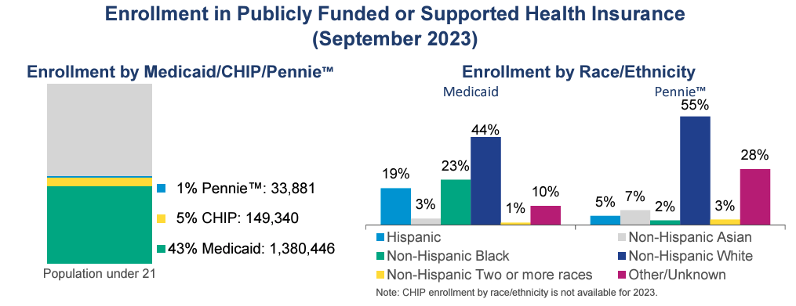
PA Children Enrollment in Medicaid/CHIP/Pennie
MEDICAID UPDATE
State of Children’s Health in Pennsylvania Report, Sept 2023, Source: papartnerships.org

Slide 15
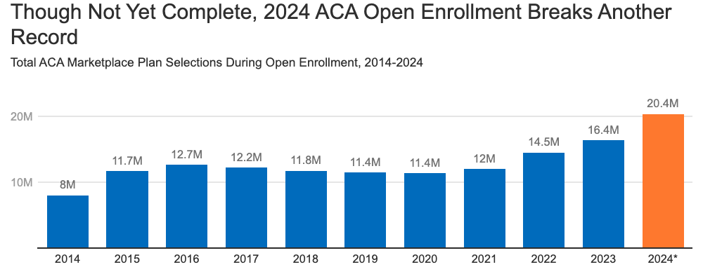
Medicaid Unwinding drives ACA Marketplace Coverage Growth
MEDICAID UPDATE
Data as of December 2023, Source: KFF

Slide 16

What is ElevatePFS currently advising patients?
MEDICAID REDETERMINATION BEST PRACTICES
During the ElevatePFS screening/application process, the following is reviewed with all patients:
Submit complete and accurate applications to the State with updated contact information
Walk patients through how to access their State Portal log in and who their contact person/team is at the county
Follow up to confirm patient has received their MCD cards in the mail 10-14 days from approval date
Remind patients to look out for redetermination paperwork on their yearly anniversary
Remind patients to report any income changes to the state as soon as they know their income has/will change as well as any household changes
If they have not received follow up communication or a MCD card, to reach back out to ElevatePFS for further guidance
Complete Redetermination or Application for those over income as well…Denied over income will be routed to PENNIE during enrollment period.

Slide 17
Proactive Strategies for Continuous Coverage
MEDICAID REDETERMINATION BEST PRACTICES
Registration and Financial Counseling teams gathering and updating all contact information for patients. This ensures that any ongoing communications are sent to the correct contacts.
Listing reminders on Health System website that redeterminations are coming up for Medicaid recipients
Letter/MyChart/Email/Text campaigns reminding Medicaid patients to update their contact information in state portal or with their county office
Marketplace enrollment partners – firming up referral process for commercial plan enrollment as many patients will truly no longer qualify for Medicaid due to increased income or change in household. Special enrollment period will permit them to purchase a health plan for future coverage if no longer Medicaid eligible.
Signage reminders posted at hospitals, clinics and affiliated care locations
Updating hold messages to include redetermination reminders

Slide 18
Higher Level Organization Strategies
MEDICAID REDETERMINATION BEST PRACTICES
Partner with state Medicaid office and or Medicaid MCOs to see if they would be willing to share the recipients up for renewal 45 days prior, to allow for outreach opportunity.
    Would require health system to provide DHS a list of Medicaid eligible patients
Identify high utilization Medicaid patients and do targeted education and intervention as necessary.
Partner with State Hospital Association to see if providers together can leverage opportunities with the state.
Partner with your Medical Assistance and community advocacy agencies to conduct outreach

Slide 19
Thank You!
QUESTIONS?

