Slide 1
Medicare Reimbursement Update

Slide 2
Agenda
CMS Transmittal 18
Medicare Bad Debt
DSH
S-10
Medicare Audit Updates
Rural Health Clinic Updates
Public Health Emergency Ends
Medicare Wage Index

Slide 3
CMS Transmittal 18
Effective for Medicare cost reporting periods beginning on or after October 1, 2022
Several changes to Medicare Cost report forms
S-2 Questionnaire
Expanded instructions for Medicaid DSH eligible days
Wkst S-10 split into two parts
Changes under Consolidated Appropriations Act (CAA) impacting Teaching Hospitals
Section 126: Distribution of additional residency positions
Section 127: Rural hospital GME funding opportunity / Rural Track Programs
Section 131: Treatment of hospitals establishing new medical residency training programs

Slide 4
CMS Transmittal 18
Home Office Forms Changes
T-18 Included extensions for –
Medicare Dependent Hospital Program
Low-Volume Hospital Payment Adjustment
Valid through September 30, 2024
New template requirements:
Medicare Bad Debt
Medicare DSH
Wkst S-10

Slide 5
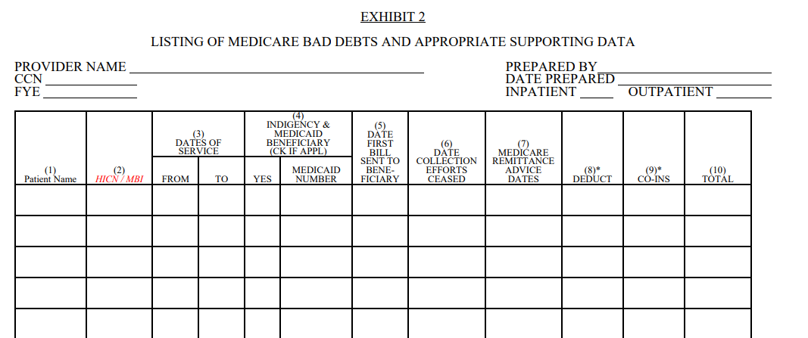
Old Medicare bad debt (mbd) template- exhibit 2
Notes:
12 columns

Slide 6
new Medicare bad debt (mbd) template- exhibit 2a
Notes:
24 columns
Giving a lot of the data to the auditors up front vs them coming back and asking during audit. Should hopefully expedite the audit process

Slide 7
Items to Know (Medicare Bad Debts):
Blue & Co Recommendation
For cost reporting period beginning on or after 10/01/2022
Mbd listing Must be filed with the cost report yearly
Make sure the detailed listing amount ties to cost report
Run additional checks to make sure everything is populated, and dates are occurring in the right order
Blue & Co Recommendation
Enter dates in the mm/dd/yyyy format
Separate by inpatient and outpatient
Separate by provider number (ccn)
Separate by bad debt type
Notes:
The first providers that this will take effect for is FYE 9/30/2023.

Slide 8
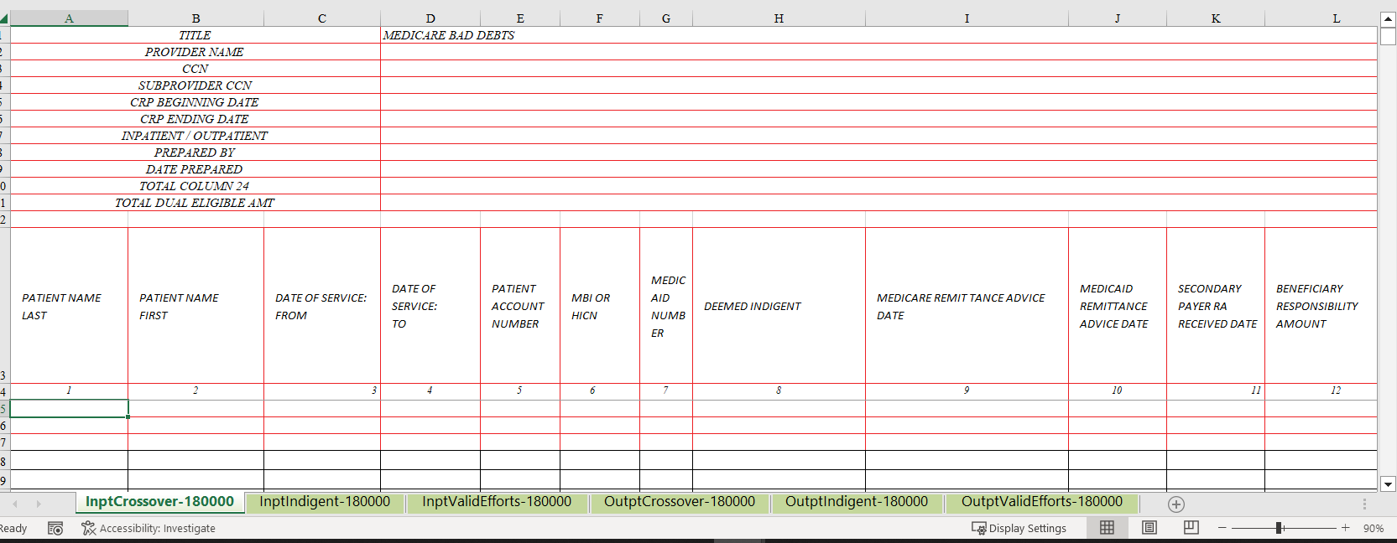

Slide 9
new Medicare bad debt (mbd) template- exhibit 2a
Notes:
24 columns
Giving a lot of the data to the auditors up front vs them coming back and asking during audit. Should hopefully expedite the audit process

Slide 10
Columns 14-17:
All
All
If 15A is yes
All
All
Notes:
**Column 14-17 may be the same date
Column 14- written off of the accounts receivable (A/R) in the provider’s financial accounting system
Column 15A- Y or N it was send to the collection agency
Column 15- if column 15A, is “Y”, in column 15, enter the date the collection agency returned the account
Column 16- date all collection efforts ceased (internal and external)
Column 17- date it was written off in the hospital system as Medicare bad debt
Some providers are currently only making a note when collection efforts ceased for traditional
Give example of when all the dates could be different- traditional

Slide 11
Columns 18-24:
All-if applicable
All
Notes:
Recoveries: Amount received in the current year on an account that was previously claimed as MBD
Column 18: any payments received on an account after the account was written off as a bad debt, including payments received in the same year the account was written off when the payment was received after the date of the write off
Column 19: enter the fiscal year end of the cost reporting period in which the Medicare bad debt (to which the recovery applies) was claimed
Column 20: Full deductible amount
Column 21: Full Coinsurance Amount
Column 22: any payments besides Medicare
Column 23: Column 20 + 21 -22- 18= Column 23
If column 19= current year
If column 19= a prior year
Then you enter the recovery amount from column 18 as a negative number. You are only trying to claim it as a Recovery

Slide 12
new Medicare dsh template - exhibit 3A

Slide 13
Columns 1-8:

Slide 14
Columns 9-18:

Slide 15
new Medicare Worksheet S-10 charity care template - exhibit 3B

Slide 16
Columns 1-10:
Very Important!

Slide 17
Column 11:
Deductible + Coinsurance + Copay
Everyone with “Insured Charity” claimed in column 2 must have amount listed here in excess or equal to charity amount.
All other charity amounts should be in “Uninsured Charity” column 1.

Slide 18
Columns 12-21:
New Item

Slide 19
new Medicare Worksheet S-10 bad debt expense template - exhibit 3c

Slide 20
Columns 1-8:

Slide 21
Columns 9-17:
Net Of
Recoveries

Slide 22
Medicare Audit Updates
Certification Letters
Hospital, RHC’s, Sub providers
Provider based clinic attestations
Teaching Hospitals
Overlaps
Organ Acquisition
Statistical Basis requests (Wkst B)
Vaccine Logs – must contain HIC number
Bed License
Floor Plans
Organizational Chart
Bad Debt Policy
Supporting documentation for A-8-2
Exhibit I’s
ER Physician’s Contracts
Prudent Buyer Concept
In House Audits
DSH
S-10
Medicare Bad Debt
Crossover Contractual
AR to BD

Slide 23
Rural Health Clinic Updates
Material errors on desk reviews
Interim Payment Rates
Productivity Exemptions (PHE coming to an end)
Clinics certified before 12/31/2020 are grandfathered at base period rate (trended for inflation)
Clinics certified after 12/31/2020 are capped:
In 2021, at $100 per visit (after March 31, 2021)
In 2022, at $113 per visit
In 2023, at $126 per visit
In 2024, at $139 per visit
In 2025, at $152 per visit
In 2026, at $165 per visit
In 2027, at $178 per visit
In 2028, at $190 per visit

Slide 24
Public Health Emergency Ends
Expired at the end of the day on May 11, 2023
Rural Health Clinic Productivity Exemptions
Flexibility for CAH 96 Hour Rule
Expanded Use of Swing Beds
COVID Expansion Beds
Add-on Payments for COVID-19 Treatment
Impacts on Medicaid Re-enrollment
340b
Registration timelines
Lump Sum Payments
Eligibility and Medicaid

Slide 25
Medicare Wage Index
MGCRB Opportunities
Section 412.103 Hospitals
Rural for geographic / Urban for payment
Roughly 600 of 3300 facilities sought dual status
Driving up Rural Floor
Rural Referral Centers
Sole Community Hospitals
Rural Benefits to Teaching Hospitals
FFY2025 Preliminary PUF released late January
Desk Reviews –
Contract Labor
Physician Administrative Time
Contracted Executives

Slide 26
Medicare Wage Index

Slide 27
Medicare Wage Index

Slide 28
Questions?

Slide 29
Contact Us
Clint Brill
Senior Manager
cbrill@blueandco.com
Becca Meredith
Senior Manager
bmeredith@blueandco.com
Nick Ficklin
Director
nficklin@blueandco.com

