Slide 1

As-a-Service (aaS) Financing
Custom Financing for Acquiring Technology & Managing TCO
Prepared for Hawaii HFMA – March 2024

Slide 2

CONTENT
Introduction
as-a-Service (aaS) financing options
Final tips & takeaways

Slide 3

01
as-a-Service (aaS) Financing

Slide 4





UBIQUITOUS XaaS
As-a-Service is everywhere
Once the exclusive domain of software, as-a-service continues to change how organizations and consumers do business
Shifts customer-supplier relationship from traditional model of ownership to one focused on providing value to customers on an ongoing basis
Provides ongoing value and benefits for both buyers and sellers
Provides an essential lower risk solution in today’s disruptive technology environment

Slide 5

ABOUT aaS
Supplier provides a service (or product with associated service) on a non-ownership basis, typically as a subscription
Shifts customer-supplier relationship from traditional model of ownership to one focused on providing value on an ongoing basis
Reduces upfront spending and increases flexibility to obtain access to the latest technologies
Benefits both buyers and sellers

Slide 6

EVERYTHING (X) as a Service
XaaS is the delivery of everything and anything as-a-Service.
Today, many solutions, technologies, and tools are digitally delivered by vendors to clients as-a-service.
Delivery takes place over a network, such as the internet, instead of physically or onsite.
Product or service is subscription or license based.

Slide 7
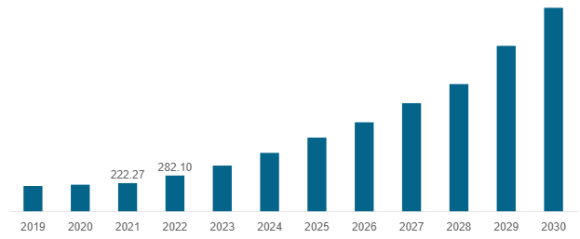
XaaS VALUE
North America Everything as-a-Service Market Size
2019 - 2030 (USD Billion)
Investments in digital transformation initiatives aimed at improving business agility and operational efficiencies are seen as significant driver for projected growth
Source: fortunebusinessinsights.com
In2022, the aaS market value valued at $559B
aaS market projected to grow from nearly $700B in 2023 to $3,221B in 2030

Slide 8

XaaS
SUBSCRIPTIONFINANCING
Advantages for Vendors
Predictable revenue streams
Improved cash flow
Increased valuation
Lower customer acquisition costs
Enhanced customer loyalty and retention
Flexibility and scalability
Helps clients obtain Potential accounting benefits with ASC842
Key Components
Subscription terms
Pricing models
Billing cycles
Engagement strategies
Obtaining funds by offering subscription-based services or products to customers to generate recurring revenue streams

Slide 9

XaaS ASSINGMENT FINANCING
Benefits
Provides predictable payments without risk of clients’ missing annual subscription renewals or incurring increases (before the aaS financing ends)
Some vendors will discount services and equipment in return for multi-year pre-paid commitments to them upfront
Assignment financing allows vendors to receive upfront cash payment for their customers’ as-a-service (aaS) contracts

Slide 10

XaaS IN HEALTHCARE
Benefits
Overcome budget constraints
Maintain state-of-the art equipment
Enhance patient outcomes
Improve operational efficiency
Optimize financial resources
May help attract, recruit and meet needs of new specialists
Allows healthcare providers to acquire essential medical equipment through flexible subscription-based payment models

Slide 11

EQUIPMENT in HaaS & SaaS
Radiology – oncology
Medical equipment & disposables
Pharmacy automation & systems
Cardiac cath labs
IT Storage & servers
IV Pumps
Software
Surgical robotics
Scopes
Telemetry, nurse call, & bed-side systems
Furniture & fixtures, including beds
Lighting, building controls
HVACs, boilers, chillers & sterilization
Sustainability equipment including solar, EV charging & recycling

Slide 12

SaaS
Software-as-a-Service
BUNDLED aaS
Work with vendor to design a system
Capture all costs of the project
Hardware, software, maintenance, licensing, services, etc.
Lender pays vendors & takes title to the equipment as applicable
Equipment location
On-premise: client facility or even co-location
Client pays for use over time
New or existing Radiology Equipment
Any IT Technology
Any Hardware Technology or Software Licensing

Slide 13
CASE STUDY - Hospital
General hospital required new radiology equipment (CT, X-ray, etc.) Previous financing included leased IT assets and Workstation on Wheels (WOWs)
Reason for financing
Budgetary issues as a public entity
CEO directive for refresh strategy to upgrade technology
ASC842 requirements for off-balance sheet on all new equipment acquisitions
Solution
Hybrid financing combining service-based and equipment subscription models to meet diverse needs of accounting and radiology
Optimize revenue generation against slower reimbursements
Spread costs over time
Ensure access to the latest technology
Customized to meet ASC842 requirements

Slide 14
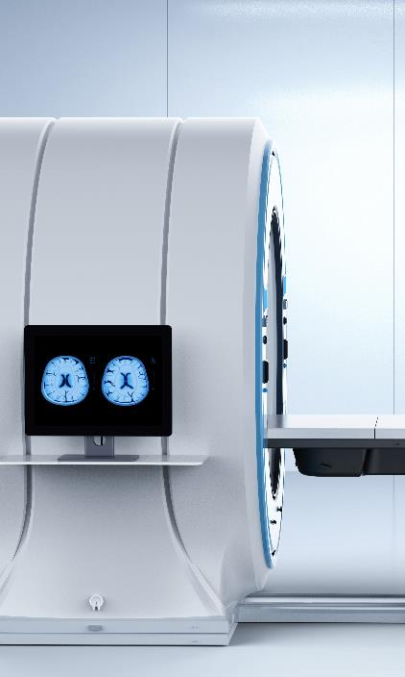
CASE STUDY - Supplier
Medical automation equipment manufacturer required financing structured to monetize contract payment streams.
Solution
Bundled Automation-as-a-Service (AaaA) subscription contracts for vendors.
Contracts include equipment software, supplies, and services totaling $200 million+
Benefits
Ongoing continuous funding of contracts provide immediate cash value
Early access to funds to use for other business purposes now
Private label financing eliminates the administrative burden on the vendor, while providing a seamless, single point of contact for the customer

Slide 15

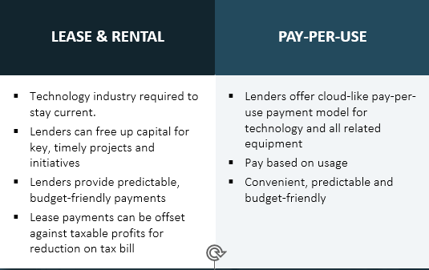
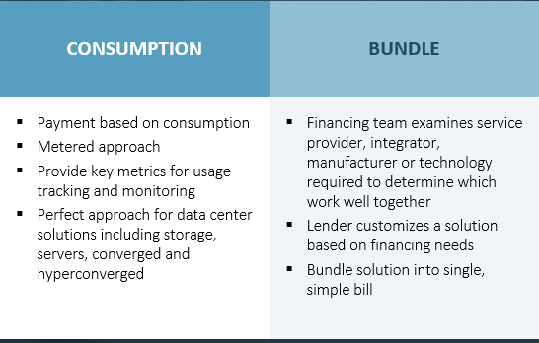
TCO & Finance Options
Total Cost of Ownership
Purchase
Service
Support
Security
Repairs
Maintenance
Upgrades
Training

Slide 16

02
Final tips & takeaways

Slide 17

THE FOREFRONT OF TECHNOLOGY
Subscription, XaaS and hybrid financing offers hospitals an opportunity to transform healthcare delivery with the latest technology.
Improve patient outcomes with convenient access to high-quality care
Enhance operational efficiency
Create financial stability
Obtaining the right financing will attract top specialists and drive patients to your facilities.

Slide 18
CONSIDERATIONSBest practices
Financial sustainability
Assess long-term financial viability, align with strategic objectives, technology needs and goals
Tailor subscription needs
Customize to meet the unique needs and preferences of technology users
Meet goals of finance leadership
Consider administrative resources/burdens for pay-per-use reporting
Invest in technology and infrastructure
Essential for delivering high-quality healthcare services and ensuring patient safety and satisfaction

Slide 19

FUTURE TRENDS
Subscription-based healthcare models will increasingly focus on preventive care and wellness initiatives
Create greater efficiencies for hospitals
Expansion of subscription-based healthcare services
New services and offerings emerging to meet the changing needs of healthcare providers
Integration with digital health technologies
Artificial intelligence, remote monitoring, and predictive analytics will further enhance the effectiveness and efficiency of subscription-based healthcare services

Slide 20
CONCLUSION
Subscription financing is poised to play a significant role in the future of healthcare
Offers hospitals an opportunity to transform healthcare delivery
Strategic tool for improving patient outcomes
Provides patients with convenient access to high-quality healthcare
Drives innovation, enhancing financial stability
Ensures predictable revenue streams and operational efficiency
Stay ahead of technology obsolescence, managing TCO

Slide 21

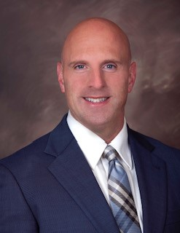
THANK YOU
TONY MONTEMURRO Mitsubishi HC Capital America Structured Finance Leasing & Technology Finance
tmontemurro@mhccna.com
C 949 274-1242

