Slide 1
Navigating VA and Work Comp Claims:
Critical Updates to Successfully Capture Revenue
March 21st, 2024

Slide 2


WHO ARE WE? – The Bad Boys of Complex Claims
02
Zach Schultz
Sr. Dir, Complex Claims & Policy
EnableComp ZSchultz@enablecomp.com
(615) 479-3328
Jason Smartt, Esq.
Associate General Counsel
and SVP, Complex Claims
EnableComp JSmartt@enablecomp.com
(615) 846-9432

Slide 3
Company overview
03
Comprehensive suite of reimbursement solutions
Veterans administration
Workers’
compensation
Motor vehicle accident/tpl
Out-of-state medicaid
a/r resolution services
Denials prevention and resolution
“safety net” denials
Zero balance review
Solutions across reimbursement lifecycle
Day one billing
a/r resolution
Zero balance
Negotiated settlements
Team of revenue specialists dedicated solely to your facility to ensure each claim is sent to the correct payer, the first time, for the maximum allowed reimbursement.
Revenue specialists and litigators manage aged accounts once placed with us. Claims are analyzed, resubmitted, and if necessary, appealed on your behalf.
Claims designated as zero balance are reviewed for underpayment and appealed for correct payment.
Specifically focused on situations where organization is presented with a prompt pay request by a payer to assure proper payment.

Slide 4





Folds of Honor
04
A nonprofit organization dedicated to providing educational scholarships to families of soldiers wounded or killed while on active duty in the US Military
More than 29,000 scholarships have been awarded totaling over $145 million since 2007

Slide 5
Agenda
05
Workers’ Compensation
Workers’ Compensation Billing Challenges
Workers’ Compensation Fee Schedule Types
Usual and Customary strategy
Contracting in Workers’ Compensation
Veterans Administration
The 21st Century (where we started and where we are)
Legislative Impact (MISSION, COMPACT, and PACT)
VA Pain Points: Timely Filing, Other Insurance, and Authorizations
VA Notification / Authorization Timeline
VA Appeals
AIR Report Recommendations – Pacific Islands (VISN 21)
Questions & Answers
EnableComp is committed to continuing education and you will receive a copy of this presentation after the conclusion of the webinar.

Slide 6
06
WORKERS’ COMPENSATION

Slide 7

Why is billing work comp complex?
07
Complicated and complex billing rules and regulations
Or lack there off in Hawaii
Validation/Registration/Verification of coverage
Document requirements
Complicated Fee Schedule math
Pre-auth and utilization review
Timely filing requirements
Compensability and presumption
Higher denial rate
Complicated appeal process
Complicated contracting considerations
Billing work comp is like flying an airplane. Make sure you have safety checks during take off and landing (Front and back end of the bill)

Slide 8

Validation and Registration Challenges/Solutions
08
Challenges:
Most injured workers do not know who their employer used for workers compensation insurance
Numerous phone calls can be required to determine claim destination (potentially to patient/employer/payer)
Company must file first report of injury
No matter what the situation, it is not a work comp claim until this happens
Solutions:
Ask the right questions at registration
Do you know who your employer uses for work comp? (just in case but they probably won’t know ☺)
Who is my point of contact at your employer (risk management/HR/etc.)
Catalogue everything!
Keeping a database of all insurance/employer relationships can save you time. (example: Enforcer360)
Always verify but do in one phone call instead of 5!

Slide 9

Complicated Fee Schedule math
09
Math problems are rarely simple and require information from multiple sources (i.e. DRG weights/Hospital cost to charge information/locality/etc.)
Not only do state have different Fee Schedules but they have different methodologies (examples on next slide)
A lot of hospital systems are not able to quantify some of the complicated Fee Schedule math/nuance
Example: Florida OP Fee Schedule contains clinical nuances that can’t be built in
Knowing the expected reimbursement before billing a claim can help with planning/appeals

Slide 10
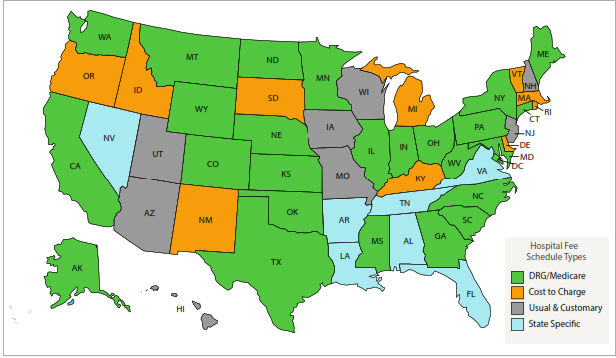
Work Comp FS types
10
Medicare (or Medicaid) based
Most common
Lower margins. Lower average reimbursement
State Specific
Usually more streamlined easier to navigate
Higher reimbursement averages
Usual and Customary
No formal work comp rules/Fee Schedule in place
Claims must not pay more than other providers in area
Difficult to work
Contracts a plus!
Hawaii is a U and C state
State run (Ohio)
Work comp division processes and pays claims
Typically, through approved managed care groups
Consistent reimbursement
Low appeal opportunity

Slide 11
Usual & Customary notes
States don’t set a number for reimbursement so bill review companies/payers can't either.
Payers don’t regulate work comp in u and C states
Up to 100% of billed charges up for grabs (however very unlikely)
Bill review companies will try to use reimbursement amounts from other claim types (MVA, Medicare, Medicaid, ect) this is not allowed. Work comp reimbursement needs to be comparable to other work comp claims.
Contracting is your friend. (not in most cases but in Hawaii is a positive)
Negotiate often! Any time you can get an agreed-on rate is a positive
The lack of work comp rules and regulations can be used to your advantage. Don’t be afraid to get on the phone!

Slide 12

Contracting in Work comp
12
Complicated!
Some states have PPO rules in place for workers’ compensation
Most states have FS in place that posses many of the benefits of contracts
Set rates
Escalation methods
This does not apply to Hawaii. Contracting is key in U & C states
Patient traffic generated organically (to an extent and with caveats)
Many bad work comp agreements get rolled into group health contracts
Smaller PT volume allows this to fly under the radar

Slide 13
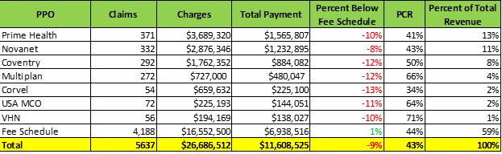
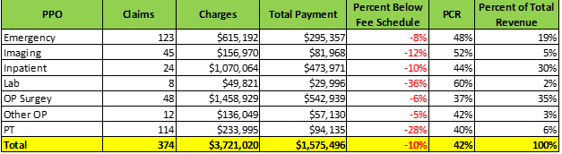
Contracting analysis example
13

Slide 14
Veterans Administration

Slide 15
The 21st Century – Where we Are Today
15
Department of Veterans Affairs
Secretary of Veterans Affairs – Denis McDonough
The Department has three central responsibilities
Veterans Benefits Administration
Veteran registration, eligibility determination, and the five business lines: Home Loan, Insurance, Vocational Rehab, GI Bill, and Pension.
National Cemetery Administration
Responsible for memorial benefits and Veteran cemeteries.
Veterans Health Administration (the VA)
Providing health care in all forms, biomedical research, and healthcare network maintenance.

Slide 16
Legislative Changes – MISSION, Compact, and PACT
16
Three Major Acts reshaped Veteran Benefits in the past five years:
Maintaining Internal Systems and Strengthening Integrated Outside Networks Act (“MISSION”)
Passed on June 6, 2018
Eligibility Expansion and Creation of the Community Care Network (CCN)
Comprehensive Prevention, Access to Care, and Treatment Act of 2020 (“COMPACT”)
Passed on December 5, 2020
Veteran Administration initiative to combat Veteran Suicide
Promise to Address Comprehensive Toxics Act (“PACT”)
Passed on August 10, 2022
Medical Coverage expansion for Toxic exposure

Slide 17
Legislative Changes – MISSION ACT
17
MISSION Merged two programs (Patient Community Center Care “PC3” and Veteran Choice Program “VCP”) into Community Center Network (“CCN”)
Differences between VCP / PC3 and CCN
VCP / PC3 – Two programs that worked in “harmony”
VCP – 40-mile exception
PC3 – Wait list is longer than 30 days for services
PC3 – Services Not available in State
PC3 – Closet is not easily accessible
CCN – Rolled both programs and added fifth option
Services not available in State
VA does not operate in that State
Veteran eligible to receive benefits under VACA Act of 2014
Grandfather – AK, ND, SD, MT, or WY
VA cannot furnish those services in a timely manner
Best Medical Interest of the Veteran
Ended the VCP Program, but extended due to COVID
How veteran eligibility changed under the MISSION Act:
The Veteran, in order for the VA to furnish care, must meet at least one of more of the conditions listed below;
The covered veteran required hospital care, medical services, or extended care services and:
No VA facility offers the care, services, or extended services the veteran requires, OR
The VA does not operate a medical facility in the State in which the veteran resides, OR
The veteran was eligible to receive care under the VACA Act of 2014, OR
The veteran has contacted an authorized VA official to request the care required, but the VA has determined that they cannot furnish it, OR
The veteran and their referring clinician determined it is in the best medical interest of the veteran, to access care or services from an eligible entity based on the following factors:
Distance, Nature, Frequency, Timeliness, Improved Continuity of Care, Quality of Care, or if the Veteran faces an unusual burden:
Excessive driving distance, Whether care at the VA is reasonably accessible, Whether a medical condition of the veteran affects the ability to travel, Whether there is a compelling reason the veteran needs to receive care and services from a non-VA facility, The need for an attendant, and The VA facility would not furnish the type of care that meets the VA quality standards.
Expected Veteran usage of CCN facilities for 2023 is approximately 45% of Veterans receive care outside the VA network

Slide 18
Legislative Changes – COMPACT ACT
18
COMPACT addresses issues due to the public health crisis associated with Veteran Suicide
As of 2020, 17 Veterans commit suicide every day.
16.8 Veterans for every 100,000 Veterans
The VA Created multiple programs and initiatives
Improved transitional phase resources and support networks
Launched a pilot program to educate Veteran families for better advocacy and identification
Tasked the VA with developing and enacting protocols to assist those Veterans in danger
On January 17, 2023, the VA implemented the last program change which directly affects hospitals
If a Veteran presents to a hospital in an acute suicidal crisis, the Veteran can receive care at any Provider
The government defines an “acute suicidal crisis” under 38 U.S.C. § 1720J(h)(1) as an individual that was determined to be at imminent risk of self-harm by a trained crisis responder or health care provider.
If an enrolled Veteran presents in this condition, the Veteran is entitled to 30 days of inpatient care and 90 days of outpatient therapy / treatment at no cost to the Veteran
The process for COMPACT notification follows the same procedure as Emergency Notifications.

Slide 19
Legislative Changes – PACT ACT
19
PACT Act addressed a growing issue amongst Veterans exposed to Toxic chemicals from the battlefield and burn pits.
Added more than 20 new Medical Conditions that result in PRESUMPTIVE eligibility for service-connected conditions.
Expanded and extended VA health care for Veterans with Toxic exposure from Vietnam, Gulf War, and post 9/11.
Several Forms of Cancer are now considered covered and paid by the VA under 38 U.S.C. § 1728
Service-Connected Conditions are paid by the VA at 100% of the Medicare Allowable
These are paid by the VA regardless of medical coverage by another payer.
New Cancer coverage include
Brain, Gastrointestinal, Gliobastoma, Head, Kidney, Lymphatic, Lymphoma, Melanoma, Pancreatic, Reproductive, and Respiratory.
New Illnesses
Asthma (after service), Bronchitis, COPD, Rhinitis, Sinusitis, Emphysema, Granuolmatous, Interstital Lung Disease, Pleuritis, Pulmonary Fibrosis, and Sarcoidosis.
Coupled with MISSION Act CCN coverage, CCN providers should expect an increase of usage of their facilities for Veterans with the above noted conditions.

Slide 20
Legislative Impacts – Year over Year
20
Community Provider Utilization
MISSION passed in 2019 and was fully implemented in 2020.
Utilization of CCN resources continues to increase at an accelerated pace.
Usage for 2023, came in just at 41%
Secretary has not released their projection for 2024

Slide 21
VA PAIN POINTS – Top 5 Denials
21
The most common denials are:
Untimely filing [90 Days for Mil Bill],
Service Connected – 2 Years
Non-Service Connected Millenium Bill – 90 days
CCN Carrier (Authorized Referral) – 180 days
Lacking an authorization (did not meet criteria or process),
Patient not enrolled (Veteran did not enroll in 24 months),
Another carrier is responsible (Medicare or Commercial), and
Coding (hybrid of Medicare coding).
https://www.va.gov/COMMUNITYCARE/providers/SEOC-Code-User-Agreement.asp

Slide 22
VA PAIN POINTS – Other Insurance (Medicare)
22
When Is Medicare Primary?
38 U.S.C. § 1725 Reimbursement for Emergency Treatment [Medicare > VA]
The VA is primary if in cases where;
The veteran is enrolled and received care within the past 24 months AND
The veteran is enrolled with VA coverage (per § 1705 of this chapter)
Medicare is primary is the patient possesses Medicare at the time services were rendered.
VA will pay as a secondary payer in these instances now (see Wolfe vs. Wilkie & Wolfe vs. McDonough)
38 U.S.C. § 1728 Reimbursement of Certain Medical Expenses [VA > Medicare]
The VA is primary if the patient presents with the following;
An adjudicated service-connected disability,
A nonservice connected disability associated with and held to be aggravating a service-connected disability,
Any disability of a veteran if the veteran has a total disability permanent in nature from a service-connected disability,
Any illness, injury, or dental condition of a veteran who
A participant in a vocational rehabilitee program; and
Medically determined to have been in need of care or treatment to make possible the veteran’s entrance into a course of training or prevent interruption of course of training.
Even if the patient possesses Medicare, the VA is primary.
VA will process and pay this claim at 100% of the Medicare allowable
Per the MSP, if VA approves the claim, they are responsible for that claim.

Slide 23
VA PAIN POINTS – Authorization vs. Notification
23
How do you review a patient encounter?
Registration
Notification (ER) or Prior Authorization (Planned)
Transfer (VA Facility) or Episode of Care Occurs
Discharge
Claim Submission
Follow Up
Review
Appeal

Slide 24
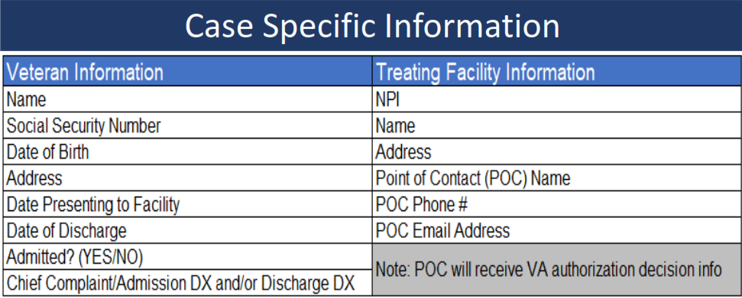
The 21st Century – Notice / Authorizations
24
Form 10-10143g
The Point of Contact (POC) will receive follow up emails and communications from the VA regarding approval, denial, transfer request, or conditional approval.
The VA utilizes InterQual as their utilization management standard (VHA Directive 1117 October 8th, 2020) and the “reasonable person” standard for emergency treatment.

Slide 25
Notification / Authorization Timeline
25
72 Hour Window
72 Hour Window
90 Days
Veteran
Treatment
Response
RFS
Denial
Register
Notification
Discharge
SAR
Appeal
Veteran appears at your ED requiring immediate assistance.
Registrar performs intake of the patient and finds that they are a Veteran.
VA’s policy mandates that the notification process initiate within 72 hours of treatment starting, not arrival time.
VA believes this gives them the most flexibility when it comes to transfer orders to their facilities that may have a bed or bay available for treatment.

Slide 26
Notification / Authorization Timeline
26
72 Hour Window
72 Hour Window
90 Days
Veteran
Treatment
Response
RFS
Denial
Register
Notification
Discharge
SAR
Appeal
Upon submitting Notification to the VA through their emergent notification portal, the VA will normally respond within 3 to 4 hours.
Information from form 10-10143g must be included in the initial notification request in order for the VA to make their determination.
Upon receipt of a response from the VA, the episode of care is either approved, a transfer order is noted, or it is denied.
If the care is approved, continue with the episode of care for the codes previously submitted. If the situation changes, the VA requests that the notification be updated with new information to adjust their expectations.

Slide 27
Notification / Authorization Timeline
27
72 Hour Window
72 Hour Window
90 Days
Veteran
Treatment
Response
RFS
Denial
Register
Notification
Discharge
SAR
Appeal
If the episode is noted as a transfer case, the hospital must stabilize the Veteran and the VA then coordinates the transfer to their facility for further treatment.
If the episode is denied, the hospital must follow EMTALA, stabilize the Veteran, and then determine if they continue with their treatment plan or discharge the Veteran. The Veteran is financially liable for this episode unless the hospital or Veteran successfully appeal to overturn the denial.

Slide 28
Notification / Authorization Timeline
28
72 Hour Window
72 Hour Window
90 Days
Veteran
Treatment
Response
RFS
Denial
Register
Notification
Discharge
SAR
Appeal
Upon discharge from the hospital, if the Veteran failed to supply their insurance information, the hospital has 72 hours from the time of discharge to file a Request for Service on form 10-10172.
Upon receipt of the form, the VA will look at the criteria utilized to treat the patient and how their interference or failure to comply with the hospital truly effected the deliver of care.
If the VA grants the RFS, the claim is authorized for the codes or dates that the VA deems necessary, not necessarily the entire claim.
If the VA denies the RFS, the hospital must appeal upon receipt of a denial so as to secure their right for review.

Slide 29
VA PAIN POINTS – Authorization Denials
29
72 Hour Window
72 Hour Window
90 Days
Veteran
Treatment
Response
RFS
Denial
Register
Notification
Discharge
SAR
Appeal
When working a Veteran Authorization Denial, you have two options available.
OPTION #1 (Authorization on file)
Under CCN → If there is an authorization on file, see if you can use Secondary Authorization Request (“SAR”).
Under VA → If there is an authorization on file, did you attempt a Request for Service extension?
OPTION #2 (Appeal)
Utilizing the Standard of Care as noted in the VA statute, if the patient feels their life is in danger and a reasonable person would conclude that services are needed, the VA will not deny the claim.
You must show why an authorization was not obtained, examples include; patient unconscious at the time at presentation, mental confusion, other insurance was provided…

Slide 30
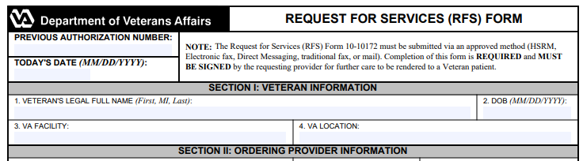
The 21st Century – Request for Service
30
Form 10-10172 - https://www.va.gov/vaforms/medical/pdf/va_form_10-10172.pdf
The RFS form is utilized when a hospital discharges a Veteran and that Veteran provides information pertaining to their VA coverage at the time of discharge.
Hospitals have 72 hours from the time of discharge to contact the VA with the relevant information to initiate a Request For Service, which is essentially a retro-authorization.

Slide 31
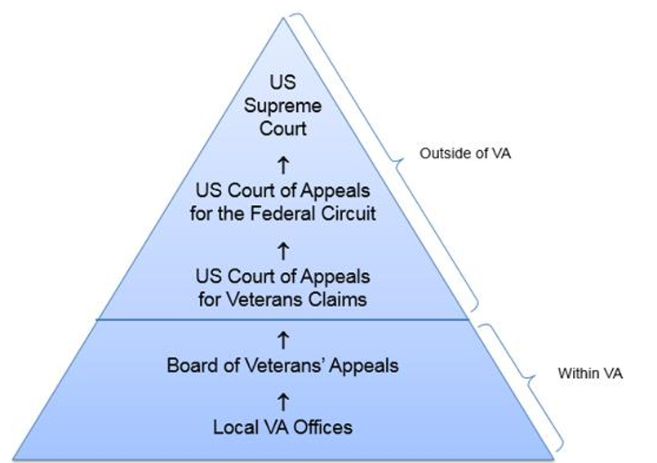
VA Appeals – Appeal Roadmap
31
Veteran Health Administration Appeal Map
Appeal landscape is difficult
Timeline;
90 Days for VA appeal
1 Year for Court Appeals
Must go through each step
If you skip a step, will be dismissed
Various Admin Law Standards
Success
Not a great overturn rate
Board of VA Appeals
Goes to Veteran’s Benefit File
Roadblocks
Will not get a copy of the Veterans Benefit file. Hospital does not have standing to sue on this issue.
Significant language barrier → Standards continue to shift, no established standard such as “Arbitrary and Capricious”. Mostly “De novo” or “clearly erroneous”

Slide 32
VA Appeals – Appeal drafting
32
How to write an appeal?
Format – Issue, Rule, Analysis, and Conclusion
Issue – Clearly Identify the reason for the denial
Examples; Authorization, Timely Filing, Responsibility
Rule – Layout the rule per statute or policy
Authorization – 72 hours when treatment starts
Analysis – Show your actions
Give detailed notes that you took to follow the procedure
Conclusion – Demand that the VA review
Request the VA overturn their previous decision after a de novo review
If you don’t have much, you still have the Kitchen Sink
Throw everything you have in your first appeal, because if you don’t mention it in your first level appeal, you can’t bring it up in your second level appeal without timely evidence.

Slide 33
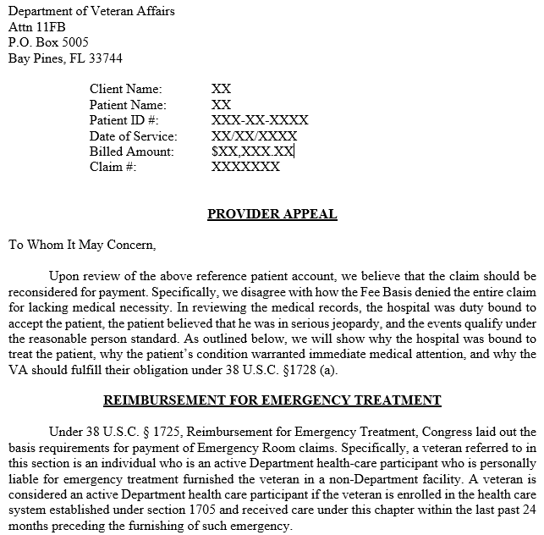
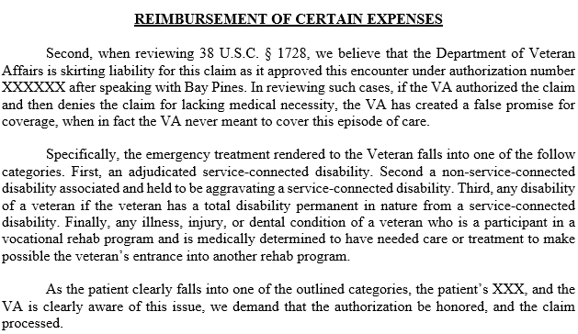
VA Appeals – Example
33
GOALS
Organization
Clarity
Specific citations
Attention to Detail
AVOID
Chaos
Generalities
Some statutes
One sentence

Slide 34
AIR REPORT – VISN 21 Pacific Island Market
34
Per AIR Report and 2020 Census
Enrollees
Market Area
2019
2029
Demand Change next 10 years
Demand for Inpt Medical / Surgical Services will increase 28.0%
Demand for Inpt Mental Health Services will increase 26.0%
Demand for Long Term Care will increase 22.0%
Demand for Outpatient Medical Services reported to increase all markets.
Recommendations
Modernize and Align Honolulu VAMC (enhancement of inpatient with Tripler)
Modernize and Align Outpatient facilities with additional Haleiwa and the continuation of moving services to Kalaeloa and closing Leeward CBOC.
Cost to Implement Changes → $851 Million
Market | 2019 | 2029
Pacific Island (VISN 21) | 53,923 | 57,751
SHIFT |  | +7.1%
These are recommendations from the AIR Committee, Congress has yet to adopt them.

Slide 35
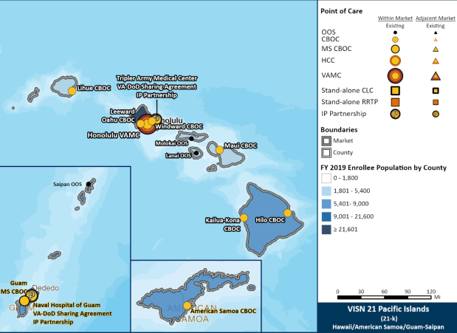

VISN 21 – Pacific Islands
35
Current
Optimized
Changes in Population and Demand will lead VA to reallocate resources. Community Providers needed to assist with changes.

Slide 36
QUESTIONS?

Slide 37

CONTACT
37
Natalie Guzman
VP, Client Services
(618) 889-0728
nguzman@enablecomp.com
4057 Rural Plains Circle, Suite 400
Franklin, TN 37064

Slide 38
THANK YOU!

