Slide 1
State of Nebraska Hospitals and Policy Update
March 22, 2024

Slide 2
Who is the NHA?

Slide 3
92 member hospitals
Nearly 50,000 hospital employees
$8.6B in total expenditures
$4B in salary and benefits
$15B in total economic impact

Slide 4
COLLECTIVE COMMUNITY BENEFITS
Community benefit refers to the initiatives, activities, and investments undertaken by tax-exempt hospitals to improve health in the communities they serve.
Non-profit hospitals must report community benefits on IRS Form 990.
$1.54B in total community benefits
$488M in other benefits like community health improvement initiatives, education programs, and health research
$125M in bad debt
$923M in unpaid costs of Medicare, Medicaid and other public programs

Slide 5
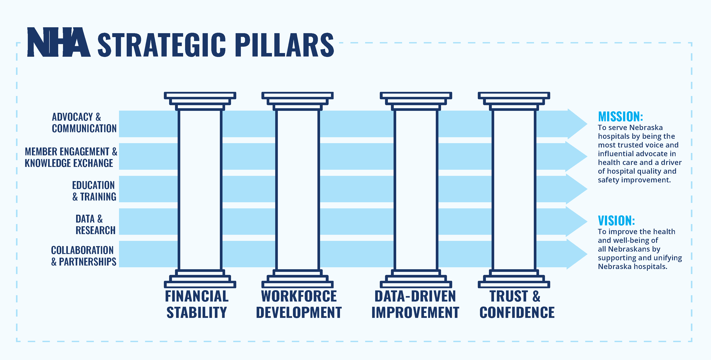

Slide 6
What are the current issues facing Nebraska hospitals?

Slide 7
which of the following best describes
your hospital or health system?
Data presented about state of Nebraska hospitals is from quarterly NHA CEO Pulse Surveys conducted from 6/2023 to 12/2023.
SYSTEM
23.9%
75%
IND CAH
63.0%
IND PPS
13.1%

Slide 8
MOST CONCERNING ISSUES FOR CEOS IN 2024
 | INDEPENDENT CAHs | Independent pps | system
#1 | Workforce | FISCAL | Workforce
#2 | fiscal | WORKFORCE | fiscal
#3 | COMMERCIAL INSURANCE/admin BURDEN | gov't regulatory burden | COMMERCIAL INSURANCE/admin BURDEN
#4 | gov't regulatory burden | COMMERCIAL INSURANCE/admin BURDEN | gov't regulatory burden

Slide 9
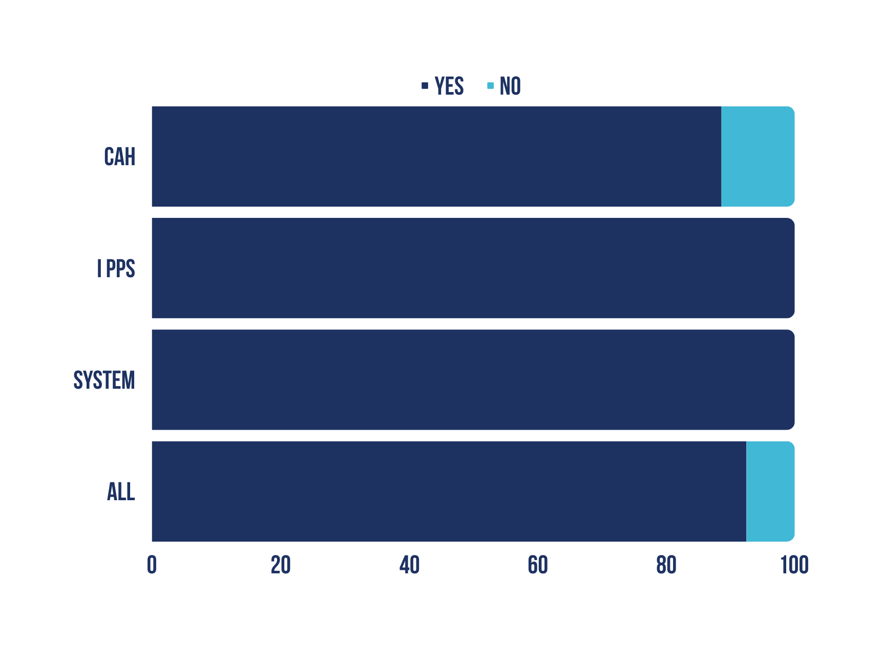
does your hospital or health system currently have a workforce shortage?
89%
100%
100%
92%

Slide 10
Hospital Workforce Challenges
Hospitals report being 8-12% understaffed.
State data shows Nebraska will experience a workforce shortage of about 5,500 nurses by 2025.
73 of Nebraska’s 93 counties have less than the national average ratio of registered nurses to patients.
9 counties in Nebraska have no registered nurses.
13 counties have no primary care physician.
44 counties do not have any OB-GYN physicians.
78 counties have no practicing psychiatrists.
About 20% of physicians and 18% of nurses in Nebraska are over 60 years old.

Slide 11
GREATEST WORKFORCE NEEDS BY CATEGORY
 | INDEPENDENT CAHs | Independent pps | System hospitals
#1 | RN | RN | rn
#2 | Nurse Aide | nurse Aide | Physicians
#3 | Lab Staff | Physicians | nurse aide
#4 | Radiology tech | Radiology tech | Radiology tech

Slide 12
Using new staffing models or expanded roles of cnaS, lpns, paramedics, med techs, or others to provide care?
Q1 2023 Pulse
45.8% Yes
Yes
No
IND CAH
55.2%
44.8%
iND PPS
66.7%
33.3%
NO
54.2%
System
90.9%
56.3%
All
65.2%
34.8%
Notes:
2

Slide 13
in the last six months, has your reliance on agency staffing increased, decreased or remained stable?
Increased
Stable
Decreased
15.2%
41.3%
ALL
16.7%
75%
33.3%
IND PPS
9.0%
54.6%
System
17.2%
37.9%
IND CAH
0
25%
50%
75%
100%

Slide 14
WHAT % OF YOUR CURRENT NURSING FTES ARE FILLED BY AGENCY STAFFING?
ALL
9.4%
System
12.4%
IND PPS
6.8%
IND CAH
8.7%
0%
5%
10%
15%

Slide 15
NEBRASKA HEALTH CARE WORKFORCE COLLABORATIVE
Nebraska Hospital Association
Nebraska Rural Health Association
Bryan College of Health Sciences
Center for Nursing/DHHS
Clarkson College
Creighton University
Health Center Association of Nebraska
Metropolitan Community College
Nebraska Association of Behavioral Health Organizations
Nebraska Chamber of Commerce & Industry
Nebraska Community College Association
Nebraska Health Care Association
Nebraska Medical Association
Nebraska Methodist College
Nebraska Nurses Association
Nebraska Pharmacists Association
Nebraska State College System
University of Nebraska Medical Center
University of Nebraska System

Slide 16
NEBRASKA HEALTH CARE WORKFORCE COLLABORATIVE
Drive statewide decisions based on data.
Future workforce projections by Nebraska hospitals, clinics, and other healthcare employers.
Aligning education programs to meet data-directed health care workforce needs.
Expand high-demand health care education programs by addressing the shortage of faculty, clinical training sites, and clinical preceptors.
Collaborate on the application process, so no interested applicant is turned away.
Collectively promote multiple pathways to health professions.professions.

Slide 17
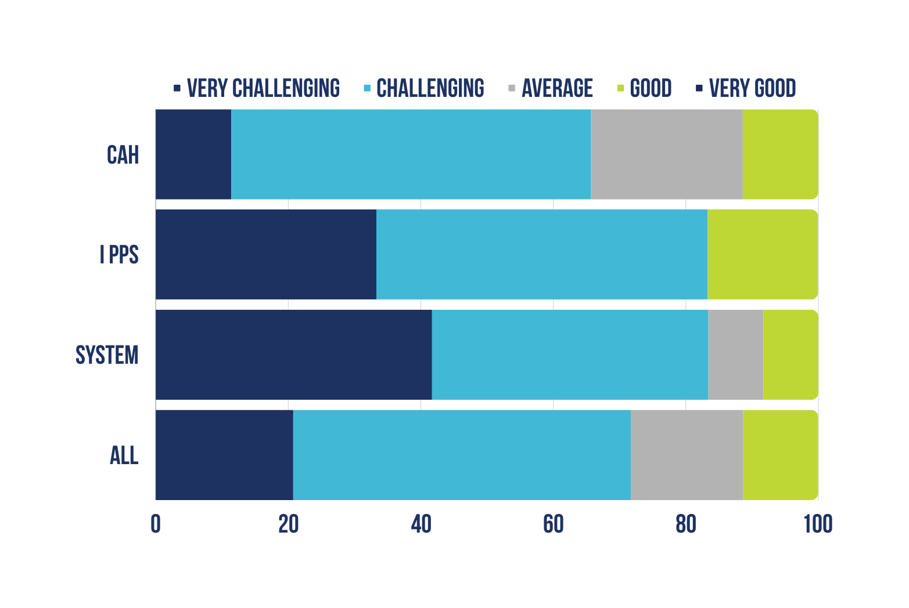
how would you describe your hospital/
system's financial conditions in the current fiscal year?

Slide 18
GREATEST impacts on 2024 fiscal outlook
 | INDEPENDENT CAHs | Independent pps | System hospitals
#1 | cost of Employed workforce | cost of Employed workforce | cost of contract labor
#2 | cost of contract labor | cost of contract labor | cost of Employed workforce
#3 | cost of supplies | Cost of pharmaceuticals | Payer administrative burdens
#4 | Cost of pharmaceuticals | cost of supplies | post-acute discharge challenges

Slide 19
Hospital Costs Have Skyrocketed
(annual percent cost increase)
 | FY 2021 & FY 2022
Labor | 19.1%
Medical Supplies | 20.6%
Drugs | 36.9%
Total Increase | 20.1%
 | Budgeted FY 2023 | Projected FY 2024
Salaries | 6.5% | 3.8%
Benefits | 7.0% | 4.7%
Contract Labor | 11.8% | 0.9%
Medical Supplies | 4.0% | 3.6%
Drugs | 4.1% | 7.4%
Food | 5.8% | 1.9%
Insurance P&C | 27.3% | 0.5%
Cyber Insurance | 68.9% | 20.3%
Utilities | 5.9% | 3.5%
Total Increase | 6.1% | 4.2%
FY 2021-2024 Compounded Cost Increase
32.8%

Slide 20
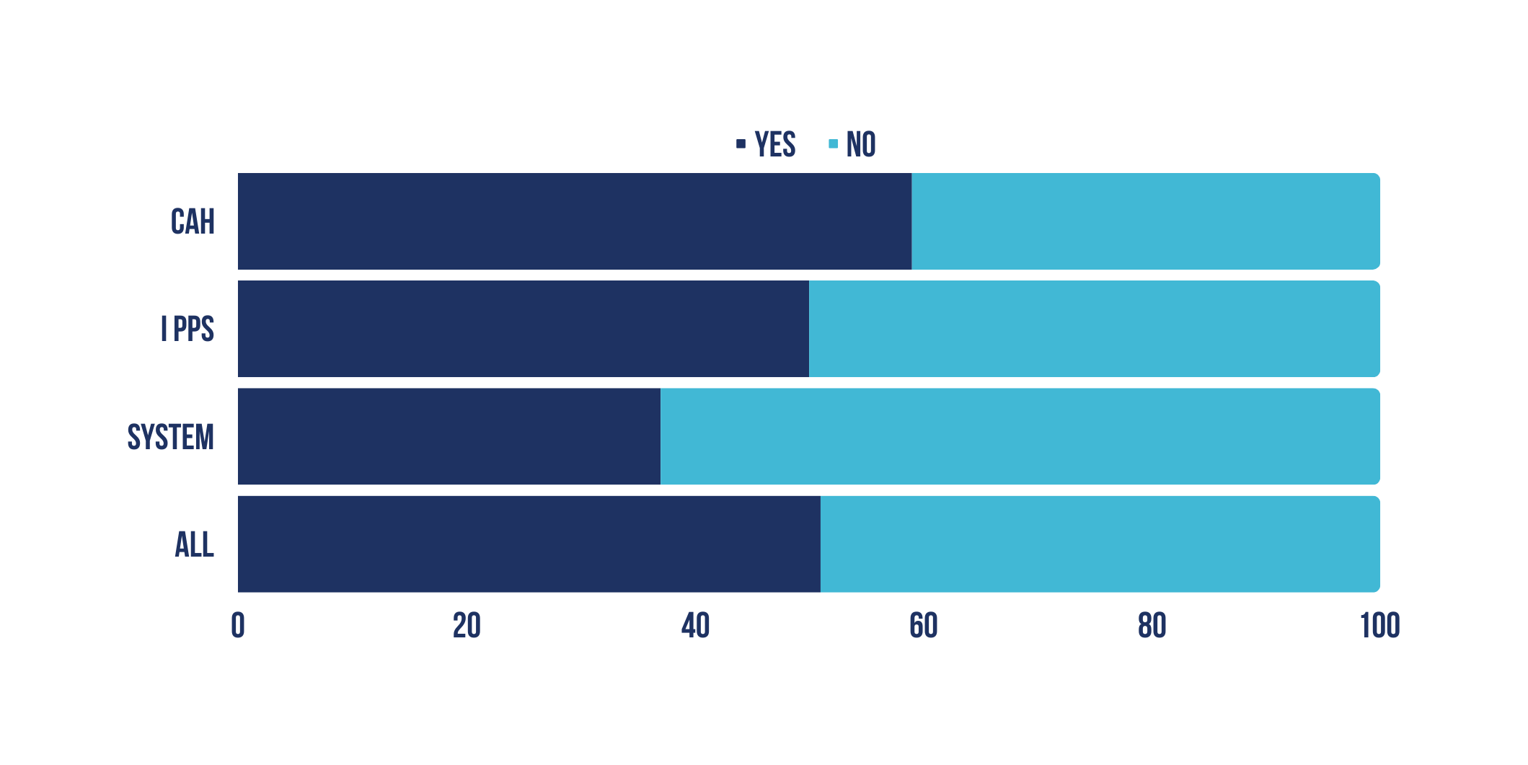
In the last quarter, did your hospital run
a negative operating margin?
59%
41%
50%
50%
37%
63%
51%
49%

Slide 21
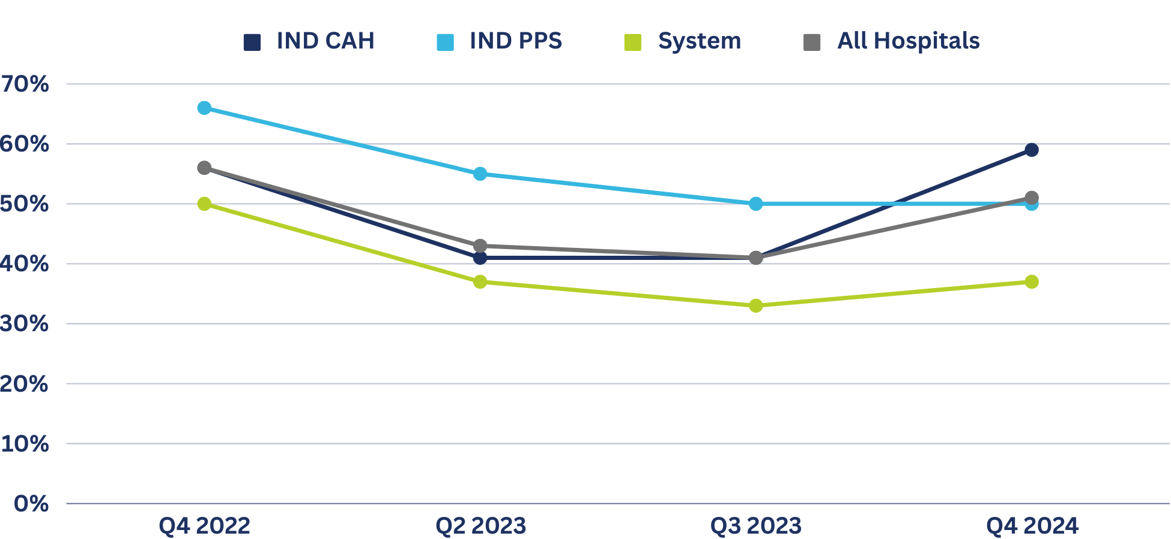
PERCENT OF Nebraska hospitals with a negative operating margin in previous quarter

Slide 22
Operational & Staffing actions in the last year
 | INDEPENDENT CAHs | Independent pps | System hospitals
#1 | Financial incentives to retain/attract employees (96.4%) | Financial incentives to retain/attract employees (100%) | Financial incentives to retain/attract employees (100%)
#2 | Uptrained/retrained staff (60.7%) | Consolidated services (83.3%) | Reduced services (54.5%)
#3 | Reassigned/Rotated staff (53.6%) | Reassigned/Rotated staff (66.7%) | Uptrained/retrained staff (54.5%)
#4 | Increase staff hours/required overtime (53.6%) | Uptrained/retrained staff (66.7%) | Increase staff hours/required overtime (45.4%)
20% of Nebraska Hospitals reported eliminating services in the last year.

Slide 23
Services Reduced or Eliminated in 2022-2023
Reduced inpatient capacity
Reduced inpatient behavioral health capacity
Reduced hours for outpatient services
Reduced orthopedic care
Reduced rehabilitation services
Reduced home health services
Reduced hospice services
Reduced admission to skilled-nursing care Reduced nursing home census
Closed inpatient geriatric behavioral health unit
Closed nursing home
Eliminated obstetric services
Eliminated orthopedic services
Eliminated nephrology services
Eliminated hospice services
Eliminated home health services

Slide 24
Nebraska hospitals are hurting.
Workforce Crisis.
Historic Inflation.
Post-Acute Placement Bottlenecks.
Growing Commercial Insurance Burdens.
We need public officials to help hospitals heal.

Slide 25
Provider Assessment &
Directed Payment Program
Data estimates as of 12/7/23

Slide 26
Medicaid Policy Landscape
Medicaid reimbursements are not keeping up with the cost of care.
Only 1.65% average Medicaid rate increase in last 21 yrs. cost increases have grown over 5.5% per year.
Reimbursements for services can be as low as 38% of costs for PPS hospitals.
Aggregate Medicaid losses have increased 60% since 2019.
Nearly $1B in loses from public programs.

Slide 27
Medicaid provider rate history

Slide 28
NHA Policy Goals
Improve operating margins by reducing Medicaid losses to preserve health care services across Nebraska.
Establish a partnership with state to pursue maximum allowable federal reimbursement for Medicaid.

Slide 29
Rate Increase Through a Provider Assessment
& Directed Payment Program
44 states have a hospital assessment supporting rates.
$1 invested by state or provider assessment is matched about $2.19 by Fed (68.68% blended FMAP).
In 2016, CMS authorized Directed Payments through MCOs and allowed up to average commercial rates.
NHA has engaged HMA to help us examine a Directed Payment Program with a provider assessment.
NE has two assessment programs in place - nursing home rates and ICF.

Slide 30
Key Principles
CMS
No hold harmless on assessments paid.
Assessment must be uniform and broad-based.
Increases can be uniform percent increase, min fee schedule, or value-based.
Must be tied to state’s Medicaid quality strategy.
NHA
Better statewide access to care for Medicaid population.
Minimize, and hopefully eliminate, net contributors.
DPP funds would supplement, not supplant, state funds.
Assessment funds not used for other purposes.
Trigger to eliminate assessment if DPP goes away.

Slide 31
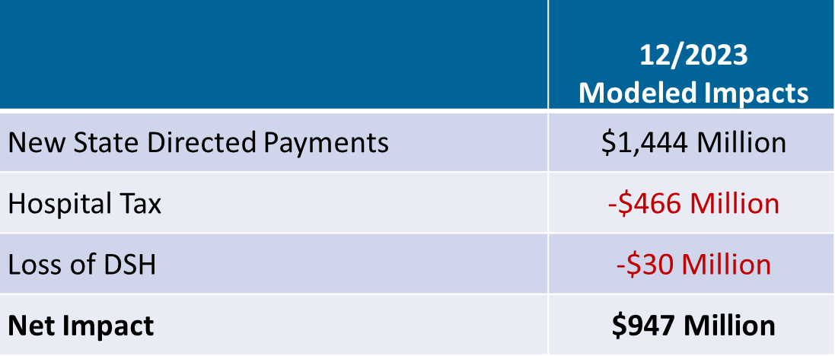
MODEL REVISED UPWARD DUE TO ACTUARIAL STUDY

Slide 32
LB 1087 - Medicaid Directed Payment program update
Hospital Quality Assurance and Access Assessment Act (LB 1087) was introduced by Sen. Jacobson of North Platte. 31 legislative cosponsors.
Legislative hearing held on Friday, February 2.
Sen. Armendariz of Omaha prioritized the legislation.
LB 1087 passed on Final Reading 45-0. Expected to be signed by Gov. Pillen week of March 25.

Slide 33
LB 1087 Key Provisions
DHHS shall file to CMS to establish a directed payment program and assessment
DHHS authority to impose assessment on hospitals upon CMS approval
DHHS shall consult with the NHA on development, implementation, and annual renewal of the
assessments and the directed payment programs
DHHS may use different assessment rates based on categories of services, as allowed by federal law
DHHS shall partner with NHA to implement quality initiatives to improve children’s mental health, adult mental health, maternity care, and senior care.
Center for Nursing will work with NHA to ensure Nebraska hospitals invest $50M per year in health care workforce development.
Assessment based on net patient revenue. Statewide aggregate assessment shall not exceed 6% of total net patient revenue

Slide 34
LB 1087 Key Provisions cont.
Hospital Quality Assurance and Access Assessment Fund is created. No proceeds from the Fund can go to the General Fund, except as provided in statute. Fund used to:
State Administrative Fee – 3% capped at $15M
Funding for Health Care Priorities – 3.5% capped at $17.5M
Funding for Clinical Nursing Training Sites – 0.5% capped at $2.5M
NHA Admin will be 1% or less and rate/budget will be set by the NHA Board. Contracted directly.
Legislative intent that Medicaid rates and the General Fund appropriations for hospital inpatient and outpatient services shall not be reduced to an amount below the rates paid and General Fund appropriations for these services in fiscal year 2023-24.
Assessments and directed payments shall be treated as a separate component in developing rates paid to hospitals and shall not be included with existing rate components. Assessment and directed payments are retroactive to July 1, 2024, or the effective date approved by CMS, whichever is earlier.
Assessments due 30 days after receipt of quarterly payment.

Slide 35
Medicaid Directed Payment Flow Payments Made Quarterly
$1
State GF
$2.19
Federal Medicaid Match
General Funds are replaced within 30 days of payment to hospitals.
Enhanced Medicaid Payments to Hospitals Based on Medicaid Services
$1 of assessment replaces Gen. Funds and $.07 pays for state admin fee and other health priorities in LB 1087.
$1.07
Assessment
$2.12
Net Benefit to Hospitals
Assessment paid based on hospital net revenue.

Slide 36
LB 1087 Key Provisions cont.
Hospitals shall not pass on the cost of an assessment to patients or non-Medicaid payors, including as a fee or rate increase.
MCOs are prohibited from setting, establishing, or negotiating reimbursement rates with a hospital in a manner that takes into account, directly or indirectly, a directed payment arrangement that a hospital receives under the Act.
DHHS shall discontinue collection of assessments if federal funds become unavailable.
If discontinued, money in the Hospital Quality Assurance and Access Assessment Fund shall be returned to the hospitals from which the assessments were collected on the same basis as the assessments were collected

Slide 37
Medicaid Quality Initiatives
NHA Medicaid Quality Council
Social Determinants of Health Screening
Maternal Postpartum Depression Screening
CAUTI Infection
Consideration After Gov. Administration Feedback
Behavioral health E.D. visit by adults after inpatient stay.
Behavioral health E.D. visit by children after inpatient stay.
Expansion of Age-Friendly model.

Slide 38
Looking ahead on Medicaid Directed Payment Program
Finalize Directed Payment Program model
CMS documents
Preprint: SDP framework needs CMS approval prior to implementation
Tax waiver: Authority to utilize a non-uniform tax
Implementation
Effective date July 1, 2024. Payment timing based on CMS response time.
While materials are pending at CMS, NHA will establish implementation process.
NHA will have TPA agreements with hospitals to serve as a liaison to MCOs and DHHS.

Slide 39
Looking ahead on Medicaid Directed Payment Program
Finalize Directed Payment Program model
CMS documents
Preprint: SDP framework needs CMS approval prior to implementation
Tax waiver: Authority to utilize a non-uniform tax
Implementation
Effective date July 1, 2024. Payment timing based on CMS response time.
While materials are pending at CMS, NHA will establish implementation process.

Slide 40
Calculation of payments
July 1, 2024 Example
State fiscal year reconciliation will take place 6-9 months after June 30, using actual claims in the fiscal year. DHHS may align to plan/calendar year.
If hospital owes, the difference will be deducted from next quarterly payment.
Medicaid Claims
Paid in Q1 2024
(two quarters prior)
Multiplied by Medicaid Directed Payment Rate
(Previous Model: 150% OP, 243% IP)

Slide 41
Medicaid/LB 227 Update
Rebasing of CAH Interim Per Diem Rates
Process is underway. More than half of CAHs have been rebased.
Legislation required rebasing every two years, but DHHS will do annually.
Working with DHHS on issues around inpatient ancillary services rebasing.
Reimbursement for Difficult to Place Patients
Medicaid reimbursement to acute care hospitals at 100% of the statewide average nursing facility per diem rate for individuals who are actively Medicaid eligible during an inpatient stay but cannot be discharged due to lack of nursing facility beds or guardianship issues.
$264 from 9/2/23 to 12/31/23 and $278 for 2024.
Day 1 of MCO timely filing is 4/1/24 and FFS is 7/1/24.
Provider Bulletin: dhhs.ne.gov/Medicaid Provider Bulletins/Provider Bulletin 24-04.pdf

Slide 42
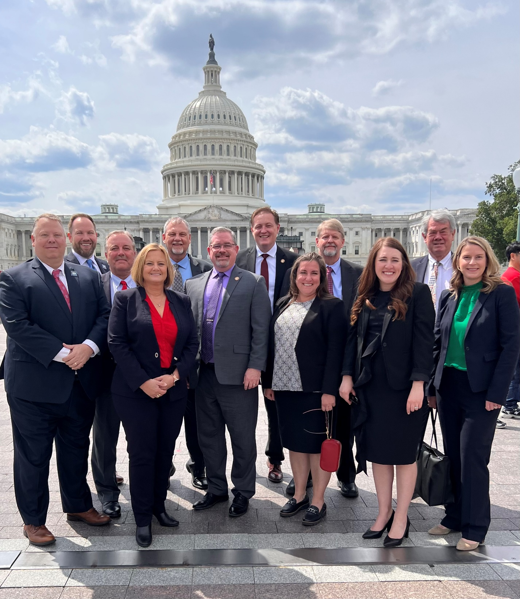
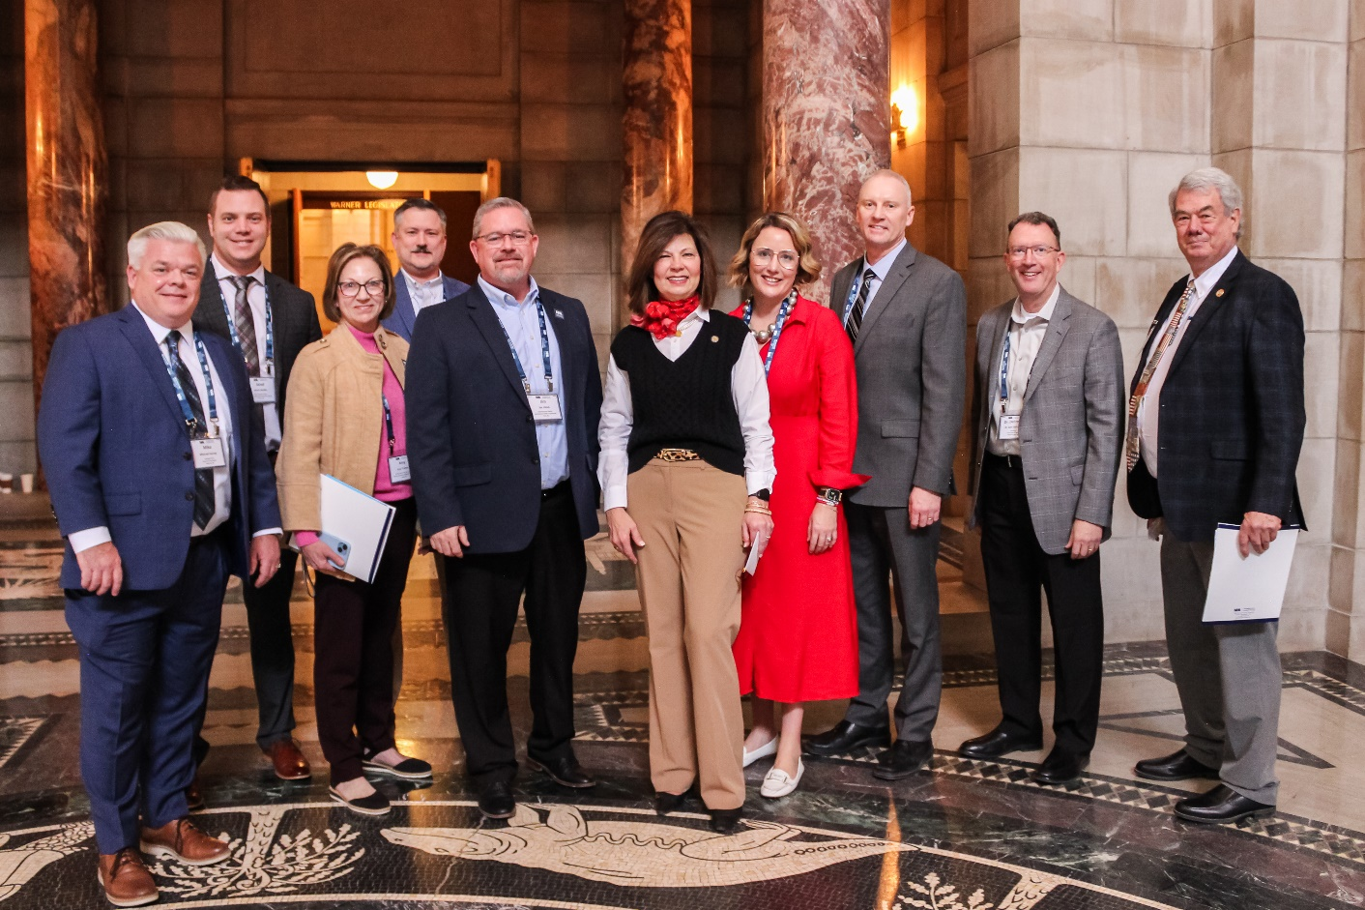
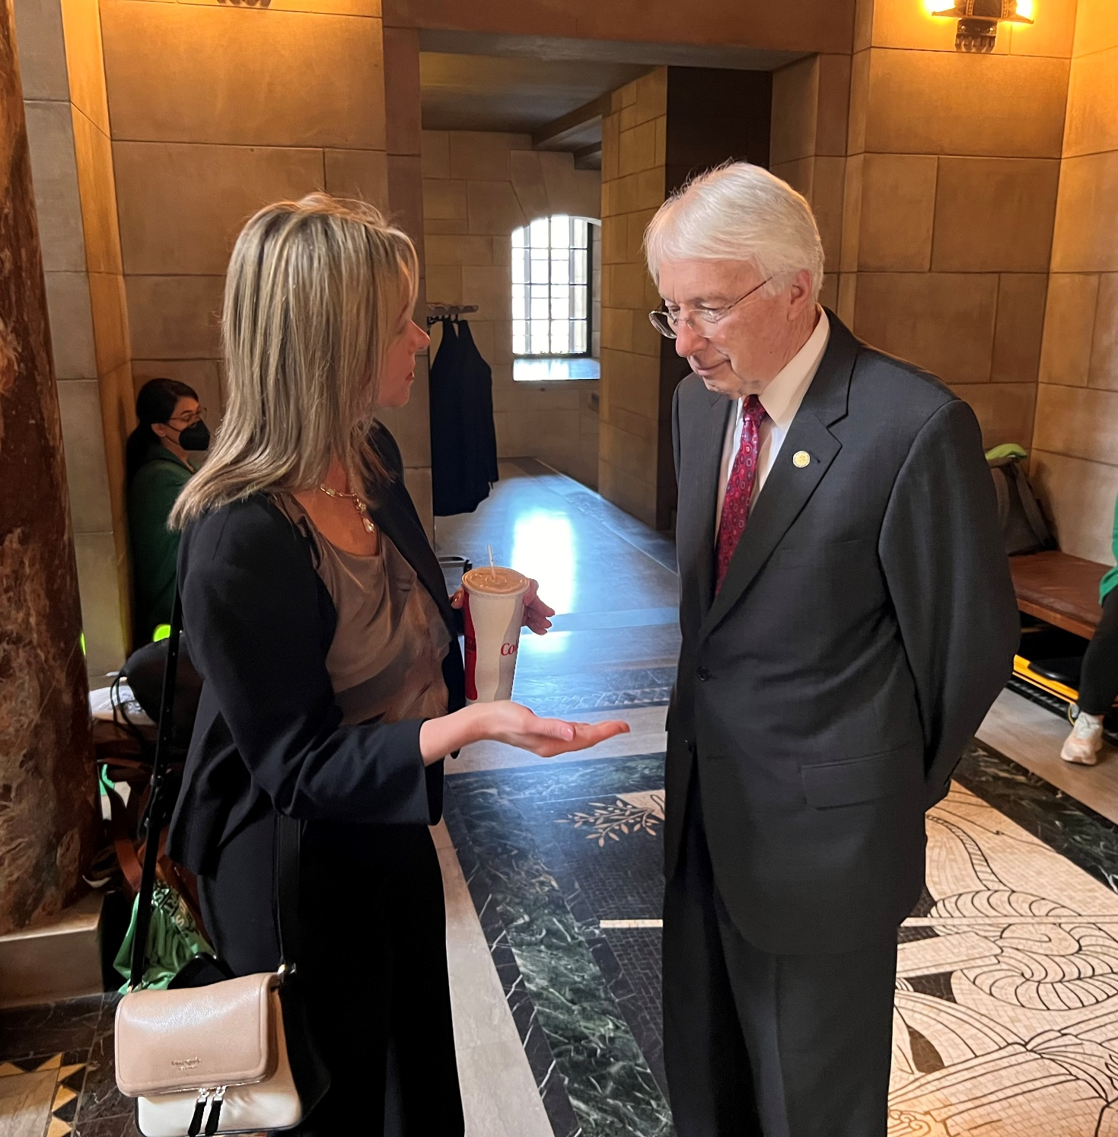
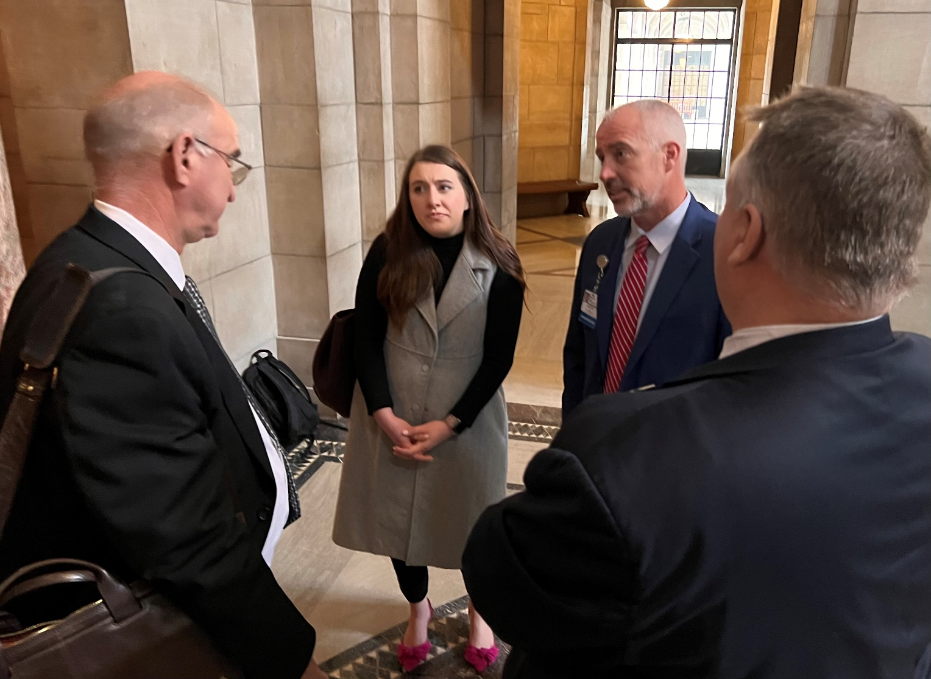
Advocacy is a team sport.
WE NEED YOU!

Slide 43
ON DEFENSE NATIONALLY

Slide 44
NHA DATABANK
Aggregates monthly utilization, income statement, and balance sheet data.
Provides members the ability to compare financial and utilization performance with other hospitals and peer groups using near real time utilization and financial data.
Used to help advocate for policy and legislative agenda.
Gives NHA regular aggregate DATABANK information to elected state and federal officials, the media and general public on important issues such as adequate payment, charity care, and rural health care.
Data submitted at least quarterly, monthly preferred.
No cost to individual members.

Slide 47
Questions?
Jeremy Nordquist, MPA
President
Nebraska Hospital Association
jnordquist@nebraskahospitals.org
402-578-6442

