Slide 1

Best Practices to Combat Denials: Keep Calm and Appeal Like a Lawyer
Sarah Mendiola, Esq., LPN, CPC, CPCO, Vice President, Denials

Slide 2
Objectives
Review best practice concepts to maximize your recovery and “Appeal like a Lawyer”.
Learn legal and organizational rules for best practice appeal writing
(PLEA and IRAC).
Applying our Knowledge!

Slide 3


Best Practices - Evaluate Internal Resources
Compliance
Care Management
Patient Financial Services
Clinical Documentation Integrity (CDI)
Health Information Management (HIM)
Patient Access
Contracting
Utilization Review

Slide 4
Best Practices - Root Cause Analysis
Non-Covered
Contractual/Technical/Administrative
Lack of Authorization
Readmission
DRG Downcode
Lack of IP Notification
Out of Network
Not Covered Under Clinical Policy
Lack of Eligibility/Benefits
Coordination of Benefits
Untimely Claim
Untimely Appeal
Billing Error
Clinical
Lack of Medical Necessity
Readmission
DRG Downcode
Delay in Service
Non-Emergent Service
Experimental/Investigational
Medically Unlikely Edits
Lower Level of Care

Slide 5
The information obtained during the registration/admitting process is crucial to prevent and fight denials!
Almost all technical denials can be challenged.

Slide 6
Best Practices - Eligibility & Insurance Verification
Just asking the right questions can prevent denials!
Verify eligibility and plan type and elicit information that is not routinely provided:
Specific policy exclusions
Pre-existing conditions limitations
Opportunity to correct potential benefit problems:
Early registration
Lapses in coverage during admission/patient involvement
Has the patient paid their premium?

Slide 7
Best Practices - Obtaining/Confirming Authorization
Is authorization needed for this particular service under this patient’s plan?
Check provider website/portal and/or call to verify.
Even if authorization wasn’t required prior, make sure nothing has changed! (ex. unclassified drugs or temporary codes)
If authorization was obtained:
Does it cover this particular service?
Is it for this date?
Is it still valid?
Has it been used already?
Number of units and effective date?
Documentation of authorization & reference number(s)
Document, Document, Document!

Slide 8
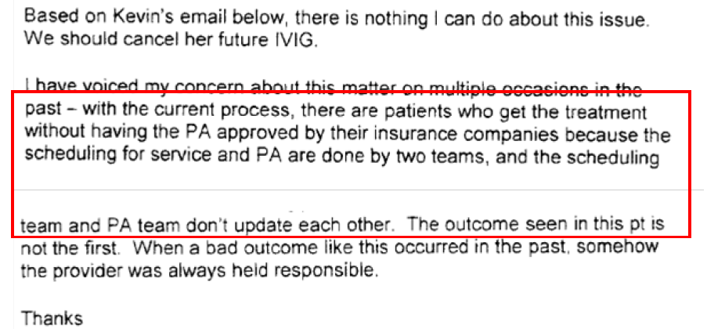
An ineffective process can impact patient care!

Slide 9
Best Practices - Contracting for Protection
In the event that the lack of authorization can reasonably be shown to have resulted from an action or inaction by Hospital, and Insurer determines the services to be Medically Necessary, then Insurer shall reimburse Hospital for all Medically Necessary Covered Services rendered to the Member.

Slide 10
Best Practices - Utilizing State & Federal Law
Type of Plan | Controlling Law
Fully insured (Insurance) | State
Self-funded (Claims paid by employer group) | Federal
Medicaid/Medicaid MCOs | State
Medicare | Federal
Medicare Advantage | Federal

Slide 11
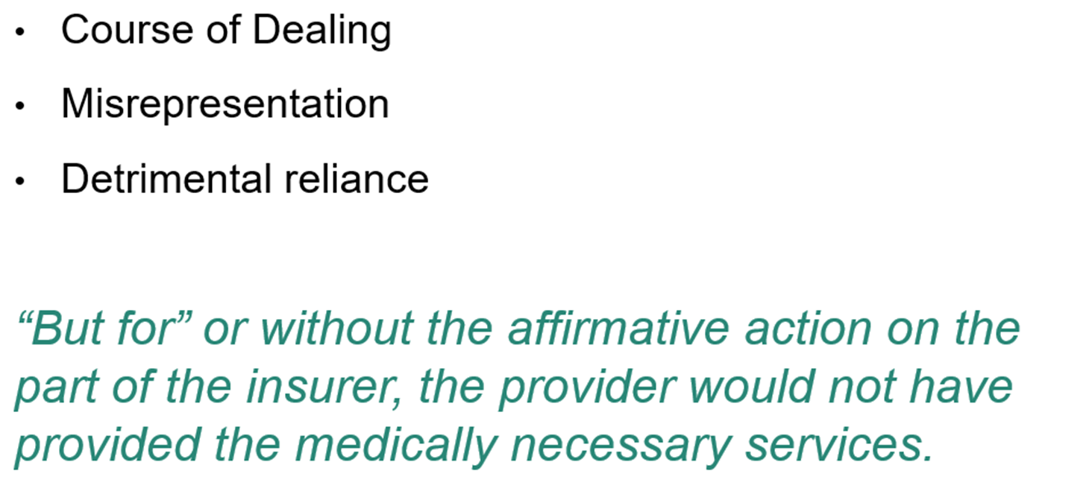
Best Practices - Helpful Legal Theories for your Appeal Toolbox

Slide 12
Best Practices - Create a Payer Matrix
This is an extremely beneficial tool for ALL team members.
Claim submission and resubmission timeframes
Coordination of Benefits
Timeframes for first and second level appeals
External appeal options and timeframes
Correct addresses, phone numbers, and fax numbers
Any key contract terms to assist in the appeals process
Availability of retro-authorization and timeframes

Slide 13
Best Practices - Example Payer Matrix
Payer | Claim Submission | Reconsideration/First | Second | Appeal Address
Aetna Contracted all lines | 180 days | 180 days from denial Reconsideration considered first level | 60 days from denial of reconsideration | Attn: Provider Resolution Team PO Box 14079 Lexington, KY 40512-4079 *Must submit appeal form with appeal
Cigna Contracted all lines | 180 days | 180 days from denial | NO second level | Attn: National Appeals Unit PO Box 188011 Chattanooga, TN 37422
United Healthcare (Commercial Product Lines) Contracted | 180 days | 365 days from denial | 365 days from denial | E-file through UHC portal
United Healthcare (Medicare Products) NOT contracted | 1 year Based on Medicare Rules | 60 days from denial Submit Waiver of Liability due to Non-Contracted Status | Appeal to be forwarded to Maximus for Independent Review if denied or appeal not completed within 60 days | PO Box 6106 MS CA 124-0157 Cypress, CA 90630-9948

Slide 14
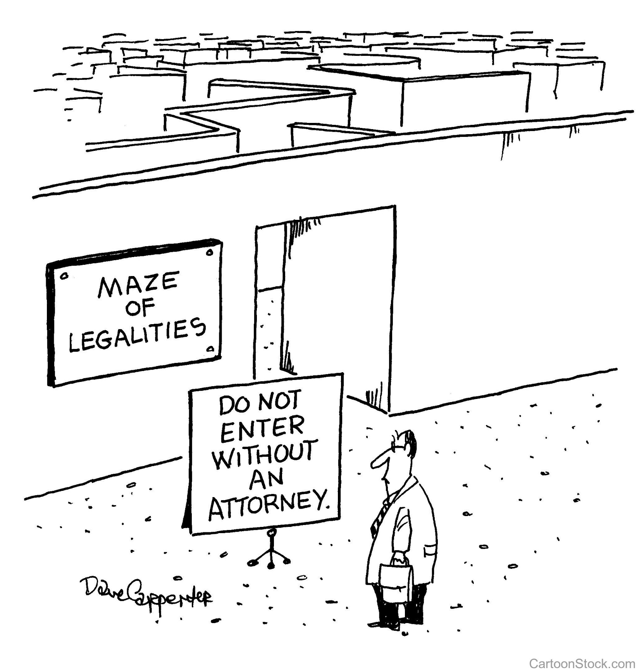
The Continuously Evolving Landscape of Today’s Denials
HAVE NO FEAR!

Slide 15
The Revenue Manager’s Lawyerly Oath
I will appeal all denials with:
Persistence
Logic
Exculpation and
Advocacy

Slide 16
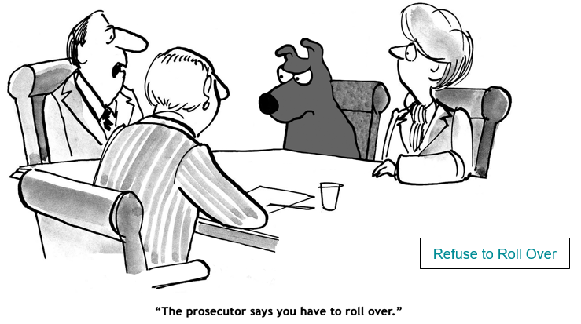
Persistence is Key
REFUSE TO ROLL OVER

Slide 17
Persistence: Example
Provider gets authorization for CPT code 29823 (Arthroscopy w/ debridement)
but bills CPT code 29826 (Arthroscopy w/ ligament release) and 23430 (Tenodesis)
that deny for lack of authorization.
The provider’s appeal asks the payer to make an “exception”
since “we neglected to get authorization for the two CPT codes”.
Does this sound like a lawyer?
Never Concede. Never Roll Over. Never Accept Blame.
We’ll cover this example in more detail in a bit…

Slide 18
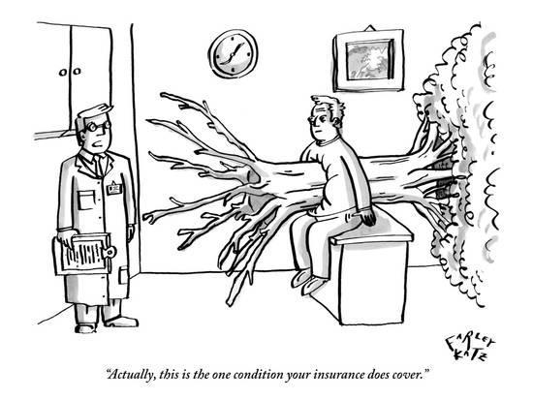
Apply Logic
IF IT SEEMS WRONG,
IT PROBABLY IS!
a.k.a. Smell Test

Slide 19
Apply Logic: Example - The Smell Test
Benefit Exclusion: Plan denied benefits to a child with cancer stating that Plan does not have to pay if the patient himself would not have to pay. Original intent was to exclude payment to family member-caretakers.
Issue: National Children’s Hospital advertises no patient will ever receive a bill.
Logic: A Plan provision cannot be so distorted from its original intent to the detriment of a Provider.

Slide 20
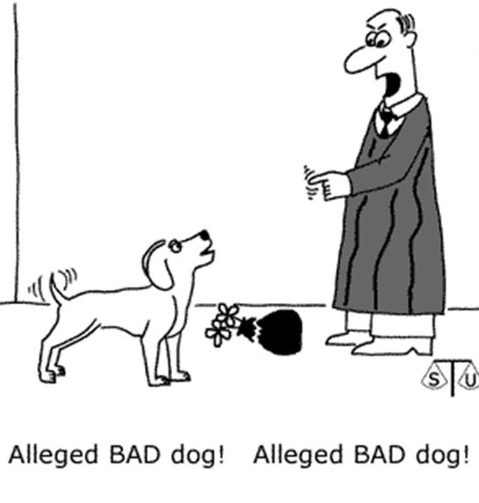
Exculpation & Advocacy
NEVER ACCEPT DENIALS AT FACE VALUE

Slide 21
Exculpation & Advocacy: Example
Payer denied a claim for Lack Notification of an ER Admission, but the Contract states the Payer has to pay for the first 48 hours.
Provider files an appeal which is rightly denied as untimely.
Give up?
NO: The Payer’s obligation for prompt pay under the Contract and law is not contingent on Provider filing a timely appeal.
Contract payment at DRG pays the claim in full.

Slide 22
Legal Writing Tools
I
ISSUE: What’s the issue you need to address?
R
RULE: What rule(s) apply to the denial?
A
ANALYSIS: How do the rules apply to your facts?
C
CONCLUSION: The logical conclusion of the analysis.

Slide 23
Issue
I
Clinical | Technical/Administrative
Not Medically Necessary | Precertification
Lower Level of Care | Notification
Experimental/Investigational | Untimely Claim
MUE | Untimely Appeal
DRG Down Code | Coordination of Benefits
Clinical Policy/NCD/LCD | Out of Network
Readmission | Stalled Appeal

Slide 24
Rule
R
What the provider was supposed to do.
What the payer was supposed to do.
  Contract
  Provider Manual/Clinical Policies
  Law
    State
    Federal

Slide 25
Analysis
A
Why the provider followed the rules.
Why the payer did not follow the rules.
Apply rules to facts.

Slide 26
Conclusion
C
Only logical outcome is overturn.
Explain the expected remedy.

Slide 27
Example
Issue
Provider gets authorization for CPT code 29823 (Arthroscopy w/ debridement)
but bills CPT code 29826 (Arthroscopy w/ ligament release) and 23430 (Tenodesis) that deny for lack of authorization.
Rule
Provider Manual:
(1) Surgical codes need precertification
(2) If you don’t follow authorization protocols, you must show
extenuating circumstances why you couldn’t.

Slide 28
Example
Analysis
Conclusion
Provider did follow the rules and got precertification for the intended code. (E)
Because Provider followed the rules, the denial goes against Payer’s own policy and they should have reviewed clinically on appeal. (A)
Extenuating clinical circumstances also exist when a slightly different or additional procedure is not foreseeable. (P)
Physicians aren’t coders so the whole process of issuing approvals based on CPT codes is flawed. Claims are coded based on medical records after-the fact. (L)

Slide 29
Example
Editorial note: case was referred after provider-exhausted appeals
ISSUE

Slide 30
Example
Rule
Analysis
Conclusion
Intra-Operative Change is not Foreseeable

Slide 31
Applying our Knowledge!
I
ISSUE: What’s the issue you need to address?
R
RULE: What rule(s) apply to the denial?
A
ANALYSIS: How do the rules apply to your facts?
C
CONCLUSION: The logical conclusion of the analysis.

Slide 32
Problem 1 - Inpatient Clinical Denial
Problem 1 - Inpatient Clinical Denial
Facts: Your facility obtains authorization #242424 from ABC Medicare Plan for the patient’s scheduled total knee revision on 2/15/24. The patient is admitted as an inpatient on 2/15 and undergoes a successful surgical procedure, removing & replacing the previously placed prosthesis. The patient recovers well and is able to be discharged the next day, 2/16. Your facility bills the claim to ABC Medicare Plan, who denies the inpatient claim as not medically necessary. Your facility is not contracted with this plan.
42 CFR 422.138 (c) Effect of prior authorization or pre-service approval. If the MA organization approved the furnishing of a covered item or service through a prior authorization or pre-service determination of coverage or payment, it may not deny coverage later on the basis of lack of medical necessity and may not reopen such a decision for any reason except for good cause (as provided at § 405.986 of this chapter) or if there is reliable evidence of fraud or similar fault per the reopening provisions at § 422.616. The definitions of the terms “reliable evidence” and “similar fault” in § 405.902 of this chapter apply to this provision. 42 CFR 419.22 Hospital services excluded from payment under the hospital outpatient prospective payment system. The following services are not paid for under the hospital outpatient prospective payment system (except when packaged as a part of a bundled payment): (n) Services and procedures that the Secretary designates as requiring inpatient care. 42 CFR 412.3 – Admissions (d)(2) An inpatient admission for a surgical procedure specified by Medicare as inpatient only under § 419.22(n) of this chapter is generally appropriate for payment under Medicare Part A regardless of the expected duration of care. Procedures no longer specified as inpatient only under § 419.22(n) of this chapter are appropriate for payment under Medicare Part A in accordance with paragraph (d)(1) or (3) of this section… (3) Where the admitting physician expects a patient to require hospital care for only a limited period of time that does not cross 2 midnights, an inpatient admission may be appropriate for payment under Medicare Part A based on the clinical judgment of the admitting physician and medical record support for that determination. The physician's decision should be based on such complex medical factors as patient history and comorbidities, the severity of signs and symptoms, current medical needs, and the risk of an adverse event. In these cases, the factors that lead to the decision to admit the patient as an inpatient must be supported by the medical record in order to be granted consideration.
I-lssue(s) - R-Rule(s) - A-Analysis - C-Conclusion(s) -

Slide 33
Problem 1 - Issue
Approved authorization was obtained for the surgery.
The patient was admitted to the inpatient level of care.
The patient did not remain in the hospital for two midnights or greater.
Issue:
  Was the patient admitted to the appropriate level of care?
  What is our argument to obtain payment?
  What are our avenues to appeal since this is a non-par relationship?

Slide 34
Problem 1: Audit & Recoupment - Rules
42 CFR 422.138
(c) Effect of prior authorization or pre-service approval. If the MA organization approved the furnishing of a covered item or service through a prior authorization or pre-service determination of coverage or payment, it may not deny coverage later on the basis of lack of medical necessity and may not reopen such a decision for any reason except for good cause (as provided at § 405.986 of this chapter) or if there is reliable evidence of fraud or similar fault per the reopening provisions at § 422.616. The definitions of the terms “reliable evidence” and “similar fault” in § 405.902 of this chapter apply to this provision.
42 CFR 419.22
Hospital services excluded from payment under the hospital outpatient prospective payment system. The following services are not paid for under the hospital outpatient prospective payment system (except when packaged as a part of a bundled payment): (n) Services and procedures that the Secretary designates as requiring inpatient care.
42 CFR 412.3 – Admissions (d)(2)
An inpatient admission for a surgical procedure specified by Medicare as inpatient only under § 419.22(n) of this chapter is generally appropriate for payment under Medicare Part A regardless of the expected duration of care.

Slide 35
Problem 1: Audit & Recoupment –
Analysis & Conclusion
Approved authorization was obtained for the surgical procedure.
The surgery performed is on CMS’ Inpatient Only List.
As of 1/1/24, Medicare managed care plans must follow the Inpatient Only List and adhere to other CMS guidance such as LCDs & NCDs and the Two Midnight Rule.
Inpatient Only List procedures are an exception to the Two Midnight Rule.
Since this is a non-contracted relationship with the payer, should the denial be upheld on appeal, we would then proceed to the IRE, and then to hearing with OMHA, if necessary.

Slide 36
Problem 2 - ERISA Benefit Exclusion
Problem 2 - ERISA Benefit Exclusion
Facts: 36-year-old man was the driver in a single car accident. He had a blood-alcohol well over the legal limit for driving but was not charged. He was taken to your ER with multiple fractures and injuries. Provider faxed all relevant clinical information to self ­insured Plan the same day for approval of the admission. Six days later the Plan denies the request for authorization under the plans "Limitations and Exclusions" under the exclusion policy below.
Plan Terms & Law: Benefit Exclusion: Services, supplies, care or treatment to a Covered person for an Injury or Sickness which occurred as a result of that Covered person's illegal use of alcohol. The arresting officer's determination of inebriation will be sufficient for this exclusion. ERISA: Urgent care claims. In the case of a claim involving urgent care, the plan administrator shall notify the claimant of the plan's benefit determination (whether adverse or not) as soon as possible, taking into account the medical exigencies, but not later than 72 hours after receipt (29 C.F.R. 2560.503-1 ). State Motor Vehicle Laws makes it unlawful to operate a motor vehicle while intoxicated.
I-lssue(s) - R-Rule(s) - A-Analysis - C-Conclusion(s) -

Slide 37
Problem 2: ERISA Benefit Exclusion: Issue
36-year-old man was in a single car accident. His blood-alcohol was well over the legal limit for driving but he was not charged. He was taken to your ER with multiple fractures and injuries. Provider faxed all relevant clinical information to self-insured Plan the same day for approval of the admission.
Patient's plan is governed by ERISA.
Issue: The Plan denies the request for authorization under the plans “Limitations and Exclusions" policy which will not cover:
  Alcohol. Services, supplies, care or treatment to a Covered person for an Injury or Sickness which occurred as a result of that Covered person's illegal use of alcohol. The arresting officer's determination of inebriation will be sufficient for this exclusion.

Slide 38
Problem 2: ERISA Benefit Exclusion: Rules
Benefit Exclusion: Services, supplies, care or treatment to a Covered person for an Injury or Sickness which occurred as a result of that Covered person's illegal use of alcohol. The arresting officer's determination of inebriation will be sufficient for this exclusion.
ERISA: In the case of a claim involving urgent care, the plan administrator shall notify the claimant of the plan's benefit determination (whether adverse or not) as soon as possible, taking into account the medical exigencies, but not later than 72 hours after receipt (29 C.F.R. 2560.503-1)
State Motor Vehicle Laws makes it unlawful to operate a motor vehicle while intoxicated.

Slide 39
Problem 2: ERISA Benefit Exclusion –
Analysis & Conclusion
Plan erred in not issuing a determination within 72 hours. This is particularly important in an ERISA non-covered denial when the balance is patient responsibility.
There was no arrest - patient was transferred directly to the ER so no independent determination.
State Motor Vehicle Laws makes it unlawful to operate a motor vehicle while intoxicated. There was no illegal use of alcohol under the State law.

Slide 40
Sarah Mendiola
sarah.mendiola@cloudmed.com

Slide 41
Q&A

