Slide 1
UNINTENDED CONSEQUENCES
Understand, engage, and measure
THE CRITICAL ROLE OF PHYSICIAN ADVISORS
Jeny McNair, MD
President |Physician Advisor On Call
Notes:
With the introduction of Medicare and Medicaid in the 1960s to control healthcare spending and provide expanded healthcare coverage, CMS enacted a requirement for Utilization Review. 42 CFR 482.30, June 17, 1986
Utilization review was meant as a cost containment measure

Slide 3
SOONER OR LATER
EVERYONE
SITS DOWN TO A
BANQUET
OF
CONSEQUENCES
Notes:
Robert Louis Stevenson

Slide 4
Notes:
And so the 2 MN rule was adopted into practice.
And you know what happened next….
This patient would’ve stayed 2 MN EXCEPT…
They died
They left AMA
They got better faster than we expected (DKA, CHF, etc)
As you know, exceptions occurred. Patients presented in extremis, received intensive, life-salvaging care but expired prior to the second midnight, for instance. The came in in DKA, were admitted to the ICU and then left AMA…and other exceptions
The healthcare community cried out and CMS responded in 2016 with an update to the 2MN rule, suggesting that physician judgment might actually supercede a wall clock.

Slide 5
2MN
RULE
an arbitrary divide?
Interpretation depends on motivation
Notes:
The 2 MN rule – believe it or not – was CMS’ attempt to clarify when hospital payment is appropriate under part A or part B.
According to the 2013 2MN rule – anything >2MN would be IP and considered reasonable for payment under Medicare Part A if a physician CERTIFIED that the pt would required at least 2 midnights of medically necessary hospital services or received a procedure on the IP only list.
What does ‘medically necessary’ mean, you ask?

Slide 6
Notes:
This update offered some exceptions that allowed for payment for stays under 2 MN by Medicare part A on a case by case basis. These exceptions include patient death, transfer, unforeseen clinical improvement, or departure AMA.
I presented that as a set of very clear rules with clearly stated exceptions. But this is real life. And not only are medicare cases not that clear, but private insurers are not beholden to this 2 MN rule. Sure, they loosely follow CMS guidance, but more and more of late 2MN to them is clearly OBS despite CMS’ guidance.
And so the role of a Physician Advisor is cemented. or rather, one of the roles of a physician advisor.

Slide 7
education
is learning what you
didn’t even know
you didn’t
know
-Daniel J Boorstin

Slide 8
THE ROLE
an evolution borne of niche tasks and the need for specific expertise
People who end up with the good jobs are the proactive ones who are solutions to problems...who seize the initiative to do whatever is necessary to get the job done.
Notes:
Stephen Covey
7 Habits of Highly Effective People
In this evolution, you’ll find Steven Covey’s quote to be true, “people who end up with the good……do whatever is necessary to get the job done”
and was initially executed by RNs in the acute care setting. The concept quickly gained popularity within the health insurance sector and an industry was born.
With research showing misuse and overutilization of services, health insurance companies were soon evaluating medical necessity and length of stay.
Before long, physicians needed to CERTIFY the admission and subsequent days, necessitating discussions with payers where differences in perspective occurred.
This series of events marked the casual introduction of the function of a physician advisor – a PCP executing these tasks as a part of their clinical role – increasing the administrative burden of practice and ultimately prompting, in the early 2000s, formalization of the role.

Slide 9
HOSPITALIZATION LIFE CYCLE
for THIS Physician Advisor
1
2
3
4
5
PATIENT PRESENTATION
FIRST LEVEL REVIEW
SECOND LEVEL REVIEW
(PA)
PAYER NOTIFICATION
PAYER DENIES BASED ON MEDICAL NECESSITY

Slide 10
HOSPITALIZATION LIFE CYCLE
for THIS Physician Advisor
6
7
8
9
10
PEER TO PEER
(PA)
CLAIM DROP
PAYER DENIAL
(MEDICAL NECESSITY, CODING, ETC)
1ST LEVEL APPEAL
2ND LEVEL APPEAL AND ALJ

Slide 11
EXPANDING SCOPE
Traditional
Level of Care
UR Committee
CC44 and HINN
Denials and Appeals
Notes:
Traditionally, and preceding the 2 MN rule, Physician advisors have assisted the UR nurse in determining appropriate level of care to justify payment based on length of stay and medical necessity when the initial UR review is inconclusive or inconsistent with the care provided.
These physicians have also served on the UR committee and provided CC 44.
As the health insurance companies expanded their review capacity and guidelines, denials and appeals have become a much larger part of UM/RCM and Physician Advisors have developed specific expertise to respond to this need.
In the past several years, there has been a significant increase in denial rates by private payers. In fact, even the OIG is aware and concerned. So much so that they are reviewing cases overturned on appeal to see if they should have been approved initially. The administrative burden of appealing so many denials has created additional strain on our facilities at a time when capacity is low…
And while MA plans overturn 75% of their own denials on appeal, only about 1 percent of denials are actually appealed.

Slide 12
EGREGIOUS DENIALS
are we in the business of appeals?
SBO
CHF/COPD exacerbation
Malignancy on CHEMO
payer says what?
payer says what?
payer says what?
Notes:
Here are some examples of cases that are being denied:
Clinical and radiographic SBO, NPO and IV fluids with serial abdominal exam; payer denies b/c no ‘documented feculent vomitus’
CHF on day 5 of IV Lasix and IV steroids for persistent symptoms; payer denies b/c there is no documented hypoxia

Slide 13
Did you know?
53%
OF DENIAL WRITE OFFS IN 2019 WERE DUE TO MEDICAL NECESSITY
Are you capturing every opportunity to collect?

Slide 14
EXPANDING SCOPE
Traditional
MultiDisc Rounds
Evolved
Length of Stay
Management
CDI
OBS Units
Notes:
More recently, physician advisors have executed multidisciplinary rounds, bridging the gap from clinician to rev cycle by bringing all internal stakeholders to the bedside to understand the clinical and socioeconomic factors contributing to the patients condition and potential barriers to recovery.
Length of stay management is becoming an increasingly common function of physician advisors.
Some physician advisors serve a dual role assisting with clinical documentation integrity and medical staff education.
And finally, more and more facilities post COVID are revisiting Observation units, which can provide significant efficiencies in the observation period with consistent staffing, geolocated stat support services such as lab and imaging, and protocol-driven care.

Slide 15
EXPANDING SCOPE
Traditional
Evolved
Evolved
Hosp to Hosp Transfers
Emerging
Payer contracting
Payer JOCs
Notes:
As the scope of the Physician Advisor role creeps/evolves, PAs are asked to do more to impact the Rev Cycle. Some of the newer tasks include management of hospital to hospital transfers – screening for medical necessity even before a transfer is accepted.
And – if your PA is NOT performing these next 2 functions – they need to be…
Payer contracting and contribution to payer JOCs. At most institutions, these meetings happen without boots-on-the-ground clinical representation and then the CFO is surprised to find there is a chasm separating what the payer considers IP from what the providers consider IP; or the payer doesn’t allow 3rd party peer to peers; or the P2P window is only 72 hours…things that are operationally inefficient or even impossible for most facilities to execute.
Each of the functions I just described aligns to two primary goals of a Physician Advisor program:

Slide 16
EDUCATION
ENSURE YOUR FRONTLINE CLINICIANS ARE CAPTURING CARE
.
Notes:
Stephen Covey
7 Habits of Highly Effective People
In this evolution, you’ll find Steven Covey’s quote to be true, “people who end up with the good……do whatever is necessary to get the job done”
and was initially executed by RNs in the acute care setting. The concept quickly gained popularity within the health insurance sector and an industry was born.
With research showing misuse and overutilization of services, health insurance companies were soon evaluating medical necessity and length of stay.
Before long, physicians needed to CERTIFY the admission and subsequent days, necessitating discussions with payers where differences in perspective occurred.
This series of events marked the casual introduction of the function of a physician advisor – a PCP executing these tasks as a part of their clinical role – increasing the administrative burden of practice and ultimately prompting, in the early 2000s, formalization of the role.

Slide 18
America's
healthcare system
is neither
healthy,
caring,
Nor a system
-Walter Cronkite

Slide 19
1 FTE PA per 250-300 adult acute beds (for UR/compliance fx only)
A
ROBUST
PA PROGRAM
weekend and holiday coverage
ancillary function coverage
Are you covered?
rapport with medical staff
basic data proficiency
Notes:
As you construct and/or evaluate your PA program, several critical factors emerge for consideration…
Some of them include staffing ratios/diplomacy/expertise…
Then,
How do you monitor the efficacy of your PA program?

Slide 20
Did you know?
>10:1 ROI
financial return on structured physician advisor services
Can you afford NOT to?
Notes:
A robust and successful PA program can net your facility ROI upwards of 10:1.
Can you really afford NOT to?

Slide 26
WITHOUT DATA
facts
YOU'RE JUST ANOTHER
drive intentional
PERSON WITH
AN OPINION
progress
Notes:
W. Edwards Deming, Data Scientist
Let’s level set our ontology.

Slide 28
CONCURRENCE
CONVERSION
Upon secondary review, ordered level of care is appropriate from a compliance stand point.
Upon secondary review, ordered level of care is non compliant and stay needs to be converted to another level of care.
Notes:
define concurrence and conversion

Slide 29
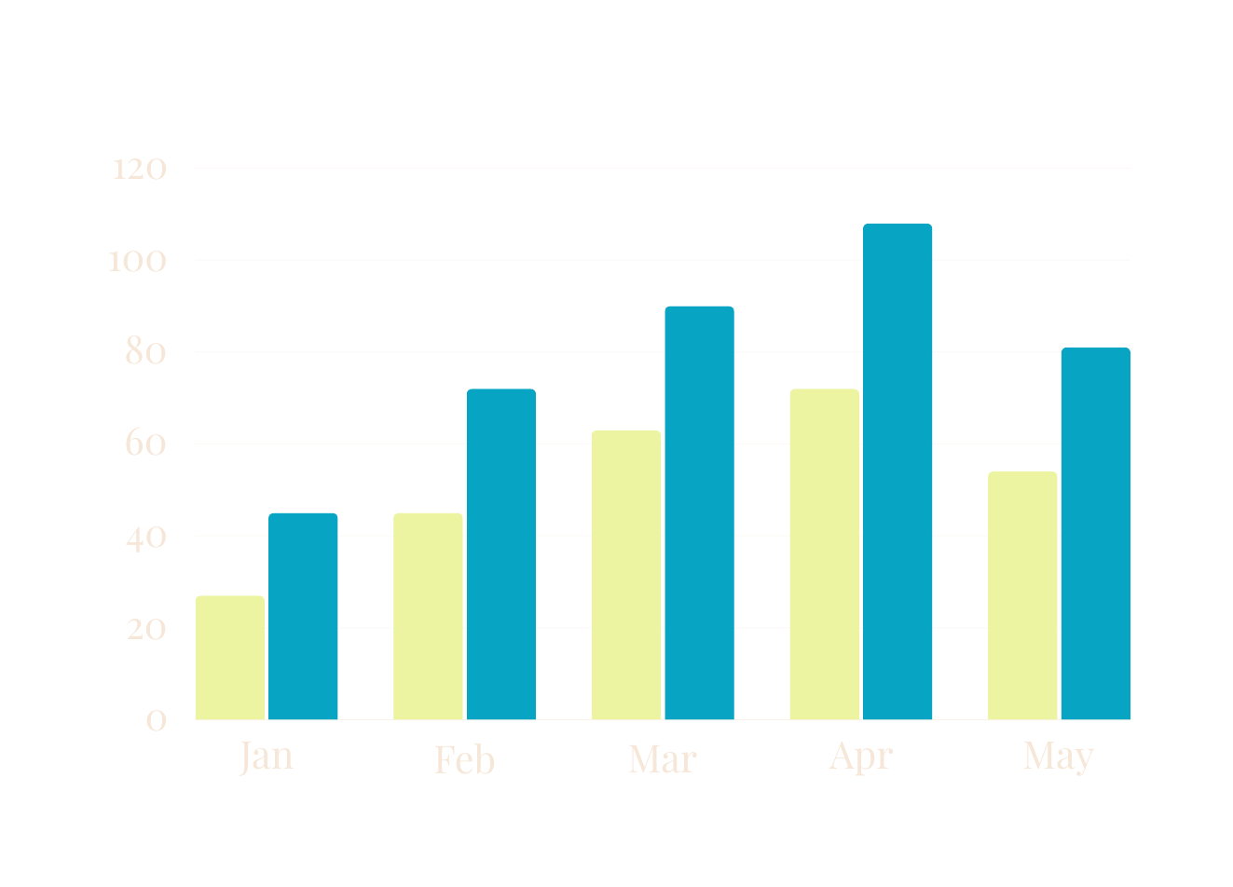
COMPLIANCE DATA POINTS
minimize your risk

Slide 30
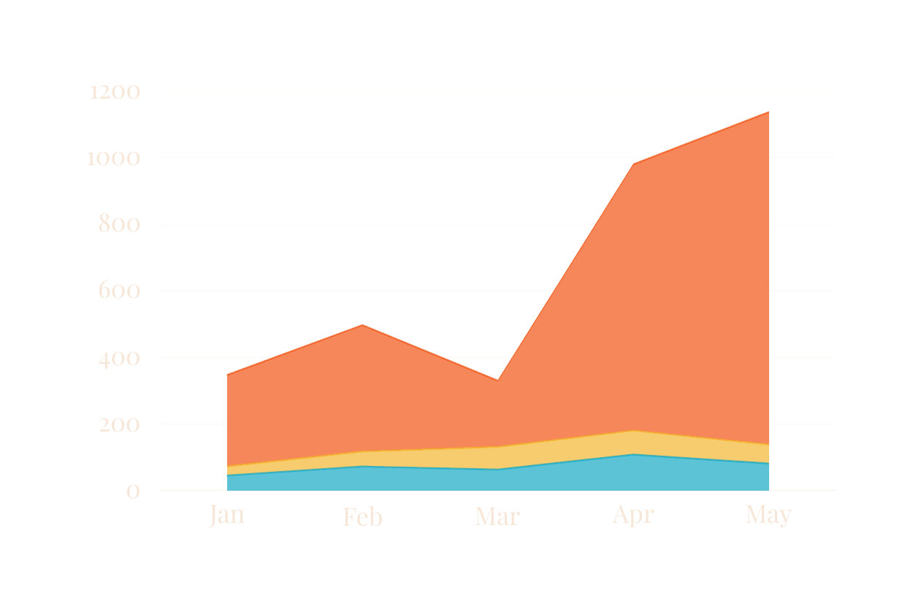
REVENUE DATA POINTS
maximize your return
Overturn on
P2P & Appeal
added
revenue
Obs to IP

Slide 31
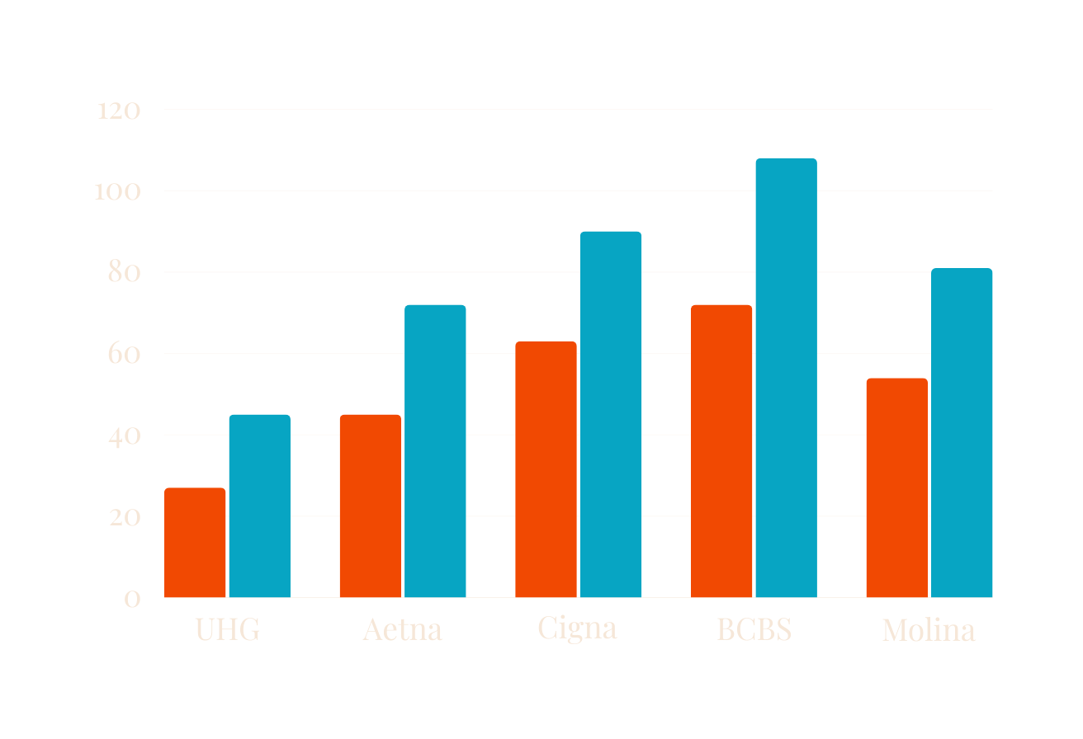
PAYER SPECIFIC DATAPOINTS
cultivate actionable data
As audiences get more distracted online, virtual presenters need
to employ different ways
of presenting ideas.
SLICERS:
Initial Denials
P2P overturns
Appeal overturn by level
VisAWERGSDFBGualize complicated and dense information with graphs and charts. These sare visual aids that help add more context ssezrfgsrdfhbdgto the topic you
are discussing.

Slide 32
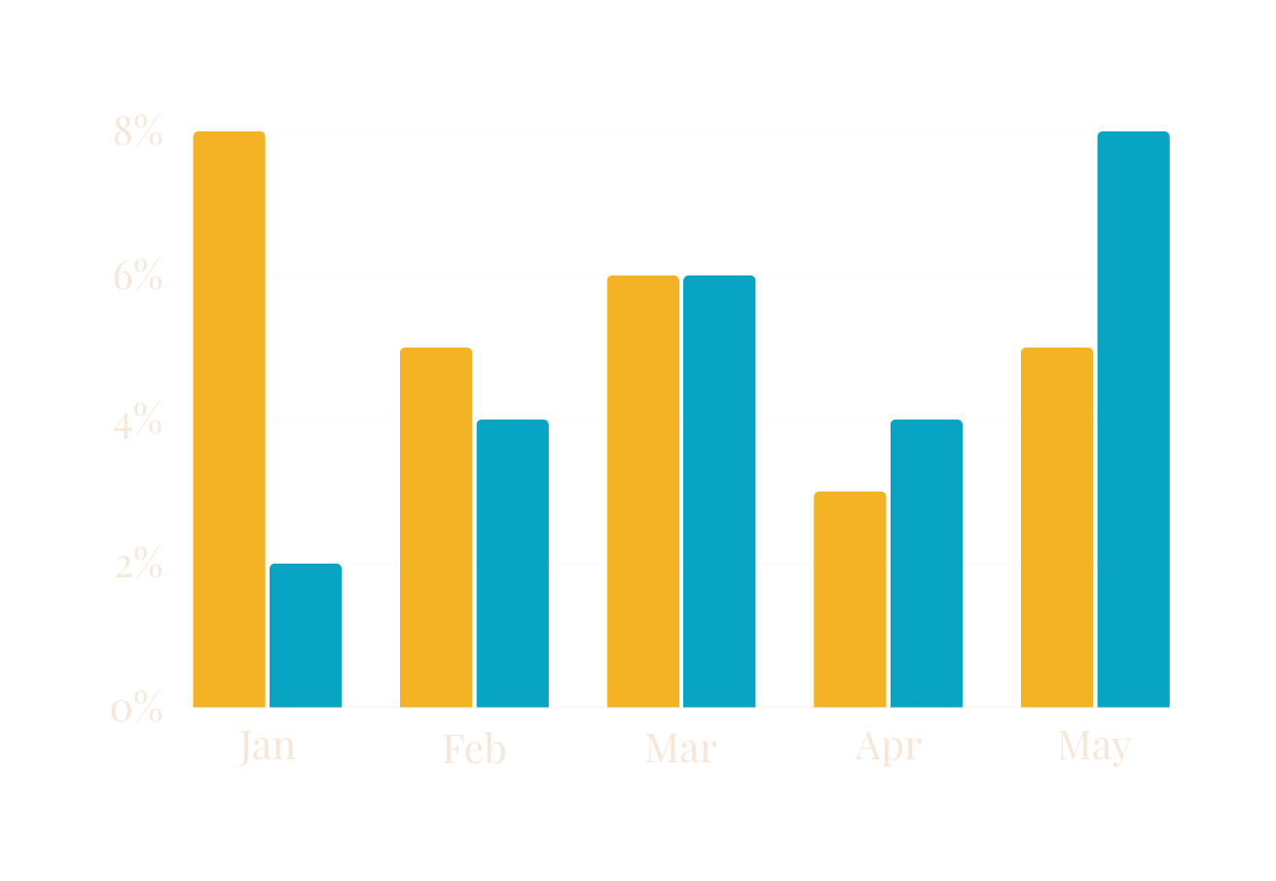
INITIAL DENIAL RATE
minimize your risk
Aetna
Cigna
As audiences get more distracted online, virtual presenters need
to employ different ways
of presenting ideas.
Visualize complicated and dense information with graphs and charts. These are visual aids that help add more context to the topic you
are discussing.

Slide 33
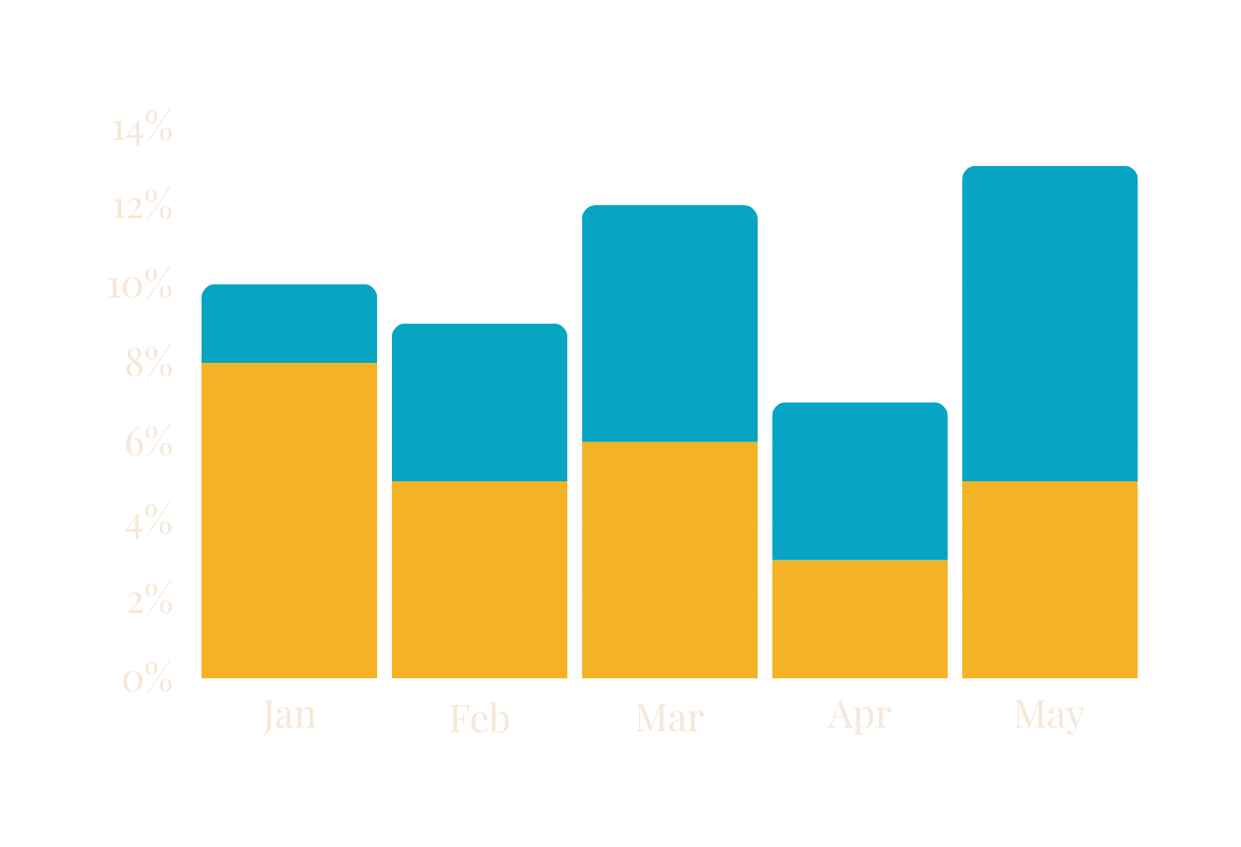
P2P PERFORMANCE RATE
minimize your risk
P2P performed
P2P missed
As audiences get more distracted online, virtual presenters need
to employ different ways
of presenting ideas.
Visualize complicated and dense information with graphs and charts. These are visual aids that help add more context to the topic you
are discussing.

Slide 34
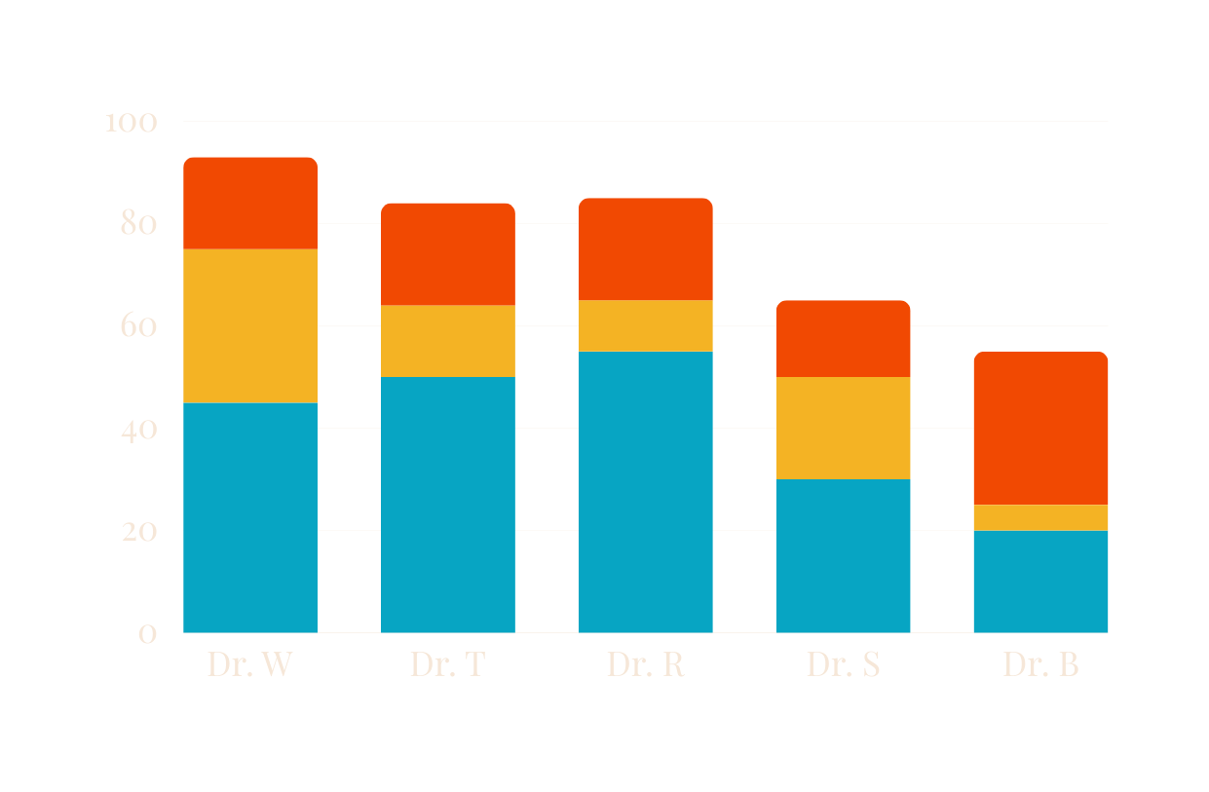
PROVIDER PROFILING
focus on opportunity
concurrences
OBS to IP
IP to OBS
As audiences get more distracted online, virtual presenters need
to employ different ways
of presenting ideas.
Visualize complicated and dense information with graphs and charts. These are visual aids that help add more context to the topic you
are discussing.

Slide 36
SOONER OR LATER
EVERYONE
SITS DOWN TO A
BANQUET
OF
CONSEQUENCES
Notes:
W. Edwards Deming, Data Scientist

Slide 37
YOUR SYSTEMS ARE PERFECTLY DESIGNED TO GET THE RESULTS YOU ARE GETTING

Slide 38
THANK YOU!
Send us a message at
getpaoc@med-metrix.com
if you have questions.

