Slide 1
Certified Revenue Cycle Representative
Coaching Course – Unit 1 Patient-Centric Revenue Cycle
Notes:
Last revised 3-1-2024

Slide 2
Unit 1: Patient-Centric Revenue Cycle
1.1 Patient-Centric Revenue Cycle Overview
1.2 Healthcare Dollars and Sense
1.3 Patient Experience & Satisfaction
1.4 Collaboration & Continuum of Care
1.5 Compliance & HIPAA Regulations
1.6 Medicare Compliance & Regulations
1.7 Ethics
1.8 Volume to Value
1.9 Financial Overview
1.10 Key Performance Indicators
Notes:
SAMPLE NOTES TO USE:
We are going to walk through some exciting material today- SPLIT UP AS YOU WISH, DAY SECTIONS 1 THROUGH 5, ETC,
REMINDERS:
Put questions in the chat and we’ll take them at the end
Stay on mute and off camera- feel free to come off mute and join online to answer questions the end

Slide 3
1.1: Patient-Centric Revenue Cycle Overview
Identify the three critical segments in the revenue cycle.
Identify the activities that occur in each segment of the revenue cycle.

Slide 4
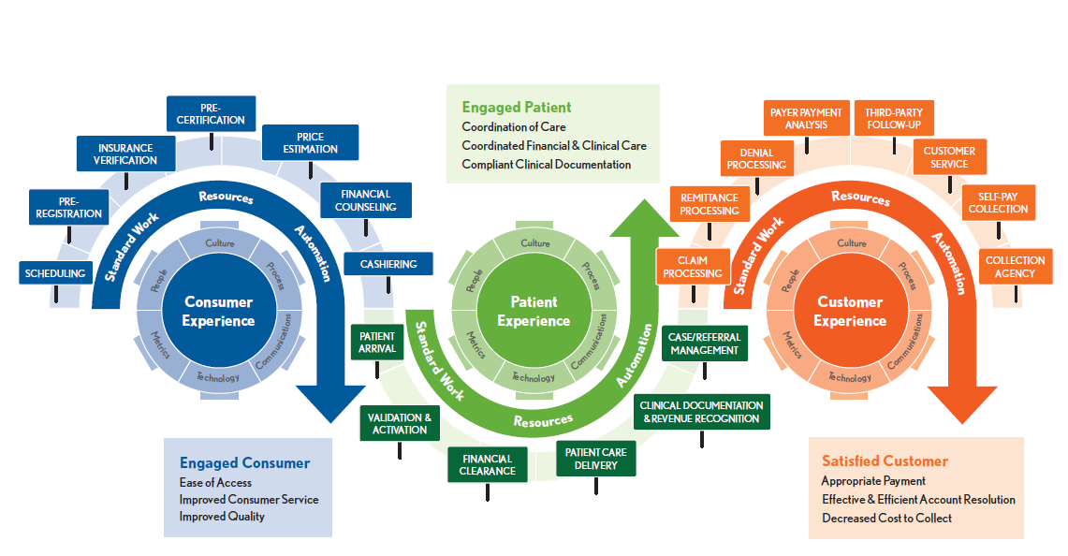
The Contemporary Revenue Cycle
The Contemporary Revenue Cycle
© 2016 HFMA
Notes:
That is the revenue cycle. It includes all of the major processing steps required to process a patient account from the request for service through zero balance.
Pre-service: Scheduling and pre-access processing set the stage for effective patient communication and data collection. During the pre-service segment, will be completed and the information will move from point to point. It is critical the providers optimize these steps to avoid downstream impact, such as denials, increased cost to collect, increased bad debt and dissatisfied patients.

Slide 5
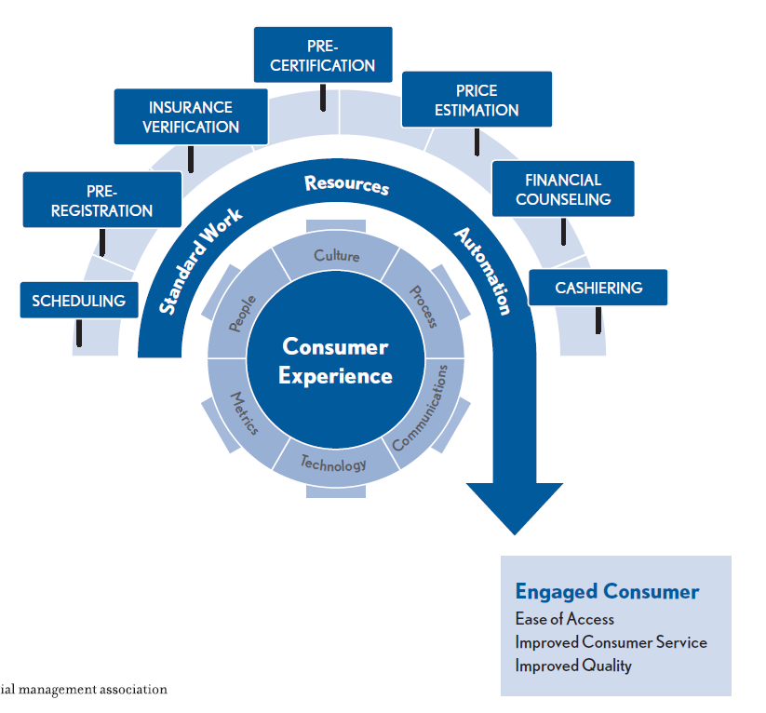
Engaging the Consumer
Notes:
Surprising patients with healthcare bills, like we did years ago, is not accepted anymore. In addition, we do disservice to our patients when we treat them clinically, but then financially bankrupt them with surprised billing.
The healthcare consumer landscape is changing. Consumers want to be known and understood in order to get a personalized healthcare experience. Therefore, understanding consumer attitudes and preferences across the healthcare journey is key for not only improving the experience but also for supporting healthy behaviors, achieving better outcomes, and remaining competitive.
Pre-service: Scheduling and pre-access processing set the stage for effective patient communication and data collection. During the pre-service segment, will be completed and the information will move from point to point. It is critical the providers optimize these steps to avoid downstream impact, such as denials, increased cost to collect, increased bad debt and dissatisfied patients
Scheduling and Pre-registration
Encounter record is generated and the patient and guarantor information is obtained and/or updated as required
Screen for Medical Necessity checking , healthcare plan coverage and benefits are verified and pre-authorizations are obtained
Estimates are created to inform the patient, in advance of the service, their cost, which will include a deductible, co-insurance, and/or co-payment amount. This should be done prior to service to help the patient make informed decisions, not be surprised by bills, and get assistance with payment as needed. In addition, when I was running my revenue cycle, many times patients, particularly in surgical events, are told to keep their personal items at home, which includes their wallet!
If not medically necessary, staff should reach out to see if additional dx’s are available to support coverage, or present the patient an ABN or a notice of non coverage

Slide 6
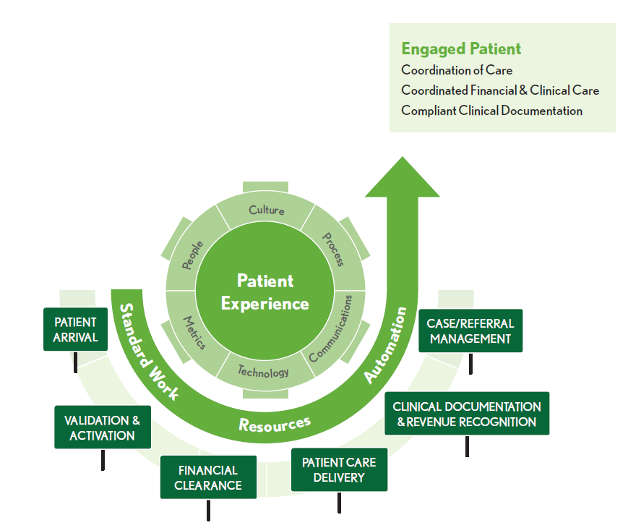
Engaging the Patient
Notes:
Time of Service
Ideally, the scheduled patient has been pre-registered and can go directly to the service unit, vs waiting in a main registration area. Consents are signed, and if not collected pre-service, agreed upon payments are made. Positive patient identification is completed, and the patient is given an armband, Unscheduled patients or non pre-registered will have to go through a comprehensive registration process.

Slide 7
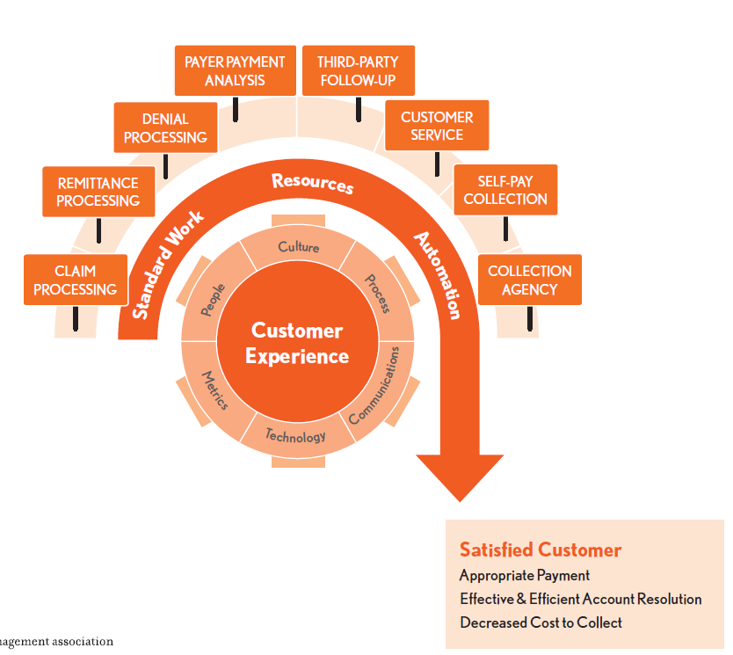
Engaging the Customer
Notes:
Post Service
Post service includes the account activities that occur after the patient is discharged until the account reaches a zero balance, such as final coding of all services provider, preparation and submission of claims, payment processing, and balance billing and resolution.
This process is so dependent on the actions that occurred pre-service and time of service, and providers should invest in optimizing processes and embracing technology that avoids re-work and increases cost to collect on the back end.
On the back end, patients want healthcare conversations and communication that are personable to them. No longer can we treat each patient the same, both in collection conversations, and modalities of communication- patients want more digital and multi modal channels of communication.

Slide 8
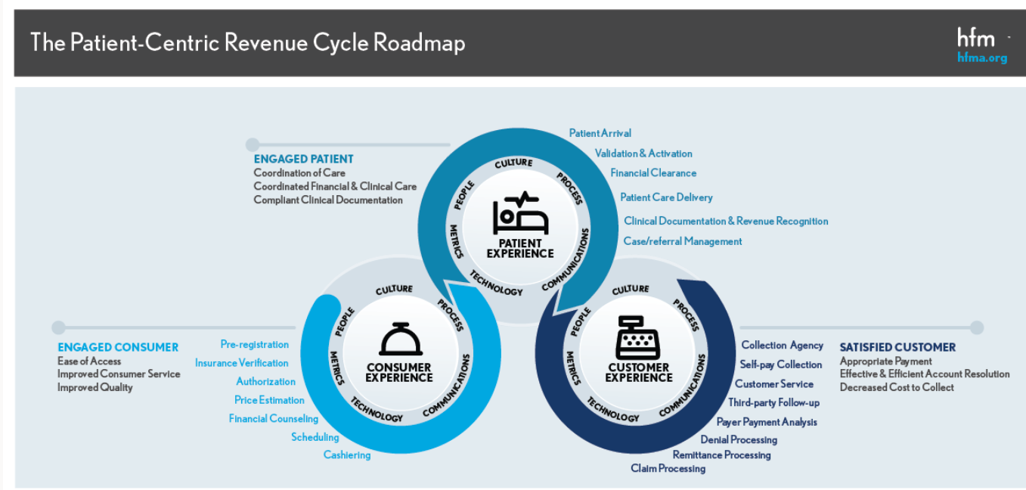
Patient Centric Revenue Cycle
Notes:
A patient-centric revenue cycle views the patient as a partner in the billing process and responds to the consumer mindset with clear communication and transparency about price and payment options
As a partner in the billing process, patients must understand their financial responsibilities and be held accountable for providing information for claims processing when required. Since healthcare is now viewed as a commodity, patients expect to understand costs up-front and have convenient and flexible payment options. They also expect claims processing and billing to be seamless. Even if the reason for a denial is due to misinformation on their part, any extra effort or frustration they experience to resolve a claim may encourage them to change providers in the future.

Slide 9
Key Points
Three segments of the revenue cycle: pre-service, time-of-service, and post-service
Pre-service is where scheduling and pre-access processing is completed.
In time-of-service a final account review is completed, or registration and financial processing is completed for unscheduled patients.
Account activities occur after is discharged in the post-service segment.

Slide 10
What happens during the post service stage?
Orders are entered, results are reported, charges are generated, and diagnostic and procedural coding is initiated
The encounter record is generated and the patient and guarantor information is obtained and/our updated as required.
Final coding of all services, preparation of claims, payment processing and balance billing and resolution.
The focus is on the patients and his/her financial care, in addition to the clinical care provided for the patient.
Notes:
Post-service is the third and final major segment of the revenue cycle. This segment includes the account activities that occur after the patient is discharged until the account reaches a zero balance.

Slide 11
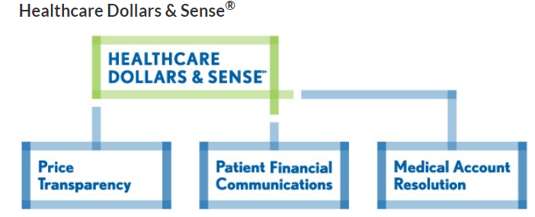
1.2: Healthcare Dollars and Sense
Identify the purpose and critical components of the HFMA Dollars and Sense initiative.
Identify the purpose and principles of: -patient financial communication best practices -price transparency -medical account resolution
Notes:
Now more than ever, people are asking about the price of healthcare. They are called on to make more decisions and pay more out of pocket costs for the services they receive. They are looking for the information they need to find and pay for quality care.
Healthcare Dollars and Sense aims to answer these questions- to help make sense of price and value in healthcare.

Slide 12
Patient Financial Communications
Consistency, clarity, transparency
When and Where to Have Patient Financial Discussions
Routine and Complex Scenarios
Routine Activities
The Provider-Patient Conversation
Notes:
These voluntary practices address the area where best practices are most urgently needed, focusing on financial discussions that take place in advance of healthcare service, at the time of service, in the ED, and in other care settings.
They provide definitive guidance about when and where patient financial discussions should take place and who should participate, and what the topics should be. First and foremost, it should respect patients privacy.
Of course, in the ED, no discussions should occur before a patient is screened and stabilized (EMTALA)
The Provider-Patient conversation should consist of the following:
Compassion, Communication, Written Follow Up, Compliance Framework and HFMA’s Adopter program.

Slide 13
Price Transparency
The Need for Pricing Transparency
The Importance of Pricing Transparency
Task Force Consensus
Notes:
This is certainly the hot topic providers are dealing with right now due to the CMS mandate to provide all charges in a machine readable format and 300 shoppable services as well.
The need for transparent healthcare pricing has never been more important, due to the need to help consumers make smart, educated decisions about the care they receive.
In order to provide a patient with information that is meaningful to them, several factors must be included:
The type of hospital service based on CPT or MS DRG code-
Total Charges
Contracts or fee schedules per health plan
Real time patient eligibility of patients current OOP
Recognizing the industry's need for guidance concerning this topic, HFMA convened a task force to develop two documents.
Price Transparency report
Consumer guide to healthcare prices
Both documents can be found in the resources section of this course.

Slide 14
CMS Price Transparency Mandate

Slide 15
No Surprises Act

Slide 16
Medical Account Resolution
Medical Account Resolution-Best Practices
Concluding Medical Account Resolution-Best Practices
Notes:
HFMA created the Medical Debt Task force that builds off of HFMA’s Patient Friendly billing work.
Best practices include:
Educate
Communication must be clear, concise, correct and patient friendly.
Establish policies and make sure they are followed internally.
Be consistent
Coordinate to avoid duplicative contacts.
Exercise good judgement.
Timing- start the clock when the first statement is sent.
Report and track, both to credit bureaus if needed and track all consumer complaints.

Slide 17
Key Points
Healthcare Dollars and Sense is the name given to three HFMA revenue cycle initiatives: -Patient Financial Communications -Price Transparency -Medical Account Resolution
Communication and sharing information with patients support higher levels of patient satisfaction.

Slide 19
Which option is not a main HFMA Healthcare Dollars and Sense Revenue Cycle Initiative?
Patient Financial Communications
Process Compliance
Medical Account Resolution
Price Transparency
Notes:
Process compliance.

Slide 20
Which items are not best practice?
Educate patients
Report to healthcare plans when patient account is transferred to collection agency.
Follow best practices for communication.
Exercise moderate judgement when communicating with providers about scheduled services.
Coordinate to avoid duplicative patient contacts.

Slide 21
1.3: Patient Experience and Satisfaction
Identify patients’ expectations related to the revenue cycle, the HCAHPS survey and the impact of communication and customer service to patient experience and satisfaction.
Recognize the strategies used by revenue cycle leadership and staff in improving overall patient experiences.
Identify the hard and soft costs to the provider of poor quality patient experiences.
Notes:
At the end of this course, you should be able to speak to these three bullets.
Patients expect value for their healthcare dollar, including greater transparency of quality and price information.
Patient satisfaction also means that patients understand the providers payment expectation and terms.

Slide 22
Today’s Patients as Consumers
Patient Satisfaction Metric within Industry (HCAHPS)
CMS
HCAHPS Survey
Notes:
HCAHPS is the Hospital consumer assessment of healthcare Providers and Systems initiative. The objective of the initiative is to provide a standardized method for evaluating patients perspective on hospital care.
For additional information, visit cms.gov and search for quality initiatives.
Of the 27, only one question encompasses the entire patient experience, which is “Would you recommend this hospital to your family and friends?

Slide 23
Revenue Cycle Team Members Role in Patient Satisfaction
Impact of Communication and Customer Service -Implement -Educate -Communicate
Treat that patient as you would wish to be treated.
Notes:
It is important to go the extra mile by creating patient friendly processes aimed at improving the overall patient experience.
Implement processes that are patient centric and efficient
Educate patient about insurance coverage , and OOP can alleviate concerns
Communicate financial information clearly, consistently and timely.

Slide 24
Cost of Poor Quality Patient Experiences
Hard – loss of revenue
Soft – negative experience passed on in various ways and to various audiences
Quality also has an impact in billing, physician and case management
Notes:
Hard cost is the loss of future revenue. Great clinical care can be eroded based on both the experience in the front end and back end collection efforts.
When I first started at UMMS, a patient called me and said that all they talk about at their parties is how bad their experience was with respect to both registration and billing. I wanted to say “you should” get new friends, but I held my tongue- and listened to his complaints and worked hard to correct it moving forward.
To improve quality and decrease back end billing, insurance verification, pre-cert and pre-auth should be done prior to service. Over 40% of the information on a claim is gathered by access services.

Slide 25
Impacts to Providers
Billing
Physician
Case Management
Legal Issues

Slide 26
Key Points
Patients are consumers with expectations
Patients want easy patient access and scheduling processes, and expect efficient and well-trained revenue cycle personnel
Expanding to a value-based payment model increases the need to satisfy patients’ expectations
Make the focus on clear communication, customer service, and quality
Notes:
Staff should receive extensive training in the art of welcoming behavior. They have a responsibility to efficiently and professionally gather all information necessary to support the patient intake process.
It is important to recognize that there is a significant organization cost if policies pertaining to communication, customer service, and quality assurance processes are not established, and legal issues can also arise. For example, if a patient is registered with the wrong MPI and the correct patient arrives in the ED and is allergic to penicillin, and it is given to them, then that can have serious legal issues.

Slide 27
What is the objective of the HCAHPS Initiative?
To provide a standardized method for evaluating patients perspective on hospital care.
To make certain that during registration, key information is verified by means of a picture ID and an insurance care.
To conduct evaluations concerning patients’ perspective on hospital care.
To provide clear communication and good customer service, which will give the provider a competitive edge.

Slide 28
1.4: Collaboration and Continuum of Care
Identify how information technology, clinical services, finance and health plan contracting work within the revenue cycle.
Identify programs and services that are part of the continuum of care.
Notes:
In this section, we’ll discuss departments and personnel with whom revenue cycle staff and leaders will work with in a patient centric revenue cycle.

Slide 29
Collaboration with Information Technology
Collaboration with Information Technology
Healthcare providers today are faced with an increasingly complex operating environment. IT provides a competitive advantage in several areas, including:
Streamlining operations
Increasing productivity
Assessing profitability by health plan and patient type
Providing quality care
Organizations that do not keep up with information technology may be faced with limitations on their ability to attract and retain patients.
Notes:
Healthcare providers today are faced with an increasingly complex operating environment. Using and optimizing technology provides a competitive edge and decreased costs by:
Streamlining operations
Increasing productivity
Accessing profitability by health plan and patient type
Providing quality care
Organizations that do not keep up with information technology may be faces with limitations on their ability to attract and retain not just patients, but staff.

Slide 30
Continuum of Care
Working Together
Philosophy
Coordination of Patient Care
Providers include: -Physician -Skilled Nursing Facility -Home Health Agency -Durable Medical Equipment -Hospice -Assisted Living
Notes:
Continuum of care is a way of coordinating and linking healthcare resources, facilitating a seamless movement among care settings. It seeks to implement linkages to connect patients who are leaving the acute care setting with post acute facilities and services.
The coordination of care has gained importance as alternative payment models expand to include bundle payments.
Physician offices provide the order, schedule the service, and obtain authorization.

Slide 31
Key Points
Information Technology enables healthcare providers to enhance patient experiences through efficient scheduling, tracking and reporting
Clinical Services prepare for and serve the patient, as well as confirm the accuracy of the patient’s information in a timely manner
Finance provides analysis and reporting to ensure compliance
Notes:
Common software applications include but are not limited to:
Scheduling
Admit, discharge and transfer system ( ADT )
Pre bill editing
Electronic claim generation
Payment tracking
Exception based workqueus
AR management
Cash posting
Denials
Refunds
Collection transfers
Some EMR’s will state they don’t require bolt on’s- pretty much an incorrect statement. Additional bolt on’s are:
Electronic Eligibility Verification
Estimation calculator
Automated Prior Authorization
Computer Assisted Coding
Charge Integrity
Claim scrubbers
Automated Claim Status ing
Denial and Appeals support
Analytics
As patients become more comfortable with the internet they are demanding online access. They expect providers to offer online scheduling, bill payment and customer chat, to name a few.
Collaboration with Clinical Services
Although focused on the clinical needs of the patient, as they should be, a number of their activities support revenue cycle as well. Some examples include:
Review patient chart and armband to ensure accuracy.
Obtaining consent, especially surgery.
Entering charges accurately and timely.
Documenting care
Collaboration with Finance
They are usually responsible for compliance with state and federal reimbursement reporting requirements. But they also provide modeling for contract negotiations, and estimates the impact of regulatory changes on the providers financial performance.

Slide 32
Key Points
Continuum of care is a way of coordinating and linking healthcare resources to avoid duplication, thus facilitating a seamless movement among care settings
Continuum of care involves healthcare professionals in multiple settings at multiple levels working together with the overall goal of coordinating patients’ healthcare

Slide 33
Which is not a department that supports and collaborates with the revenue cycle?
Clinical Services
Finance
Assisted Living
Information technology
Notes:
Assisted living is a non acute care residential service typically part of the continuum of care for a select group of patients.

Slide 34
Which option is not a continuum of care provider?
Hospice
Health Plan Contracting
Physician
Skilled Nursing Facility
Notes:
#2

Slide 35
1.5: Compliance & HIPAA Regulations
Identify the purpose of essential elements in a corporate compliance program.
Identify the purpose and elements of an Office of the Inspector General (OIG) work plan.
Identify the purpose and elements of HIPAA.
Notes:
We’ll talk about:
Rise in corporate compliance programs, including their complexity and importance
Components of the programs
Role of the Compliance officer
HIPAA, including electronic transaction code sets, and privacy and security components
They cover the key risk areas that are perceived to lead to potential fraud and abuse. Such risk areas include:
Upcoding of MS-DRG assignments
Inaccurate or incorrect coding
Bundling/unbundling of services
Duplicate billing
Billing for medically unnecessary services
Waiving of deductibles or copayments to entice business
Insufficient documentation

Slide 36
Introduction to Compliance
Guidance Documents
Essential Elements
Compliance Planning
Notes:
Believing that organizations are ultimately in the best position of self police, the Office of Inspector General developed the model Compliance plan for labs in 1997, and for hospitals in 1998, followed by a dozen other guidance documents, for pretty much every type of healthcare provider and service provider, like DME and pharmacy.
They cover the key risk areas that are perceived to lead to potential fraud and abuse. Such risk areas include:
Upcoding of MS-DRG assignments
Inaccurate or incorrect coding
Bundling/unbundling of services
Duplicate billing
Billing for medically unnecessary services
Waiving of deductibles or copayments to entice business
Insufficient documentation
There are 16 essential elements:
Self reporting
Culture that encourages reporting
Compliance officer
Oversight
Written procedures, including an employees code of ethics
Training
Hotline
Exercise due diligence with sanctioned individuals
Monitoring systems
Established standards and procedure
Must be in writing
Effective Plan
Discretionary authority
Independent evaluations
Disciplinary measures
Audit plan
Essential Elements.
If you don’t follow the plan_ in 2017, The federal justice department recovered 2.6Billion for allegedly providing unnecessary or inadequate care, paid kickbacks to healthcare providers to induce the use of certain goods and services, and overcharged for goods and services paid for by Medicare, Medicaid and other federal healthcare programs.

Slide 37
Compliance Programs
Key risk areas that can lead to potential fraud and abuse for
hospitals and providers include:
Upcoding of MS-DRG assignments
Inaccurate or incorrect coding
Bundling/unbundling of services
Duplicate billing
Billing for medically unnecessary services
Waiving of deductibles to entice business
Insufficient documentation
Notes:
Highlight the key risk areas in the billing area
A comprehensive plan along the lines suggested by the OIG indicates that an organization is serious about being compliant with regulations and may serve to keep the federal government from dictating a plan for it. It will also insulate the hospital from violations of False Claims (Fraud and Abuse) regulations

Slide 38
Compliance Program Elements
Regular, comprehensive training
“Hotlines” or other means of receiving anonymous communications about compliance issues
Mechanisms for monitoring compliance, including independent evaluations
Communicating standards and procedures internally
Notes:
Note the essential elements of a compliance program; tie to the organization’s program and policies, e.g. provide copies of the policies and procedures and then review

Slide 39
Compliance Program Elements
Self-reporting of adverse administrative events
A corporate culture that encourages the constructive identification of potential or actual violations
Full support by the entire organization
Oversight of personnel by high-level personnel
Written policies and procedures, including an employee code of ethics
Notes:
The purpose of a compliance program is to create a program that is transparent, clearly articulated, and emphasized at all employee levels as a seriously held personal and organizational responsibility, one that relies on full communication inside and outside the organization.
Note the essential elements of a compliance program; tie to the organization’s program and policies, e.g. provide copies of the policies and procedures and then review

Slide 40
Which of the following are not essential elements of a compliance program?
Reasonable methods to achieve compliance
Established compliance standard and procedures
Automatic dismissal of any employee excluded from participation the federal healthcare program
Oversight by high level personnel
Designation of a compliance officer employed within the Billing Department
Notes:
#3 and 5

Slide 41
Code of Conduct
Areas of Focus: -Human resources -Privacy/confidentiality -Quality of care -Billing/coding -Conflicts of interest -Laws/regulation
Benefits of the Code of Conduct
Role of the Chief Compliance Officer (CCO)
Notes:
The code of conduct is believed to be the backbone of the organizations compliance program.
The code of conduct, if implemented effectively and enhanced as needed, can reduce weaknesses by helping employees and agents understand their roles and responsibilities while fostering an environment where concerns and questions are raised without fear of retaliation or retribution. It is a living, breathing embodiment of the program.
In the most effective programs, the CCO reports directly to the Board of Directors/Trustees so they can maintain independence.

Slide 42
Office of the Inspector General
Identifies opportunities to improve programs and holds accountable those who do not meet federal standards
Publishes an annual work plan with specific tasks
Violations of the OIG Work Plan result in issuance of Corporate Integrity Agreements
Notes:
The OIG was created to protect the integrity of HHS.
Identify and hold accountable those who do not meet program requirements.
Publish an annual statement of work but is now updated, as needed, on a monthly basis.
Some examples of work plan include initiatives related to:
Prescription opioid drug abuse
Medicare payments made outside of Hospice
Denials and appeals in Medicare Part D
Some well known names that were issued Corporate integrity agreements included Tenet, National Health Laboratories and U of Penn.

Slide 43
HIPAA
Health Insurance Portability and Accountability Act (HIPAA) Goals
Expand health coverage by improving the portability and continuity of health insurance coverage in group and individual markets
Give patients access to their health files and the rights to request amendments or make corrections
Facilitate electronic exchange of medical information
Notes:
Goals of HIPAA are:
Protection of patient information
Restrictions of access to PHI
BAA’s in place

Slide 44
Transaction Sets
The final rule on transactions standardized the electronic formats so that data, remittance advice, and claims information could be transmitted using one type of electronic format
Notes:
I usually state there is no standardization in the ANSI transaction set, but the rule was intended to do that.

Slide 45
Transaction Sets
Transaction/Code Set Name ID Number
Healthcare claim transactions 837
Enrollment and disenrollment in a health plan 834
Healthcare benefit/eligibility inquiry and response 270/271
Healthcare claim payment and remittance advice 835
Health plan premium payments 820
Health claim status request and response 276/277
Referral certification and authorization 277/278
Claim 837
Notes:
-The final rule adopted standards for eight electronic transactions and code sets that are to be used throughout the healthcare industry

Slide 46
Standard Unique Employer Identifier
The use of a unique employer identifier is required under HIPAA. The rule adopts the employer identification number assigned by the IRS to be used in standard transactions to identify the employer of an individual described in a transaction, such as the transmission of enrollment information to a health plan.
Notes:
On May 31, 2002, HHS released its final rule, Health Insurance Reform: Standard Unique Employer Identifier. The use of a unique employer identifier is required under HIPAA. The rule adopts the employer identification number assigned by the IRS to be used in standard transactions to identify the employer of an individual described in a transaction, such as the transmission of enrollment or disenrollment information to a health plan.
- Any business required to furnish a taxpayer identification number (meaning that wages are paid to one or more employees) must use an Employee ID Number (EIN) as its taxpayer identifying number. The compliance date for the implementation for most covered entities was July 30, 2004 (August 1, 2005, for small health plans).

Slide 47
National Provider Identifier (NPI)
The NPI is a unique identification number for covered healthcare providers.
NPIs are used in the administrative and financial transactions adopted under HIPAA.
Notes:
- The National Provider Identifier (NPI) is a HIPAA Administrative Simplification Standard. The NPI is a unique identification number for covered healthcare providers. Covered healthcare providers and all health plans and healthcare clearinghouses will use the NPIs in the administrative and financial transactions adopted under HIPAA. The NPI is a 10-position, intelligence-free numeric identifier (10-digit number). This means that the numbers do not carry other information about healthcare providers, such as the state in which they live or their medical specialty. Beginning May 23, 2007, the NPI must be used in lieu of legacy provider identifiers in the HIPAA standards transactions

Slide 48
Privacy of Health Information
Define protected health information and access thereto by individuals, payers, and business associates -- provide training
Ensure that training is based on the job responsibilities of staff who handle protected health information.
Ensure that a privacy officer is hired/designated
Ensure that a contact person is hired/designated to handle questions or concerns regarding the protection of personal health information
Notes:
- Provide training to all staff within the organization on its policies and procedures governing HIPAA compliance
- Define protected health information and access thereto by individuals, payers, and business associates
-Ensure that training is based on the job responsibilities of staff who handle protected health information. The only exception to training staff is if an organization is a group health plan (that provides only benefits and does not create or receive protected health information other than in the form of enrollment or disenrollment information), they are exempt from having to provide training to their staff
Ensure that a privacy officer is hired/designated
Ensure that a contact person is hired/designated to handle questions or concerns regarding the protection of personal health information

Slide 49
Security of Health Information
HIPAA specifies a series of administrative, technical, and physical security procedures for covered entities to use to ensure the confidentiality of electronic protected health information.
Notes:
The Administrative Simplification provisions of HIPAA Title II required the Department of Health and Human Services (HHS) to establish national standards for the security of electronic healthcare information. The final rule adopting HIPAA standards for security was published in the Federal Register on February 20, 2003. This final rule specifies a series of administrative, technical, and physical security procedures for covered entities to use to ensure the confidentiality of electronic protected health information. The standards are delineated into either required or addressable implementation specifications.

Slide 50
Key Points
Compliance plan required
Revenue Cycle staff are required to understand the importance of compliance, especially Medicare rules
HIPAA requires privacy and security of information and use of electronic transaction standards
Notes:
Each healthcare organization has a compliance program. Within the revenue cycle, staff need to understand the importance of compliance with federal and state program requirements. Medicare program issues related to the Three-Day Window, One-Day Window, Medicare Secondary Payer, and Advanced Beneficiary Notices, as well as CCI rules, are keys to compliant claims processing. HIPAA requirements for privacy and security, as well as the opportunities presented through the electronic transaction sets, also impact revenue cycle operations.

Slide 52
Identify which option is not a work plan task mentioned in this course.
Reconciliation of Outlier Payments
Denials and Appeals in Medicare Part C
Medicare Payments made outside of the hospice benefit.
Denials and appeals in Medicare Part D.
Notes:
Reconciliation of Outlier payments to enable Medicare contractors to perform final settlement of the hospitals associated cost reports.

Slide 54
1.6: Medicare Compliance & Regulations
Identify Medicare compliance issues specific to the patient-centric revenue cycle.
Identify coding issues specific to the patient-centric revenue cycle.
Notes:
In this course we will address:
Specific Medicare compliance and coding issues
Terms such as:
MS-DRG window
Two-Midnight Rule
Correct Coding Initiative (CCI)
Modifiers
Medicare Secondary Payer (MSP

Slide 55
DRG Window
Known as the “Three-Day Rule”
Basics to keep in mind:
Non-diagnostic outpatient serves
Diagnostic services provided
Defining “three days”
Notes:
Basic things to keep in mind regarding the Three-Day Window rule:
Any non-diagnostic outpatient service, is considered related to the admission if it uses the same ICD-9-CM diagnosis code as the principle diagnosis for the hospital admission.
All diagnostic services and related charges provided within the window are considered to be related. These include radiology, cardiology, clinical laboratory, EEG, pulmonary function and audiology tests. Related charges include anesthesiology and drugs used to provide radiology or other diagnostic services
Services are considered to fall within the window if they are dated within three days before the date of the admission, or on the date of admission. For example, if the admission is on Wednesday, any services provided on Sunday, Monday, Tuesday and before the time of admission on Wednesday are within the billing window.
Ambulance, maintenance renal dialysis, and Part A services provided by a nursing home are not considered related.

Slide 56
Specific Medicare Compliance Issues
Medicare as Secondary Payer (MSP)
Medicare, from the beginning, has required payers in certain defined situations to pay the entire claim
MSP requirements are clearly defined as well
Notes:
From the beginning of the Medicare program, certain payers have always been liable for payment of claims. More recently, with the enactment of the Medicare Part c, or Medicare Advantage plan option, this principle has been expanded to include:
-Work-related injuries and accidents (workers’ compensation claim)
-Black Lung program services
-Veterans Affairs services
-Patient’s enrollment in a Medicare Advantage plan
-Federal grant programs
-Public Health Service programs
In these cases, Medicare does not make a secondary payment. The amounts paid by the primary payers are considered payment in full. In recent years, the OIG has been reviewing these claims to ensure compliance with the MSP rules.

Slide 57
MSP Situations
Working aged
Accident or other liability
Disability
End-Stage Renal Disease (ESRD)
Notes:
The Medicare Secondary Payer situations.
Working Aged: The patient aged 65 or more (or spouse) is employed and the patient has GHP coverage through The workplace. A GHP is a group health insurance plan provided by an employer that has 20 or more employees.
If the employer has less than 20 employees, the GHP does not qualify as the primary payer and Medicare is billed as primary.
The patient is not required to accept the employer’s insurance coverage; in that case, Medicare would be primary.
The employer is prohibited from offering a supplemental policy in place of the standard group health plan benefits offered to other employees.
Accident or Other Liability: When the patient needs medical care as the result of an accident, the liability insurance company may be responsible for payment. Automobile accidents as well as premise accidents are included in this MSP category. Healthcare providers are required to obtain the billing information for the liability carrier. Liability is prime only if the accident did not occur on patient’s own property and if the patient states there is liability. . Required coding on the UB-04 includes the occurrence code and the date of the accident. If no medical payment or other third-party coverage exists, occurrence code 05 and the date of the accident or injury must be provided.
Disability: The patient is eligible for Medicare due to a disability, is under the age of 65, and has group health insurance coverage through a large group health plan (LGHP). An LGHP is a group health insurance plan provided by an employer that has 100 or more employees.
Patient is under the age of 65
Patient (or spouse) has current employment status with employer
If the employer has less than 100 employees, the GHP does not qualify as the primary payer and Medicare is billed as primary
End-Stage Renal Disease (ESRD): The patient has permanent kidney failure, is covered by a GHP, and has not completed the 30-month coordination period. Note: after completion of the 30-month coordination period, Medicare becomes the primary payer, unless another MSP condition exists.
Insurance must be a qualifying GHP
Must still be in the 30-month coordination period
DRG Window
Under Medicare rules, certain outpatient services provided by hospitals or by entities owned or controlled by hospitals must be billed as part of an inpatient stay. These include:
All diagnostic tests provided to a Medicare beneficiary by a hospital on the date of the beneficiary’s inpatient admission or during the 3 calendar days immediately preceding the date of admission, unless there is no Part A coverage
Outpatient services that are not diagnostic provided to a Medicare beneficiary by a hospital on the date of the inpatient admission or during the three days immediately preceding the date of admission
Other names for this policy include DRG window, three-day window, 72-hour rule, one-day window, and 24-hour rule. Hospitals may not bill services provided within this window under Medicare Part B (physician and outpatient insurance) if the patient has Part A coverage (inpatient insurance).

Slide 58
Medical Necessity Screening and ABNs
Medicare program pays only for medically necessary services
Providers are expected to screen services for compliance with Medicare coverage rules
Advanced Beneficiary Notice (ABN)
Notes:
The Medicare program pays only for medically necessary services. Therefore, providers are expected to screen outpatient services for compliance with Medicare coverage rules. If an ordered service does not meet medical necessity based on the test and diagnostic information provided, the provider is required to issue the appropriate Advanced Beneficiary Notification (ABN).

Slide 59
ABN Requirements
Wording
Specificity
Determining information
Timeliness
Understandable
Comply with CMS form
Notes:
An ABN must:
- Follow the wording provided by CMS to ensure that the text is easily understood
- Clearly identify the specific test or services identified as non-payable
- Provide the information used to determine that Medicare may not pay for the test or service previously identified
- Be provided to the patient far enough in advance to allow time for the beneficiary to make an informed decision
- Be understood by the patient or the patient’s designee
- Comply with the use of the form provided by CMS for this process

Slide 60
The Two- Midnight Rule
Notes:
Traditionally, the decision to admit a patient as an inpatient has been up to the judgment of the treating physician, with oversight from the hospital and input from the patient.
CMS recovery audit contractors (RACs) and Medicare administrative contractors (MACs) had a tendency to second-guess physician judgment, declaring that some patients who were admitted should not have been.
This has created ambiguity over who decides what constitutes an appropriate admission and what the criteria are for making such a determination.

Slide 61
CCI, Modifiers, and CPT/Revenue Code Issues
Centers for Medicare and Medicaid Services (CMS) developed the Correct Coding Initiative (CCI)
The purpose of the CCI is to ensure that the most comprehensive groups of codes, rather than the component parts, are billed.
Notes:
In order to promote the use of correct coding methods on a national basis and prevent payment errors due to improper coding, the Centers for Medicare and Medicaid Services (CMS) developed the Correct Coding Initiative (CCI). The purpose of the CCI is to ensure that the most comprehensive groups of codes, rather than the component parts, are billed.
The program consists of edits that are implemented within providers’ claim processing systems. The CCI edits are incorporated within the outpatient code editor. The edits also check for mutually exclusive code pairs. The unit-of-service edits determine the maximum allowed number of services for each Healthcare Common Procedure Coding System (HCPCS) code.
Using a modifier allows a hospital to indicate a specific circumstance that has affected a procedure or service without changing its definition or code. The appropriate use of modifiers reduces the need for separate procedure listings on a bill by describing the modifying circumstance.

Slide 62
Key Points
Medicare DRG Three-Day Window Rule focuses on certain outpatient services to be billed as part of an inpatient stay
The ABN informs a Medicare beneficiary before receiving specified items or services regarding payment status
Medicare acts as a secondary payer in certain situations
Correct Coding Initiative (CCI) developed by Centers for Medicare and Medicaid (CMS)
Notes:
As you move on, please keep in mind the following points.
The Three-Day DRG Window Rule requires certain outpatient services that are provided within three days of the admission date, by hospitals or by entities wholly owned or controlled by hospitals, to be billed as part of an inpatient stay.
The purpose of the ABN is to inform a Medicare beneficiary “before he or she receives specified items or services that might otherwise be paid for” that Medicare certainly or probably will not pay for those items or services on that particular occasion.
The situations where Medicare acts as secondary payer include:
Working Aged
Accident or Other Liability
Disability
End-Stage Renal Disease (ESRD)
In order to promote the use of correct coding methods on a national basis and prevent payment errors due to improper coding, the Centers for Medicare and Medicaid Services (CMS) developed the Correct Coding Initiative (CCI).
The purpose of the CCI is to ensure that the most comprehensive groups of codes, rather than the component parts, are billed.

Slide 63
In order to promote correct coding, CMS developed what?
The correct coding initiative (CCI)
The Advance Beneficiary Notice of Noncoverage (ABN)
The Medicare Secondary Payer (MSP)
Modifiers
Notes:
A. The purpose of the CCI is to ensure that the most comprehensive groups of codes, rather than the component parts, are billed. The program consists of edits that are implemented within providers’ claim processing systems. The CCI edits are incorporated within the outpatient code editor. The edits also check for mutually exclusive code pairs.

Slide 64
1.7: Ethics
Define business or organizational ethics.
Identify the resources used to guide the application of ethics.
Identify ethics issues or violations as they pertain to the revenue cycle.
Notes:
In this section we will address:
Business or organizational ethics.
The application of ethics in healthcare and the revenue cycle.

Slide 65
Ethics
Why talk about it?
What to talk about? -Health Care Complexity -Resources to Review -Ethics Issue Awareness -Interpretation of Ethical Behavior
Notes:
Why Talk About Ethics?
Our society is changing at a rapid pace:
Expanding global economy
Increasing workplace diversity
Expansion of the information highway
Increasing technology
Unique generational differences
As a result, defining and applying ethical business practices and principles is important to all industries.
Healthcare services are important to both individuals and our society and as a result, healthcare providers and those that work in the healthcare industry have additional ethical duties to the patients and communities they serve

Slide 66
Ethics Violations Examples
Financial misconduct
Overcharging
Theft of property
Falsifying records to boost reimbursement
Miscoding claims
Privacy violations
Notes:
Examples of ethics violations which may occur that impact the revenue cycle include:
Financial misconduct
Overcharging
Theft of property
Falsifying records to boost reimbursement
Miscoding claims
Provider policies and procedures should be in place to reduce the risk of these types of violations; however, it is just as important to be aware that an individual’s experiences and value system may impact his/her actions and result in non-compliance.

Slide 67
HIPAA
Examples:
Using Personal email account with patient information
Access EHR for valid reasons
Cannot review your own record or family

Slide 68
Key Points
Ethical behavior is important, especially in health care
Ethical standards are hoped for and expected by staff and management in health care
It is important for staff and management to uphold the business ethics of the provider and act as peer role models
Notes:
Business ethics or organizational ethics represent the principles and standards by which organizations operate. Business or organizational ethics are relevant to the conduct of individuals within an organization.
Examples of ethics violations which may occur that impact the revenue cycle include:
Financial misconduct
Overcharging
Theft of property
Falsifying records to boost reimbursement
Miscoding claims
Other points to keep in mind include:
Ethical behavior, which is considered to be actions that are the right thing to do, not just what is required by a law, regulation or rule, is very important in healthcare.
The concept of ethical standards applies to actions that are hoped for and expected by each individual staff and management member within healthcare.
It is important for staff and management to uphold the business ethics of the provider and act as peer role models.

Slide 69
What do business/organizational ethics represent?
Principles and standards by which organizations operate
A healthcare providers practices and principles
An employees actions influenced by experiences and value system
The patient privacy standard within healthcare.
Notes:
A, In healthcare, both clinical and financial personnel must be fully aware and engaged in the laws and regulations that govern their work. Business or organizational ethics are relevant to the conduct of individuals within an organization.

Slide 71
1.8: Volume to Value
Recognize the major provisions of the Affordable Care Act.
Identify the purpose of an Accountable Care Organization (ACO) and current types being tested.
Identify the purpose and participants of the Standard Quality Measures.
Notes:
In this course we will address:
The broad provisions of the Affordable Care Act (ACA) of 2010.
CMS’s proposed alternative delivery and payment models.
Standard Quality Measures.

Slide 72
Overview of the Affordable Care Act
The Patient Protection and Affordable Care Act, also known as the Affordable Care Act or ACA, was passed and signed into law in 2010. It was designed to reform the healthcare system into a system that rewards greater value, improves the quality of care and increases efficiency in the delivery of services.
Notes:
The Patient Protection and Affordable Care Act of 2010 (PPACA)
The Patient Protection and Affordable Care Act, also known as the Affordable Care Act or ACA, was passed and signed into law in 2010. It was designed to reform the healthcare system into a system that rewards greater value, improves the quality of care and increases efficiency in the delivery of services.

Slide 73
ACA Provisions
Improving the quality of care is one of the major cost containment provisions of the Act.
Another cost containment provision of the act is reforming the healthcare delivery system.
The Act also has the goal of encouraging price transparency and modernized financing systems.
Addressing waste, fraud, and abuse is another goal of the ACA.
Notes:
The act includes provisions to:
Improve the quality of care
Reform the healthcare delivery system
Encourage pricing transparency and modernized financing systems, and
Address the issues of waste, fraud, and abuse
More details are in your online CRCR course.

Slide 74
Improving Quality of Care
Quality of care improvements include:
Reducing hospital readmissions.
Reducing hospital acquired conditions.
Comprehensive Joint Replacement and Cardiac Services
Improving physician quality reporting.
Notes:
Over the next 10 years, these improvements will not only improve the quality of care provided but also reduce Medicare spending by more than $15 billion.

Slide 75
Reforming the Delivery System
Notes:
Another cost containment provision of the ACA is reforming the healthcare delivery system.
Reformation of the healthcare delivery system includes:
Establishing regulations for the development and financing of Accountable Care Organizations (ACOs).
Developing new approaches to payment and delivery systems through the Center for Medicare and Medicaid Innovation.

Slide 76
Center for Medicaid Innovation
Notes:
The Center for Medicare and Medicaid Innovation is charged with the ongoing development of new models for delivery and payment of services. Targeted innovations involve quality improvements and/or increases to efficiencies that could be expanded throughout the healthcare system.

Slide 77
ACO Types
Medicare Shared Savings Program
Next Gen ACO
Investment Model ACO
Comprehensive ESRD Care Model
Notes:
An Accountable Care Organization (ACO) is a delivery system of physicians, hospitals, and other healthcare providers, who work collaboratively to manage and coordinate the care of a patient population. The point of this collaboration is to ensure:
Appropriateness of care
Elimination of duplicate services
Prevention of medical errors for a population of patients
Examples of various ACO’s are listed that are currently being tested.

Slide 78
Volume to Value
Other Non-demonstration Pay-for-Performance Programs -Hospital Value Based Purchasing -Hospital Readmission Reduction Program -Physician Quality Reporting
Episode Based Payment Initiatives -Bundled Payments for Care Improvement (BPCI) -Comprehensive Care for Joint Replacement
Notes:
HVBP is a CMS initiative that rewards acute care hospitals with incentive payments based on how closely best clinical practices are followed and how well hospitals enhance patients experience of care during hospital stays.
HRRP – CMS is required to reduce payments to hospitals with excessively high rates of avoidable readmissions.
PQR- provides financial incentive to physicians for reporting quality data to CMS. In 2015, incentives were eliminated and Medicare payments were reduced for those physicians who did not satisfactorily report quality data.
CMS used learnings from the first BPCI models to launch the Bundled Payment for Care Improvement Advanced Model (BPCI-A) in 2018. BPCI Advanced operates under a total-cost-of-care concept, in which the total Medicare fee for services (FFS) spending on all items and services furnished to a beneficiary during a clinical episode, including outlier payments, will be part of the episode expenditures for purposes of the target price and reconciliation
The Comprehensive Care for Joint Replacement (CJR) model aims to support better and more efficient care for beneficiaries undergoing the most common inpatient surgeries for Medicare beneficiaries: hip and knee replacements (also called lower extremity joint replacements or LEJR).

Slide 79
Medicare’s Pay-for-Performance Initiatives
Standardized Quality Measures -Critical component of CMS initiatives -Promote systemic adherence to quality goals that include effective, safe, efficient, patient-centered, equitable and timely health care -Variety of stakeholders worked to develop the Standardized Quality Measures
Notes:
The Standardized Quality Measures are a critical component of the CMS initiatives. Quality measures are tools that help us measure or quantify healthcare processes, outcomes, patient perceptions, and organizational structure and/or systems that are associated with the ability to provide high-quality health care and/or that relate to one or more quality goals for health care.

Slide 80
Key Points
An ACO is a delivery system of physicians, hospitals and other healthcare providers to manage and coordinate the care of a patient population.
The ACA was designed to reform the healthcare system into one that rewards greater value, improves the quality of care and increases efficiency in the delivery of services
CMS has set a target of moving Medicare payments from volume-based to value-based payments and increasing the types of alternative payment models which include value-based payments
Quality is an integrated part of the changes involved in the volume to value initiatives

Slide 82
What is the intended outcome of collaborations made through an ACO?
To ensure appropriateness of care, elimination of duplicative services, and prevention of medical errors.
To create cost-containment provisions to reform the healthcare delivery system.
To reform the healthcare system into a system that rewards greater value, improves the quality of care and increases efficiency in the delivery of services
To provide financial incentives to physicians for reporting quality data to CMS.
Notes:
A. By meeting established benchmarks for quality and efficiency, participating organizations may receive a share of the savings generated by reducing duplicative services, improving productivity, minimizing paperwork, and other cost efficiencies.

Slide 83
1.9: Financial Overview
Identify the basic components on a healthcare provider’s financial reports.
Recognize the difference between terms gross accounts receivable (A/R) and net A/R.
Identify the concepts related to establishing “reserves” for contractual allowances, bad debts, and charity, and determine how they are presented on financial statements.
Notes:
n this course we will address:
The various financial reports governed by a number of regulations defined by various boards and commissions.
Gross revenue, net revenue, and calculations used to determine amounts for reporting.

Slide 84
Financial Reports
Income Statement -Revenue -Expenses -Profits
Balance Sheet -Asset -Liabilities -Equity
Cash Flow Statement -Operation -Investment -Financing
Notes:
The purpose of financial reports is to present information that may be used by others to make determinations regarding the financial status of an organization. Financial reports are governed by a number of regulations, including those defined by:
The Securities and Exchange Commission (SEC) The Financial Accounting Standards Board (FASB) Generally Accepted Accounting Principles (GAAP)

Slide 85
Accounting Methods
Accrual: Revenue recorded when it is earned to permit the alignment of revenue with associated expenses.
Cash: Revenue recorded when payment received.
Fund: Record-keeping method to manage categories of net assets to ensure compliance with the restrictions on those funds.
Notes:
In accrual accounting, revenue is recorded when it is earned to permit the alignment of revenue with the associated expenses. Healthcare providers generally use accrual accounting
Cash accounting records revenue when payment is received.

Slide 86
Gross and New Revenue
Gross Revenue: Total charges entered for all patients for the services they received.
New Revenue: Estimate the dollar amount of contractual, discount, or other allowances against gross revenue.
Notes:
To accurately report revenue, a provider must be able to calculate the difference between gross revenue and net revenue.

Slide 87
Gross and Net Revenue
Estimating Net Receivables
Reserve Amounts on a Provider’s Financial Statement -Contractual Allowances -Bad Debts -Charity Care
Importance of Calculating Reserves
Contra-Account Amounts
Notes:
To determine net revenue, financial services must estimate the dollar amount of contractual, discount or other allowances that will be applied against those revenues. With the implementation of ASC 606 change to the accounting rules governing the calculation of net revenue, revenue cycle may continue to use the terminologies of contractual adjustments, bad debts and charity, but the finance terminology and methodologies will be changed. These changes are reflected in a change in financial statement presentations concerning net revenue. ASC 606 creates two types of adjustment to incurred charges: explicit price concessions and implicit price concessions

Slide 88
Bad Debt vs. Charity Care
Notes:
Bad debts represent the portion of the patient liability which cannot be collected from the patient. These amounts represent a failure to pay and not an inability to pay on the part of the patient
Charity care represents care provided to a patient who does not have the ability to pay for the services or portion of the services received.

Slide 89
Key Points
To determine gross revenue, the charges for all the services that patient has received is totaled.
To determine net revenue, financial services estimate the dollar amount of contractual, discount or other allowances that will be applied against those revenues.
Reserve amounts are reported on the provider’s financial statement as Contractual Allowances, Bad Debts, and Charity Care.
Notes:
As you move on, please keep in mind the following points.
In order to report a provider’s revenue accurately, it is important to calculate the difference between gross revenue and net revenue.
To determine gross revenue, the charges for all the services that a patient has received is totaled.
To determine net revenue, financial services estimate the dollar amount of contractual, discount, or other allowances that will be applied against those revenues.

Slide 90
Which of these statements describes the new methodology for NPR?
A. Net patient service revenue is defined as the average payment amount for the payer but not recorded until the end of the month processing is completed.
B. Gross patient service revenue is recorded as net patient service revenue until such time as all payments are received.
C. Net patient service revenue is defined as the total incurred charges, less the explicit price concession, less any applicable implicit price concession(s) as applied to the specific portfolio of accounts.
D. Net patient service revenue is gross revenue minus any contractual adjustments applicable to the account. Any additional adjustments are not recorded until the account reaches a zero balance.
E. Net patient service revenue is the sum of the balances of all charges and payments recorded in the accounting period.
Notes:
C. Net patient service revenue is now defined as the total incurred charges, less the explicit price concession, less any applicable implicit price concession(s) as applied to the specific portfolio of accounts

Slide 91
1.10: Key Performance Indicators
Identify the purpose of Key Performance Indicators (KPIs).
Identify the components of an accounts receivable (A/R) aging analysis.
Identify the calculation used to determine the days of revenue in A/R.
Notes:
In this course we will address:
Key performance indicators (KPIs) and benchmarking in revenue cycle management.
The various techniques used to measure revenue cycle management.

Slide 92
HFMA MAP Keys
Notes:
The hospital and system MAP Keys® are strategic KPIs that set the standard for patient-centric revenue cycle excellence in the healthcare industry.
Developed by industry leaders and led by HFMA, these industry standard metrics represent the revenue KPIs. The keys define the essentials of revenue cycle performance in clear, consistent, and unbiased terms.

Slide 93
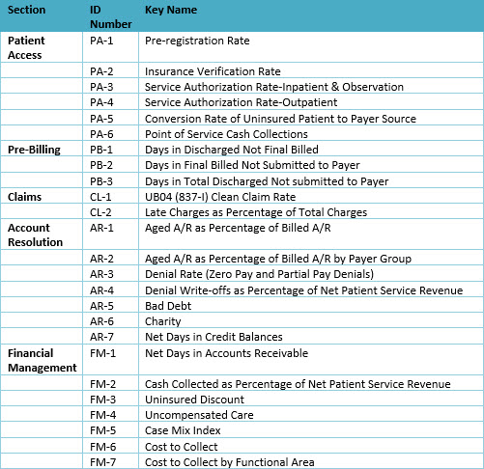
Key Performance Indicators (KPIs)
Notes:
Key Performance Indicators (KPIs) set standards for accounts receivables and provide a method of measuring the collection and control of accounts receivables. Benchmarking is used to compare key performance indicators in an organization to an agreed upon average or expected standards within the same industry. There are some key benchmarks that should be used to analyze A/R within a provider organization.

Slide 94
General KPIs
Days of Revenue in Receivables
A/R Aging Analysis
Discharged Not Final Billed
Notes:
Days of Revenue in Receivables
Also known as A/R days, this measure is widely used throughout the healthcare profession to measure how fast receivables are collected. Industry standards for A/R days are available
A/R Aging Analysis
Aging reports divide the accounts receivable into 30, 60, 90, 120 days and over categories, based on the date of service/discharge. The A/R may also be aged from bill date; however, this presentation completely masks the impact of any processing delays that occur between completion of the service and production of the bill. It is important to age from date of service to understand the impact that timely billing, or lack of timely billing, has on collection of accounts receivable.
Discharge Not Final Billed (DNFB)
This is the portion of the accounts receivable that identifies charges for patients where services are completed but the healthcare facility has not been able to bill the claim. There are a number of activities that must be completed before bill submission can take place. These include the completion of all charging, final medical record coding and could include insurance verification activities.

Slide 95
General KPIs
Cost to Collect
Cash Collected as Percent of Net Revenue
Denials as a Percent of Net Revenue
Credit Balances – Days Outstanding
Notes:
Cost to Collect
Because healthcare is not typically a cash-upfront business, there is a cost to collect for services rendered. This cost is calculated by dividing the total patient financial services operating expenses by the gross patient care collections for that same period. Patient financial services’ expenses must also include admitting/registration.
Cash collected as a percentage of net revenue
This key performance indicator is also known as the net collection rate. It lets you know how much actual cash you collected as a percentage of what was available to collect. It is the ratio of cash to net revenue.
Denials as a percentage of net revenue
Less than 2% of claims should be denied on the first submission
Credit balances—days outstanding
Credit balances should be resolved timely and should be benchmarked at <1% of the days outstanding in the accounts receivable

Slide 96
Key Concept Slide
Key Performance Indicators (KPIs) set standards for accounts receivables (A/R) and provide a method of measuring the collection and control of A/R.
Days in A/R is calculated based on the value of the total accounts receivable on a specific date.
A/R day calculations can also be done for specific payers to evaluate the collection efficiency and payment progress on third-party payers or self-pay patients.
Completing an analysis of A/R aging and KPIs can help identify issues and areas for improvement

Slide 97
What are KPI’s?
A. Benchmarks which are used to compare Key Performance Indicators in an organization to an agreed upon average or expected standard within the same industry.
B. Key performance indicators, which set standards for accounts receivable (A/R) and provide a method of measuring the collection and control of A/R.
C. Days in A/R is calculated based on the value of the total accounts receivable on a specific date.
D. A component that can divide the accounts receivable into 30, 60, 90, 120 days, and over 120 days categories, based on the date of service/discharge
Notes:
A. Benchmarks are actually derived from KPIs, which in turn set standards for accounts receivables (A/R) and provide a method of measuring the collection and control of A/R. The correct answer is: Key performance indicators, which set standards for accounts receivables (A/R) and provide a method of measuring the collection and control of A/R.

Slide 99
Thank You!

