Slide 1
HFMA Certification Programs Overview
Notes:
Learner comments!

Slide 2
HFMA Certification Programs
Certified Revenue Cycle Representative (CRCR)
Certified Revenue Cycle Representative (CRCR) – GCC for international audience
Certified Healthcare Financial Professional (CHFP)
Certified Specialist Accounting and Finance (CSAF)
Certified Specialist Business Intelligence (CSBI)
Certified Specialist Payment and Reimbursement (CSPR)
Certified Specialist Physician Practice Management (CSPPM)
Fellow of the Healthcare Financial Management Association® (FHFMA)
Executive of Healthcare Revenue Cycle (EHRC)
Notes:
Hfma offers 9 certifications
Unlike the other certs which require examination, Fellowship and EHRC are awarded to HFMA members who have demonstrated certain expertise and leadership. Details shared in later slides.
All included with membership, except CRCRGCC- international certification there is a fee added

Slide 3
HFMA Certification Programs
Why get HFMA certified?
Establishing and maintaining a clear competitive edge is a prerequisite for today’s changing economy – for individuals and organizational leaders. You can gain and demonstrate your edge by enhancing your knowledge and proving proficiency with HFMA’s certification programs. Explore and choose your area of focus from the wide-range of certification options available to you.
Notes:
Why get certified? Because earning a certification validates your proficiency. And, the benefits of getting certified range from higher salary to increased job fulfillment to improved organizational performance.
If you’re personally interested in earning one or more HFMA certifications, know you’re taking the first step in increasing your earnings potential and standing out among your peers. If you’re interested in having your team certified, you’re amplifying the importance of professional development and goal setting in your organization.
In addition to the Certified Healthcare Financial Professional (CHFP), HFMA also offers specialized certifications in revenue cycle, accounting and finance, business intelligence, managed care, and physician practice management. And, when you become a member of HFMA, all certification fees and study materials are included in your membership dues – that’s whether you earn one or all of our designations.

Slide 4
HFMA Certification Programs
Value for individuals: Increase your earning potential and stand out among your peers. The job market is highly competitive. Maintain the skills, confidence, and proficiencies you need to give yourself an edge in healthcare finance.
Value for organizational leaders: Build a culture of learning and position your organization for success. Increasing your team’s knowledge of industry terminology helps them meet the demands of department leadership and provides the tools they need to exceed the expectations of your clients, patients, and partners.
Notes:
What do you want to accomplish in your profession? HFMA certifications can help you reach your career goals by enhancing your industry knowledge and proving proficiency to your colleagues and organization’s leaders.
A credential from HFMA authenticates your education. One of the many benefits of pursuing an HFMA certification is earning a digital badge. Your HFMA digital badge will contain metadata describing your qualifications and credentials, including how you earned this achievement. You can share your credential easily with your peers, boss, or prospective employers. More on next slide

Slide 5

HFMA Digital Credentials
All HFMA Certification programs offer a digital badge.
Digital badges:
Increase an earner’s credibility - An HFMA credential validates that you have the education needed to succeed in your field.
Position a person for advancement - Show your manager you are committed to staying up to date in your profession.
Differentiate an earner in the job market - Maintain the proficiencies leaders in the field are seeking to meet their organizational goals.
Notes:
HFMA digital credentials:
HFMA partners with Credly to issue digital badges to all certified individuals which provides an easy way to share your designation through your email signature, LinkedIn profile, and more. You earned the designation and digital badging enables your ability to show off your accomplishment.
For organizations digital badges can give managers the tools to track engagement and monitor the number of employees downloading the badges and how they are being used.
The badge page display includes identity verification ensuring credibility and authenticity. Digital badging protects the integrity of the HFMA credential.
Digital credentials are described as, or more commonly known as, a graphic representation of an acquired skill or accomplishment:
•A digital credential is a visual token of achievement in the online learning environment
•A digital credential can represent attained knowledge, specific skills, set of skills, a certificate program, a course or certification program
Popular with micro-credentialing, highlighting competencies, and career pathing. Etc.
FAQs: Digital Badging (hfma.org)
On the following slides we will review each of the Certification programs and maintenance information

Slide 6
HFMA’s Certified Healthcare Financial Professional (CHFP)
Notes:
Section break slide

Slide 7

CHFP Overview
Course material provides powerful guidance about the Business of Health Care
Great Content Overall
Module II Use of case studies to validate the content learned in Module II
Very well organized and informative
Digital Credential
CHFP is Required for Fellowship
CHFP Membership Requirement
Notes:
The CHFP is providing the necessary foundations for success as a finance leader.
The CHFP offers a multidisciplinary approach to health finance, addressing the business issues of the industry stakeholder groups: payers, physicians and providers.
HFMA is striving with the CHFP program to lead the industry be assisting health care finance professionals to develop fiscal literary and sound business judgment
CHFP is required for Fellowship- if you are interested in pursuing Fellowship CHFP is a key component
CHFP Membership Requirement
Please note HFMA professional or business partner all-access membership is a required aspect to hold and maintain the CHFP credential. Paid student members are eligible to register for and to take both modules of the CHFP certification program (included with membership). Student members who successfully complete the CHFP requirements (two modules) will earn their designation upon assuming Professional or Business Partner level member status. - they can take both modules but then must upgrade from student member to be able to hold the CHFP/use designation/receive certificate and digital badge.

Slide 8
CHFP Program Modules
The Business of Health Care | Operational Excellence: Pursuing Strategy
The Big Picture Accounting Principles Cost Accounting Principles Managing Financial Resources Strategic Financial Planning Looking to the Future: Trends | Working with the Stakeholders: Payers Physicians and others Providers Patients
All CHFP materials are available through HFMA’s website and accessed via the member eLearning account
Notes:
The CHFP program is structured in two (2) modules: HFMA’s Business of Health Care and Operational Excellence: Pursuing Strategy. Module I consists of six courses-listed here; module two contains a series of randomize case studies examine payer, physician and provider business issues.
The course is entirely on-line and available through HFMA’s website. There are substantial downloadable concept guides as well, highlighting the concepts candidates need to know
The CHFP is self-contained- candidates have all they need to be successful – and candidates work in a self-paced, self-managed style. Candidates are generally able to complete the program within a couple of months.

Slide 9
Earning the CHFP
Step 1:
  Enroll in CHFP Module I - HFMA Business of Health Care
    75 multiple choices questions to be completed in 90 minutes. Successfully complete the end-of-course assessment prior to taking ‘Step 2' below.
Step 2:
  Enroll in Module II - Operational Excellence assessment
    8 case studies, each with 7 multiple choice questions. Total of 56 questions to be completed in 3 hours
Notes:
The CHFP- Certified Healthcare Financial Professional- is awarded upon the successful completion of both modules’ examinations as noted here. The examinations are part of the online course and may be taken in a office or at home.
There is a 30 day waiting period to retake the exam if necessary. The exam may be taken as many times as needed to successfully complete the program within the access period.
Step 1: Enroll in CHFP Module I – HFMA Business of Health Care ®. The HFMA Business of Health Care® online program offers participants an overview of healthcare finance, risk mitigation, evolving payment models, healthcare accounting and cost analysis, strategic finance, and managing financial resources. Review the online course and successfully complete the end-of-course assessment prior to taking ‘Step 2' below.
Step 2: Enroll in Module II - Operational Excellence assessment. The HFMA Operational Excellence exam includes exercises and case studies on the application of business acumen in healthcare.

Slide 10
FHFMA – Fellow of HFMA
Notes:
Section break slide

Slide 11

Fellow of HFMA
Earning the HFMA Fellowship attests to one's financial expertise and leadership.
As recognized industry leaders, HFMA Fellows act as ambassadors to the profession by raising the standard of practice through consistent participation in professional development activities and service to the healthcare finance industry.
HFMA Fellows recognize and accept the responsibility of utilizing healthcare finance professional skills for community benefit.
Notes:
There are no fees for qualifying members to apply for Fellow status.
Earning the HFMA Fellowship attests to one's financial expertise and leadership. Fellowship is awarded to HFMA members who have demonstrated financial expertise and leadership through the use of personal financial knowledge and skills in voluntary community service.
As recognized industry leaders, HFMA Fellows act as ambassadors to the profession by raising the standard of practice through consistent participation in professional development activities and service to the healthcare finance industry. HFMA Fellows recognize and accept the responsibility of utilizing healthcare finance professional skills for community benefit.
Modified FHFMA requirements
Effective June 19, 2020: The HFMA Board of Examiners (BoE) recently modified the Fellowship requirements to emphasize applicants' contributions to HFMA and/or the industry, either through serving as a healthcare educator and/or through leadership service. The requirements are refined as follows:
1. Volunteer requirement: expansion of the volunteer activity options.
2. New requirement: submit a letter of recommendation from an active HFMA Fellow (FHFMA) or active local chapter leader.
More details on the changes and modified requirements can be found here

Slide 12
Fellow of HFMA
Hold the Certified Healthcare Financial Professional (CHFP) designation
Minimum five (5) years professional membership in HFMA (student membership does not count toward this total)
Evidence of bachelor's or master’s degree
Letter of recommendation from an FHFMA (active HFMA Fellow) or chapter leader
Volunteer activity — demonstrate one of the listed contributions to HFMA or the industry within the three years prior to applying
Notes:
Advantages of Becoming a Fellow of HFMA
Fellow of the HFMA
Requirements for FHFMA® certification include:
Current CHFP designation - CHFP is required for Fellowship
Five years total as a regular or advanced HFMA member (student membership does not count toward this total)
Bachelor degree or 120 semester hours from an accredited college or university
Volunteer activity — demonstrate any one of the following contributions to HFMA or the industry within the three years prior to applying:
1. Preparation and publication of one or more professional articles in a publication accepted as authoritative in the healthcare industry.
2. Service as an adjunct instructor at an accredited (post-secondary school) educational institution.
3. Service in an education, certification, or leadership committee role within the local HFMA chapter or service on one of the HFMA association boards or committees.
4. Demonstrating a minimum of 10 Hours in the service or preparation of one of the following:
a. Speaking to community groups on health care issues
b. Providing internal staff education on healthcare finance topics
c. Presenting at an HFMA educational program
d. Presenting at a related healthcare industry educational program
e. Assistance to those desiring HFMA certification or fellowship designation
f. Mentorship of healthcare finance professionals
There are no fees for qualifying members to apply for Fellow status.

Slide 13
Executive of Healthcare Revenue Cycle
(EHRC)
Notes:
Section break slide

Slide 14

Executive of Healthcare Revenue Cycle (EHRC)
Overview:
  An executive level designation for revenue cycle professionals in the industry and HFMA
  The EHRC certification designation demonstrates revenue cycle excellence
  Digital Badge awarded
  Link: www.hfma.org/ehrc
EHRC Application Requirements:
  Hold the CRCR designation
  HFMA Membership (minimum 5 years)
  Letter of Recommendation
  Professional Activity (select one of several options)
Notes:
Launched Feb 2024
Offers an executive level designation for revenue cycle professionals in the industry and HFMA.
Certificate and digital badge awarded
Unlike the other HFMA certifications, this certification is earned through a variety of activities, etc., not by taking an exam. (similar to Fellowship in HFMA)
Offered to all members of HFMA that allows both Provider and Business Partners to hold the designation.
The EHRC certification designation demonstrates revenue cycle excellence.
Earning this represents a high level of achievement and distinguishes you as a leader and role model in the revenue cycle industry.
This designation demonstrates your commitment to leadership within the revenue cycle area of healthcare as well as continued involvement and education in healthcare revenue cycle.

Slide 15
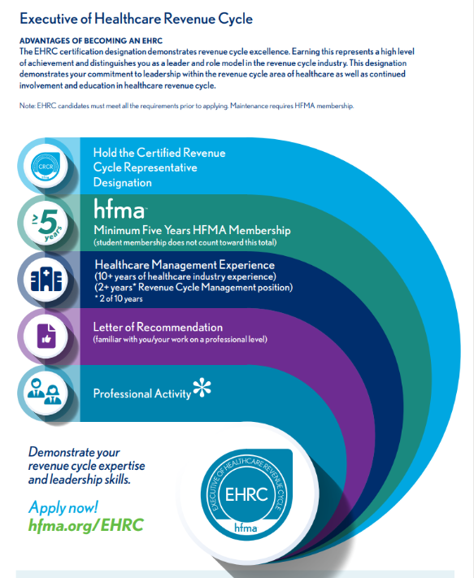
Executive of Healthcare Revenue Cycle (EHRC) Requirements
Notes:
There are no fees for qualifying members to apply for EHRC status.
Requirements for EHRC certification application include:
Hold the Certified Revenue Cycle Representative (CRCR) designation.
Minimum five (5) years professional membership in HFMA (student membership does not count toward this total) – must be an active member.
Letter of recommendation from an industry leader, HFMA chapter leader or national volunteer, familiar with you/your work on a professional level.
Select one of several professional options here:
Provider- PFC Adopter , MAP Award or MAP App Subscriber
Business Partner- Peer Reviewed or RCC/AC Sponsor
Volunteer activity — demonstrate any one, or combination of the following contributions to HFMA or the industry within the three years prior to applying:
Service as an adjunct instructor at an accredited (post-secondary school) educational institution.
Service in an education, certification, or leadership committee role within the local HFMA chapter or service on one of the HFMA association boards or committees (Example: RC Executive Council).
Demonstrating a minimum of 10 Hours in the service or preparation of one of the following:
a. Preparation and publication of professional articles in a publication accepted as authoritative in the healthcare industry.
b. Speaking to community groups on revenue cycle topics and/or issues
c. Providing internal staff education on healthcare revenue cycle topics
d. Presenting at an HFMA educational program (Example: Executive Councils, Annual Conference)
e. Presenting at a related healthcare industry educational program
f. Assistance to those desiring HFMA certification
g. Mentorship of healthcare revenue cycle professionals

Slide 16
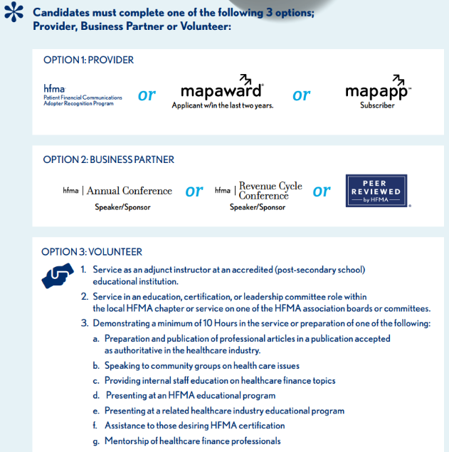
Executive of Healthcare Revenue Cycle (EHRC) Requirements
Notes:
Cont. from previous slide

Slide 17
HFMA's Certified Revenue Cycle Representative (CRCR)
Notes:
Section break slide

Slide 18
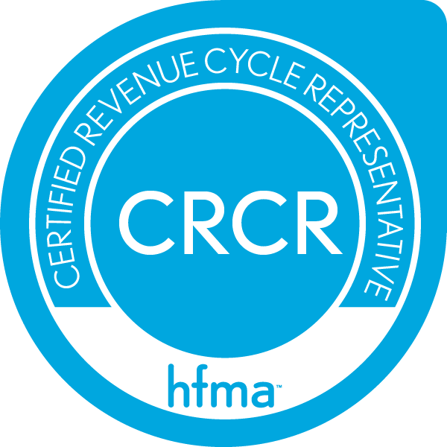
HFMA's Certified Revenue Cycle Representative Program
Here’s where to gain the insight and knowledge to succeed in today’s contemporary revenue cycle environment
HFMA's CRCR is the only content available today that provides a national-level certification for addressing the contemporary patient-centric revenue cycle
With HFMA’s CRCR certification, you will be better prepared to increase receivables, reduce denials, and work more efficiently – all while earning your organization high patient satisfaction scores
Notes:
After this program, you'll be able to.
Enhance the patient experience
Reduce denials and simplify collections
Improve financial performance
Comply with new regulations
Increase interdepartmental cooperation
Heighten staff confidence and work satisfaction
Measure revenue cycle staff proficiency
Recognize staff knowledge and expertise
Decrease turnover

Slide 19
Program Format
Modular
The CRCR is an online, self-directed, interactive program made up of short, searchable courses with knowledge checkpoints.
Each course takes 15-20 minutes to complete
Interactive
Enrollees can validate what they learn through periodic course interactions. There is one final, comprehensive assessment for the entire program
Stop-and-Start Convenience
Courses can be completed independently from each other. Current progress is bookmarked when logging out of the program.

Slide 20
HFMA's Certified Specialist Programs
Notes:
Section break slide

Slide 21
HFMA Certified Specialist Programs
Programs enhance healthcare finance skills through expansion of the knowledge and skill sets required by specific functional areas
HFMA offers four (4) specialist programs
    Accounting and Finance
    Business Intelligence
    Payment & Reimbursement
    Physician Practice Management

Slide 22

Certified Specialist Accounting and Finance (CSAF)
What the certification helps candidates do:
Compare various types of budgets
Identify types of cost behaviors
Recognize the types of risk-sharing arrangements in managed care contracts
Identify capital investment evaluation techniques

Slide 23

Certified Specialist Business Intelligence (CSBI)
What the Certification helps candidates do:
Identify the concepts and tools of business intelligence
Recognize how information for better decisions is derived from large clinical, financial, and other databases
Recognize the decision types and analytic tools that are part of decision management
Identify how data warehousing, reporting and analysis tools, and data systems architecture are used
Apply the basics of analytical and quantitative skills of BI in
healthcare

Slide 24

Certified Specialist Payment & Reimbursement (CSPR)
What the certification helps Candidates do:
Identify key factors that influenced the development of managed care
Explain coordination of benefits, managed Medicare organizations, and TRICARE
Describe the role of Medicare and Medicaid Managed Care
Identify the clinical integration components of case management
Describe basic hospital service reimbursement methodologies and cost control incentives
Describe the impact of the ACA on reimbursement, and list emerging payment trends under healthcare reform
List key case and utilization (care) management and clinical integration components
Identify major trends in healthcare policy, including consumerism, outcomes-based reimbursement, and other elements of reform

Slide 25

Certified Specialist Physician Practice Management (CSPPM)
What the certification helps candidates do:
Recognize the Resource Based Relative Value System (RBRVS) and its components
Recognize the difference between bad debt and charity accounts
Identify processes for evaluating a contract
Recognize Stark legislation and the laws it has developed for regulation of the medical group
Identify the elements of managing third-party receivables and self-pay receivables
Name techniques commonly used to measure accounts receivable

Slide 26
Certification Programs: Availability and Costs
Available for individuals, enterprise members and organizational purchase
Included with HFMA All-Access membership
Access via HFMA’s Website
Price $399 individual non-member; variable with organizational purchase
Downloadable certificate and digital badge on completion
Notes:
All certifications are $399 OR included with Professional All-Access Membership
Contact careerservices@hfma.org for more details
Members have access for the length of their membership and non-members 12 months access

Slide 27
HFMA Certification Maintenance
Notes:
Section break slide

Slide 28
Certified Healthcare Financial Professional (CHFP) and Fellow of HFMA (FHFMA)
  HFMA members who have earned either the Certified Healthcare Financial Professional (CHFP) or Fellow of HFMA (FHFMA) designation must maintain their certification every three years by meeting two basic requirements:
  Remain an active HFMA member in good standing
  Complete 60 hours of eligible education activities every three years
Notes:
Reporting Your Education Activities
Online Reporting Tool: It is your responsibility to self-report your education hours/activities using the online reporting tool. The only educational activities that do not need to be self-reported are activities sponsored by HFMA National for which you have received CPE credit. Access to the online reporting tool is available only to current CHFP/FHFMA certified members; login required.
Download instructions for using the online reporting tool along with a list of eligible CHFP/FHFMA maintenance activities. This document also includes general certification maintenance information.
See Maintenance FAQs for more information.

Slide 29
EHRC Maintenance
HFMA members who have earned the EHRC designation must maintain their certification every three years by meeting the following requirements:
  Remain an active HFMA member in good standing
  Complete 45 hours* of eligible education activities every three years.
*Examples: HFMA national events, Revenue Cycle Council meeting attendance.
Notes:
Maintenance is required every 3 years

Slide 30
Certified Revenue Cycle Representative (CRCR) and Certified Specialist (CS)
HFMA CRCR and CS certificants must maintain their certification every two years. The recertification process is straightforward:
To re-certify as a CRCR or CS, you must take a 50-question online exam. To help you prepare for the exam, you will have access to an updated eLearning course.
With all-access membership there is no cost for the CS and CRCR recertification exams.
The maintenance fee for non-members is $100 per certification.

Slide 31


Slide 32
Resources
HFMA Chapter/Region Contact
XXXXXXX
HFMA National Contact
Email careerervices@hfma.org or call (800) 252-4362 and ask for a member of the Career Services Team

Slide 33
Notes:
Final slide

