Slide 1
Healthcare Financial Management Association: An Introduction
Helping Health Care Professionals & Their Organizations Succeed

Slide 2
Today’s Presentation
Industry overview
HFMA initiatives
Organizational overview
Benefits and resources
Get involved

Slide 3
Industry Overview

Slide 4
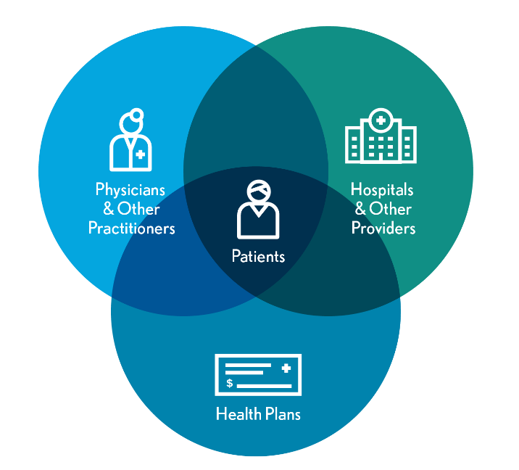
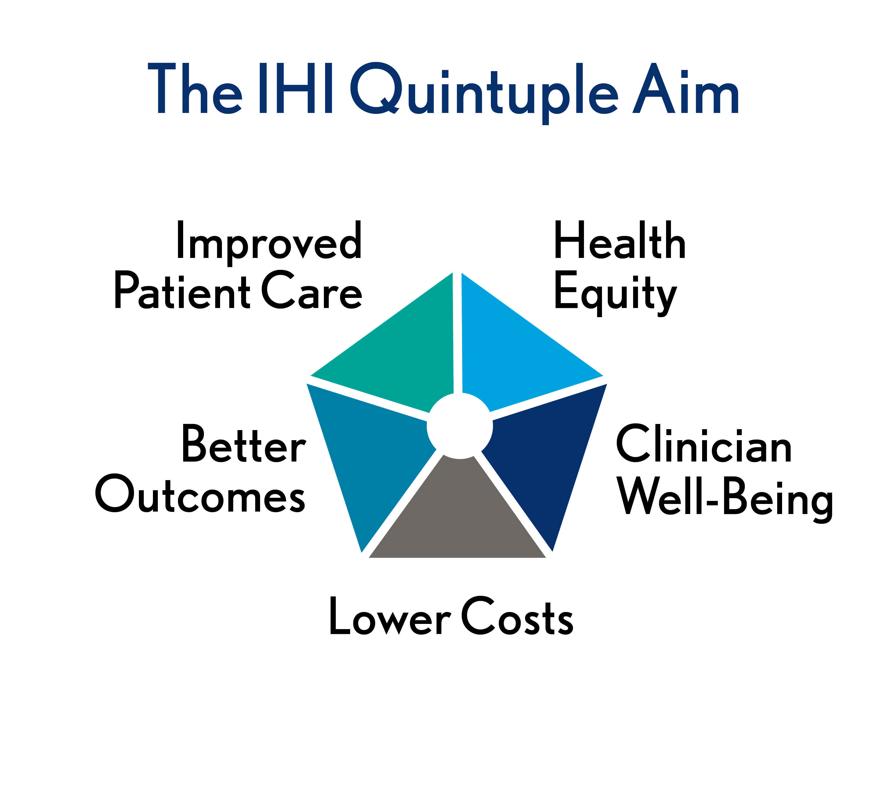
Realignment Is Erasing Traditional Healthcare Boundaries
Driven by demands for care transformation, the healthcare industry is realigning at an unprecedented pace.

Slide 5
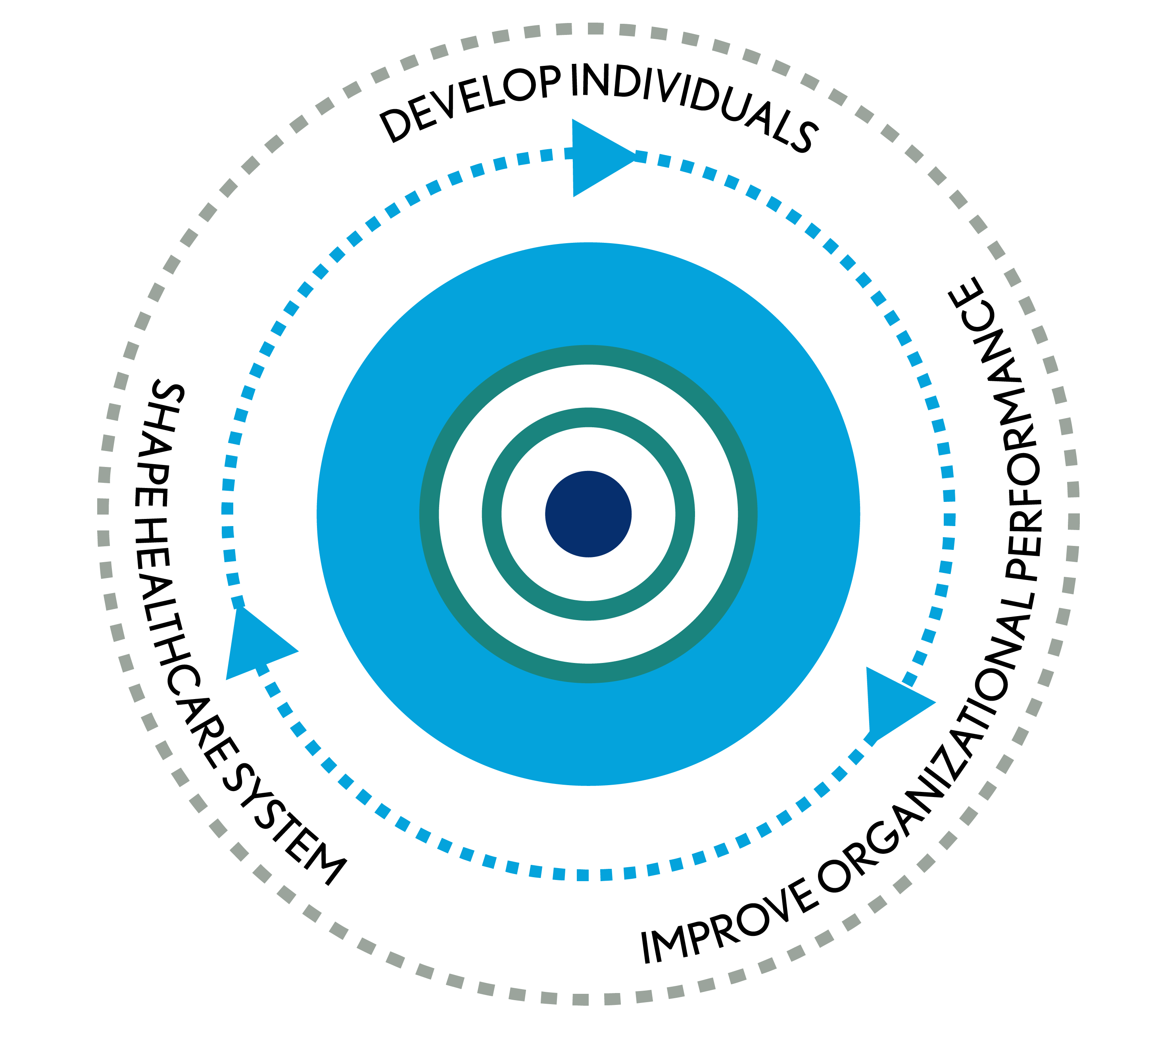
We Help Stakeholders Achieve Optimal Results
OUR MISSION
Leading the financial management of health care
OUR VISION
HFMA will bring value to the industry as the leading organization for healthcare finance

Slide 6
Thought Leadership Shapes the Future of Health Care
WHAT WE DO
Share finance perspectives to drive improvement
Convene healthcare groups to build consensus
Develop strategic frameworks to guide action
Establish principles and guidance to advance capabilities
Foster measurement and accountability for outcomes
CHANNELS
Official Comments and Testimony
Media
Other Associations and Industry Groups
Chapters

Slide 7
HFMA Helps Turn Knowledge into Action
Continuing education and training
Career development and certification
Small group-focused interactions
Information analysis and perspective
Guidelines and best practices
Organizational performance management
Problem-solving community: online and face-to-face networking
Your Challenge. Our Mission.

Slide 8
HFMA Initiatives

Slide 9
Regulatory Resources: Perspective on the Policymaking Process
hfma.org/policy

Slide 10
HFMA’s Environmental Assessment Series, Healthcare 2030
Volume 3 builds on Volumes 1 and 2, which closes out with a dive into hospitals' role in precision medicine.
hfma.org/hc2030

Slide 11
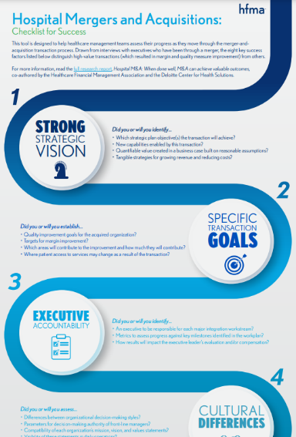
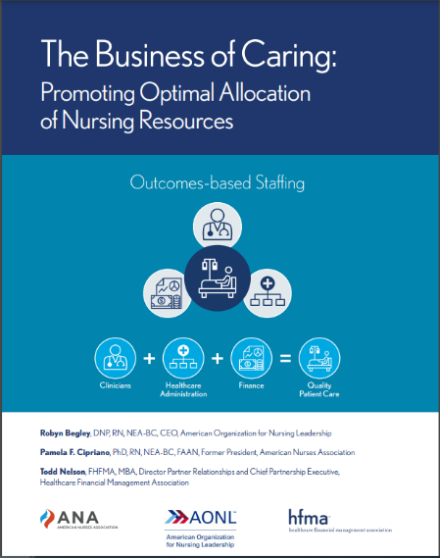
HFMA Research: Strategies for Success
HIGH-VALUE HEALTHCARE
hfma.org/valueproject
MERGERS
NURSE STAFFING
hfma.org/guidance/research-trends
Notes:
Total cost of care report:
Growth of population-based payments is not associated with a decrease in market-level cost growth, yet.
Market factors associated with Medicare costs and cost growth.
What is driving total cost of care? Analysis of factors influencing total cost of care in U.S. healthcare markets.

Slide 12
Our Consumerism Best Practices and Resources
PATIENT FINANCIAL COMMUNICATIONS
PRICE TRANSPARENCY
MEDICAL ACCOUNT RESOLUTION
CONSUMER EDUCATION
hfma.org/dollars
Notes:
Update your business processes to align with HFMA’s best practices for patient financial communications.
Ensure that your organization’s policies reflect consumer needs in the high-deductible health plan era.
Provide consumer education resources online.
Adopt best practices for consumerism.
HFMA has developed a whole suite of industry-consensus best practices in this area. They address price transparency, financial communications with patients and medical debt resolution. We call this initiative Healthcare Dollars & Sense. Hundreds of providers have adopted these best practices but others may still be unaware.
These best practices, together with the self assessment tool in our consumerism maturity model, provide a solid foundation for building a consumer-centric revenue cycle.

Slide 13
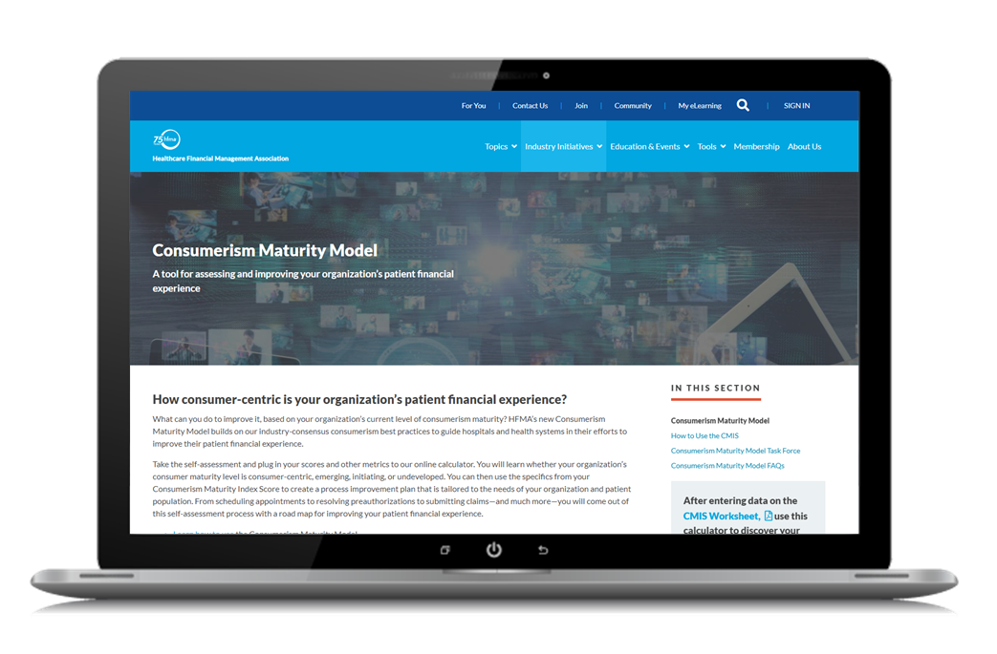
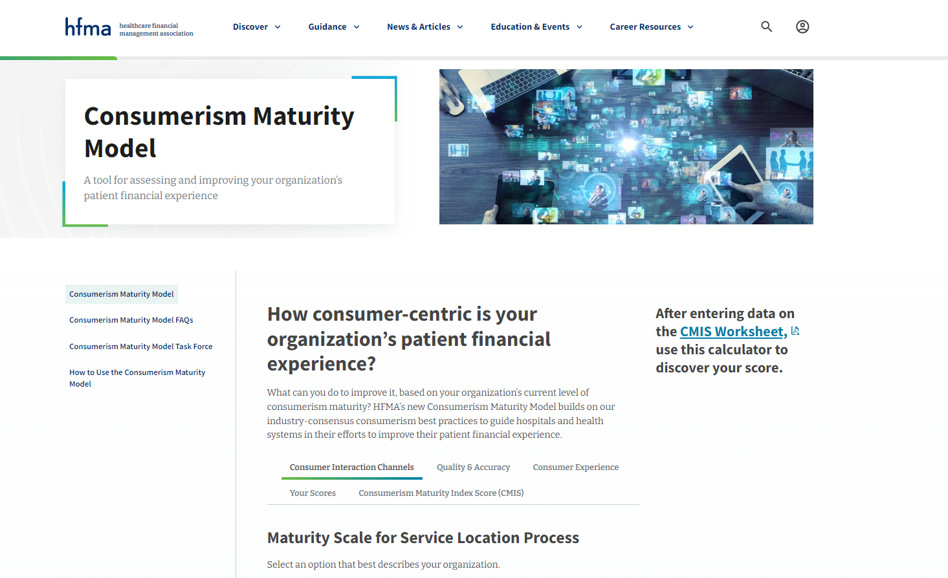
HFMA’s Consumerism Maturity Model
Online self-assessment tool
Appropriate for all providers: hospitals, systems and physician groups
Takes a consumers-first viewpoint
Identify gaps and areas for improvement
Build your roadmap for success
Designed by industry-wide task force
hfma.org/consumermodel

Slide 14
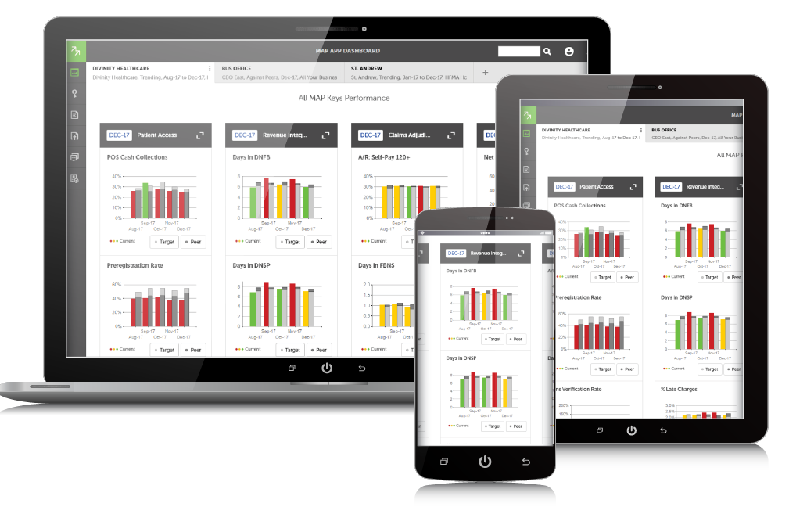
MAP: Hit Your Revenue Cycle Performance Targets
MAP Keys – Industry standard KPIs
MAP Award – Recognizes revenue cycle excellence
MAP App – Online benchmarking tool
hfma.org/map

Slide 15
Organizational Overview

Slide 16
Professional Membership Association – serving both individuals and organizations
95
122
%
%
117,000+
MEMBER COUNT AS OF APRIL 2024
ENTERPRISE MEMBERSHIP RETENTION RATE AS OF APRIL 2024
MEMBERSHIP GROWTH FROM JUNE 2020 TO APRIL 2024

Slide 17
Organizational Membership
Organizations can offer HFMA benefits and resources to all employees - administrative and clinical.
Cost effective means for providing teams with relevant healthcare finance training and tools.
Build staff competencies, knowledge and engagement.
Drive organizational performance.
Options for all sizes of provider and business partner organizations.
hfma.org/enterprise

Slide 18
Member Career Stage
23.1%
8.4%
41%
27.5%
EXECUTIVE LEVEL
PROFESSIONAL LEVEL
DIRECTOR/MID LEVEL
OTHER
As of April 2024

Slide 19
Primary Member Job Functions
REVENUE CYCLE
FINANCE
PATIENT ACCESS
PATIENT FINANCIAL SERVICES
ACCOUNTING
ADMINISTRATION & OPERATIONS
HEALTH INFORMATION/MEDICAL RECORDS
DECISION SUPPORT/BI/ANALYTICS
As of April 2024

Slide 20
Member Profiles Vary by Membership Category
2%
14%
58%
14%
7%
INDIVIDUAL MEMBERS
55%
ENTERPRISE MEMBERS
21%
29%
EXECUTIVE LEVEL
PROFESSIONAL LEVEL
DIRECTOR/MID LEVEL
OTHER
As of April 2024

Slide 21
Provider Organizations (Hospitals/Systems) Make Up Majority of Membership Base
12%
18%
17%
55%
27%
83%
88%
Total Members
Individual Members
Enterprise Members
INDIVIDUAL
HOSPITALS/HEALTH SYSTEMS
ENTERPRISE
BUSINESS PARTNERS
OTHER
As of April 2024

Slide 22
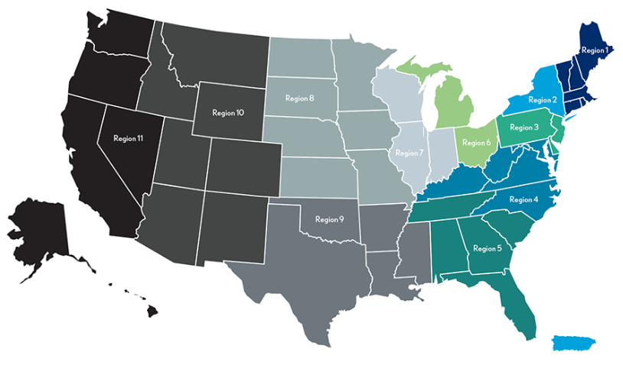
Our Members Belong to 59 Local Chapters
Chapters and Regions
REGION 1
Connecticut
Massachusetts-Rhode Island
Northern New England
REGION 2
Empire New York
Metropolitan New York
Puerto Rico
Rochester Regional
REGION 3
Central Pennsylvania
Metropolitan Philadelphia
New Jersey
Northeastern Pennsylvania
Western Pennsylvania
REGION 4
Kentucky
Maryland
North Carolina
Virginia - DC
West Virginia
REGION 5
Alabama
Florida
Georgia
South Carolina
Tennessee
REGION 6
Central Ohio
Michigan Great Lakes
Northeast Ohio
Northwest Ohio
Southwestern Ohio
REGION 7
Greater Illinois
First Illinois
Indiana Pressler Memorial
Wisconsin
REGION 8
Greater Heartland
Iowa
Kansas (Sunflower)
Minnesota
Nebraska
North Dakota
South Dakota
REGION 9
Arkansas
Lone Star
Louisiana
Mississippi
Oklahoma
South Texas
Texas Gulf Coast
REGION 10
Arizona
Colorado
Idaho
Montana
New Mexico
Utah
Wyoming
REGION 11
Hawaii
Nevada
Northern California
Oregon
San Diego – Imperial
Southern California
Washington - Alaska
Notes:
Every member is provided free membership in one local chapter. In addition, they can get communications from additional chapters, if interested.

Slide 23
Physician & Physician Practice Engagement
For clinical leaders—The opportunity to learn the business side of healthcare.
For physician practice groups—Strategies to lead the transition to value-based case.
hfma.org/education-events
hfma.org/physician
hfma.org/webinars
Notes:
Invite physician colleagues to attend HFMA’s Annual Conference for a deep dive educational experience in the most pressing challenges facing physicians and practice executives.
Business of Health Care course is certified for 13.5 AMA PRA Category 1 Credits TM for physicians as well as continuing education credit for dentists, pharmacists, nurses, and health care executives offering hours toward Fellows of the American College of Healthcare Executives (FACHE) designation
Suggest that physicians and physician practice executives check out HFMA’s webinars on topics of interest to them

Slide 24
Heath Plan Engagement
Health plan executives stay up-to-date on the financial management of healthcare organizations.
hfma.org/education-events
hfma.org/healthplan
Share HFMA reports focused on industry collaboration to deliver greater value to the patient while ensuring financial sustainability.
Notes:
Invite health plan colleagues to attend HFMA’s Annual Conference to network and hear first-hand about how physicians, providers, and health plans are collaborating in novel ways to improve quality while reducing costs.
Price Transparency report: Clarifies basic definitions that are often misused, Sets forth guiding principles, Establishes roles for health plans, providers, others, Reflects consensus of key stakeholders
Consumer Guide to Understanding Healthcare Prices: Describes how to request price estimates, step by step, the guide can be downloaded for free at hfma.org/consumerguide and posted on your organization’s website as a resource for consumers. No permission needed.

Slide 25
Belonging to HFMA

Slide 26
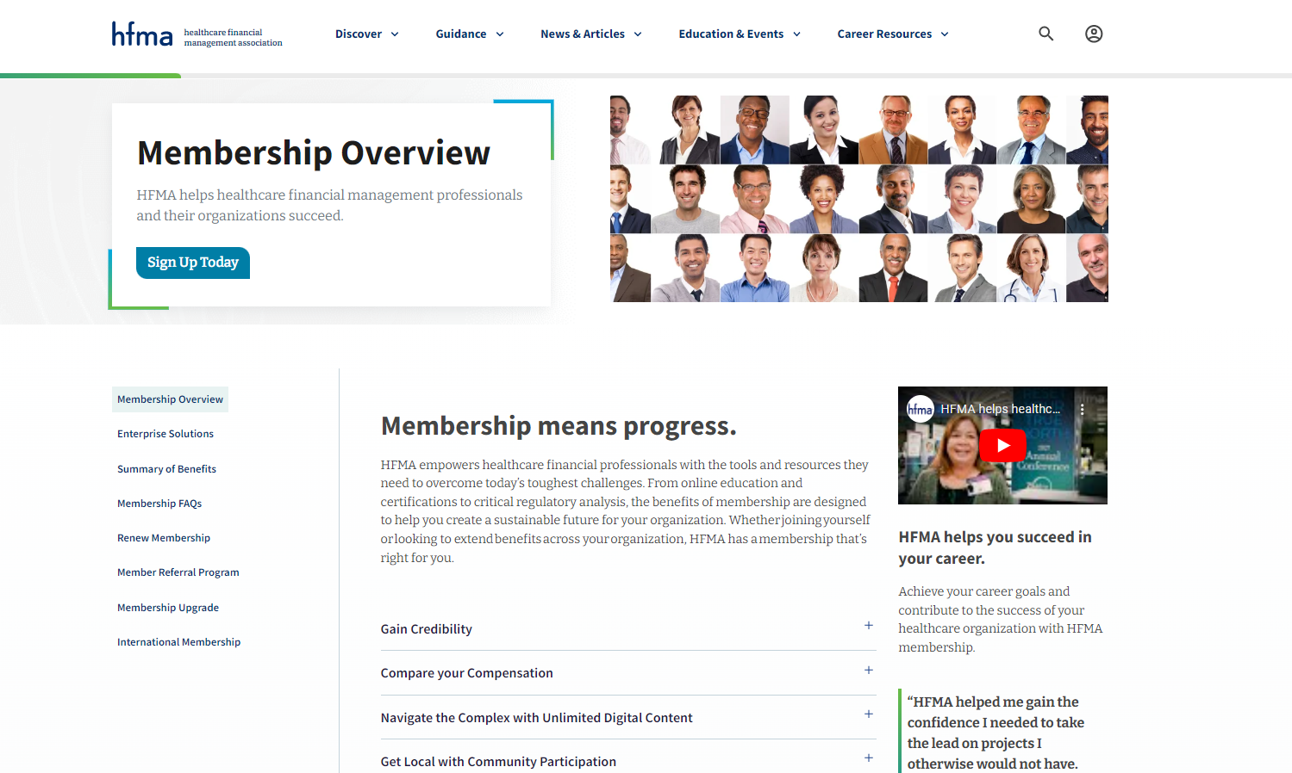
When you belong to HFMA
Easily find & discover
relevant information
Access what you need when you need it
Navigate the complex healthcare environment
Belong & engage Collaborative opportunities & communities to actively
hfma.org/membership

Slide 27
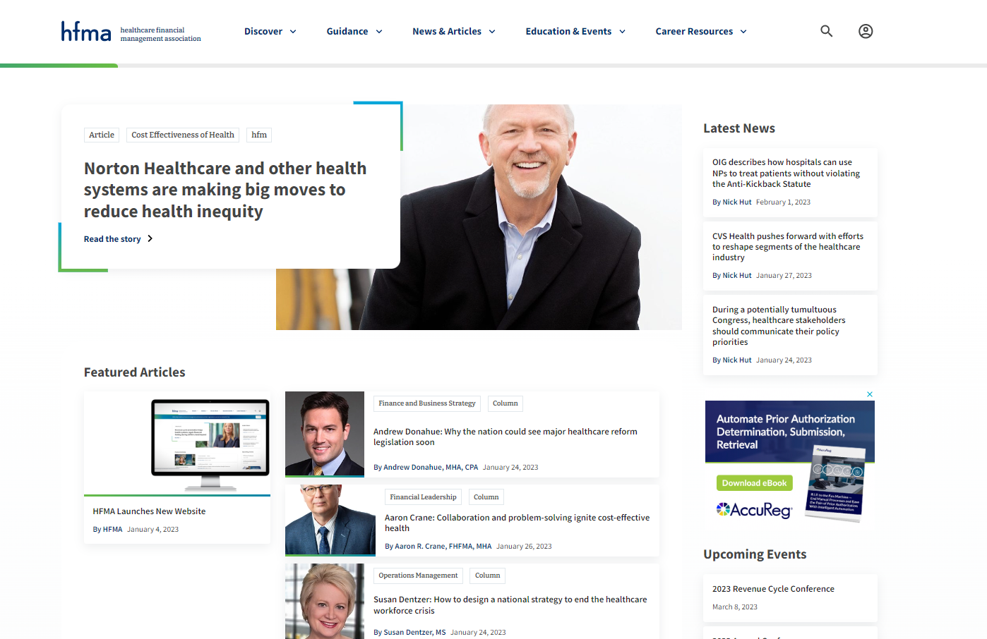
Online Member Home
Get acquainted video series
Provides a tour of hfma.org including highlighting member benefits
hfma.org/gettingstarted
Notes:
Managing your HFMA account is now centralized. From tracking CPE to paying your dues, from setting communication preferences to referring friends and associates to join, all activities are easily managed online.
- Most online content is now member-only access. (Registered Guests only get up to 5 pieces of content per month)

Slide 28
Included with HFMA Membership
Professional Certifications
E-Learning Courses + Webinars
Community
E-Newsletters
Member-Only Content

Slide 29
Distinguish Yourself with Certification
hfma.org/certifications
Notes:
NOTE: For your clinical colleagues, the HFMA Business of Health Care ® course is certified for 13.5 AMA PRA Category 1 Credits TM for physicians as well as continuing education credit for dentists, pharmacists, nurses, and health care executives offering hours toward Fellows of the American College of Healthcare Executives (FACHE) designation

Slide 30
News, Strategies, Insights
hfm magazine
E-Newsletters
HFMA Daily
Revenue Cycle Insights
Cost-Effective Health Report
Healthcare Policy Beat
Healthcare Finance Strategies
Notes:
- HFM available to read with an online reader, as well as mobile app for all mobile devices, including iPhones, tablets and all Android devices.
E-Newsletters contain newsworthy content, industry stories, and strategies – log into My Profile on hfma.org and review My Communication Preferences to ensure you are opted in

Slide 31
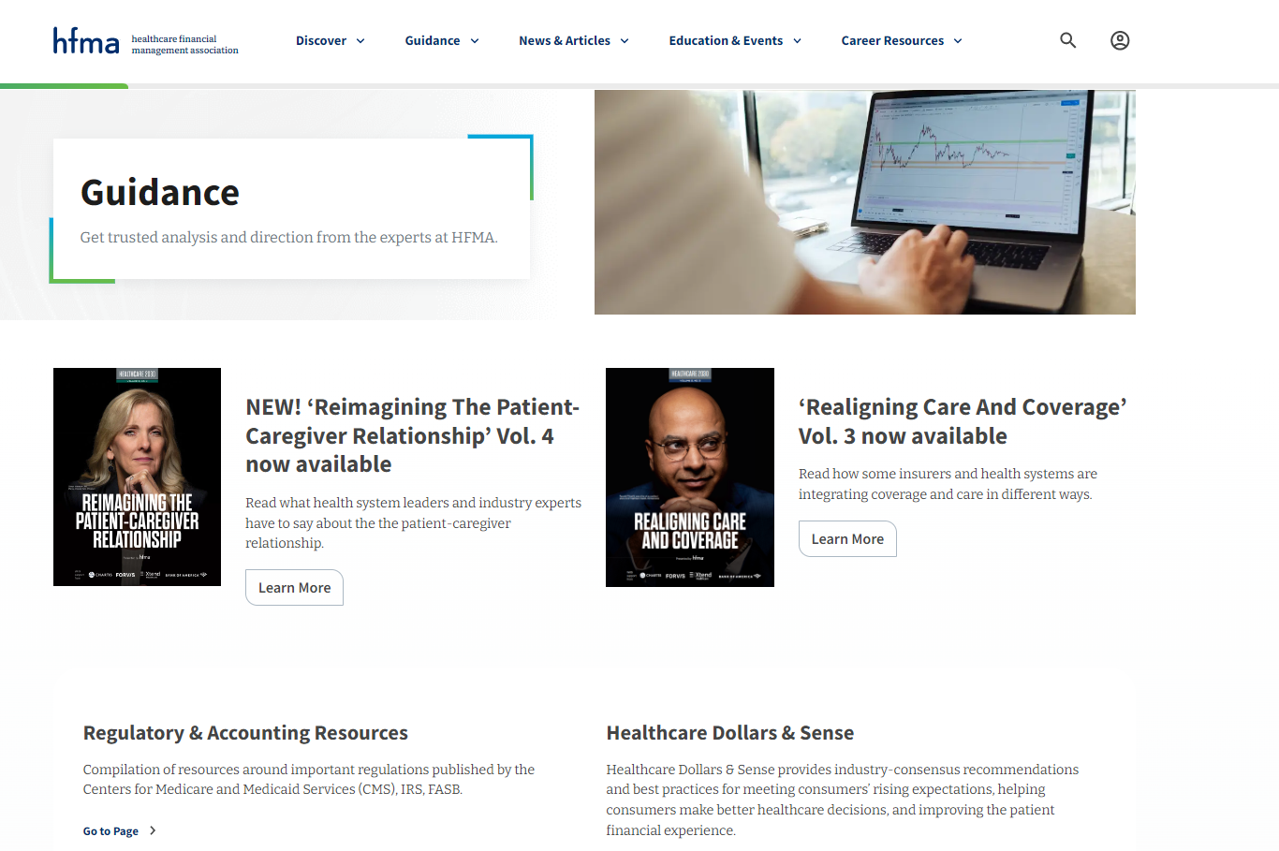
Guidance: Reports + More
Regulatory and Accounting Resources
Healthcare Dollars & Sense
Value Project
Patient Friendly Billing
Healthcare 2030
Consumerism Maturity
Research & Trends
Claim Integrity
Special Reports from HFMA's Thought Leadership Retreat

Slide 32
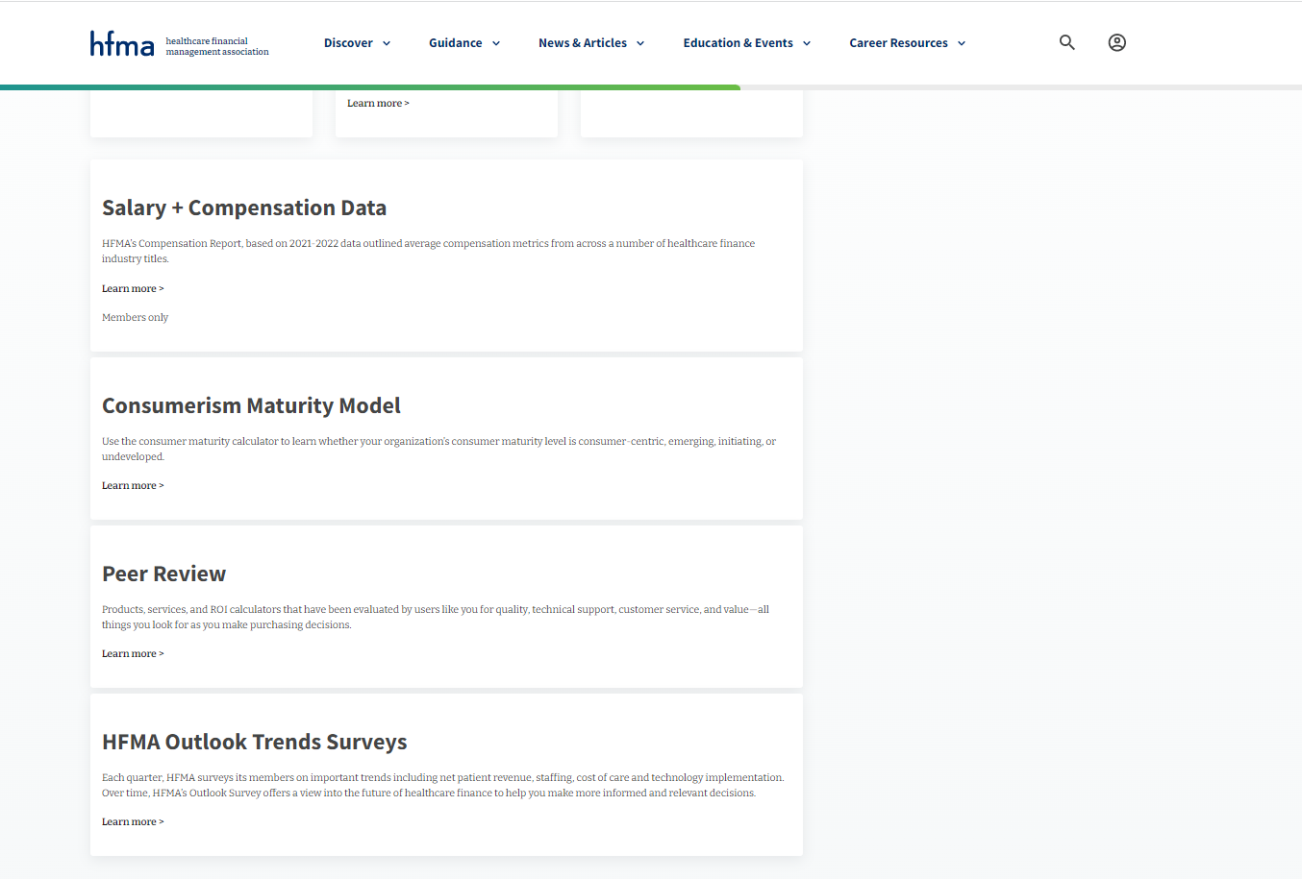
Data + Insights
Salary + Compensation Data
Consumerism Maturity Model
MAP Award Score Calculator
HFMA's Peer Review
Outlook Trend Surveys
Healthy System Purchase Plans Report
CFO Pain Points 2024 Report
RCM Technology Adoption Model
GuideIQ, a market intelligence tool
Equity Quotient, helping leaders navigate equity compliance
Turquoise Health, gain a competitive edge through price transparency data
+ more
hfma.org/data
Notes:
HFMA’s Compensation Report, outlineds average compensation metrics from across a number of healthcare finance industry titles.
Use the consumer maturity calculator to learn whether your organization’s consumer maturity level is consumer-centric, emerging, initiating, or undeveloped.
benchmark your performance against previous MAP Award winners.
Products, services, and ROI calculators that have been evaluated by users like you for quality, technical support, customer service, and value—all things you look for as you make purchasing decisions.
Each quarter, HFMA surveys its members on important trends including net patient revenue, staffing, cost of care and technology implementation. Over time, HFMA’s Outlook Survey offers a view into the future of healthcare finance to help you make more informed and relevant decisions.

Slide 33
HFMA’s Podcast Series
Insights from leading experts on a range of topics in healthcare finance
hfma.org/podcast

Slide 34
Connect: Stay in Touch
Community
hfma.org
HFMA Daily
Social Media
Notes:
HFMA Daily: delivers Monday through Friday and keeps you in the know
hfma.org: updated regularly with the most news, feature articles and industry blogs.
HFMA Community: your place to network, crowdsource ideas, share expertise and solutions, ask questions of your colleagues and more.
HFMA social help channels keep you connected.

Slide 35
Get Involved

Slide 36
Get Involved!
Attend local and national educational events
Take advantage of networking opportunities
Write an article, contribute to a podcast
Speak at an HFMA local or national event
Participate in national workgroups
Volunteer for your local HFMA chapter and pursue leadership opportunities
Contribute to the HFMA online community
Get certified
Participate in an HFMA Executive Council
Refer your colleagues
hfma.org/volunteer

Slide 37
Why Volunteer?
Volunteering for your professional association is a great way to enhance your career, expand your connections and have fun!
Other reasons to volunteer include:

Slide 38
THANK YOU!

