Slide 1
Module I – HFMA Business of Health Care
Course 5: Managing Financial Resources
Notes:
Last revised 3-31-2024

Slide 2
Learning Objectives
YOU will be able to
Describe how healthcare providers are reimbursed for services;
Recognize the types of reimbursement methods used in the healthcare industry;
Describe the processes by which a hospital or physician clinic bill insurers;
Notes:
After completing this module, you should be able to:
Describe how healthcare providers are reimbursed for services;
Recognize the types of reimbursement methods used in the healthcare industry;
Describe the processes by which a hospital or physician clinic bill insurers;
Calculate metrics used to manage the revenue cycle;
Name resource management issues in a health care business; and
Recognize the methods that healthcare businesses finance receivables and acquire capital equipment.
Next

Slide 3
Learning Objectives (cont)
Calculate metrics used to manage the revenue cycle;
Name resource management issues in a health care business; and
Recognize the methods that healthcare businesses finance receivables and acquire capital equipment.

Slide 4
Purpose of this Chapter Learning Program
Highlight key knowledge for strong job performance
Provide an overview of important concepts. The in-depth presentation is in the online course.

Slide 5
The Patient Portion
Insurers generally require some out-of-pocket payment by the patient to supplement the insurance payment
Notes:
insurers generally require some out-of-pocket payment by the patient to supplement the insurance payment - , usually as an incentive for the patient to use insurance only when needed

Slide 6

Types of Patient Payments
Deductible
Coinsurance
Co -pay
Notes:
The types of out-of-pocket payments required are: deductible, copayment, and coinsurance. The deductible is a pre-determined amount that the patient pays before the insurer begins to pay for services. Coinsurance is a percentage of the insurance payment amount paid by the patient, along with the amount paid by the insurer. A copayment is a flat amount that the patient pays at each time of service.
It is important to remember that the patient is ultimately responsible for payment for services to a physician or hospital. A contract between an insurer and a provider may limit the ability for the provider to collect from a patient for denial of payment for covered benefits. However, the patient may have to pay a provider for any services not determined to be a covered benefit under the patient contract with the insurer.

Slide 7
Paying Physicians' for
Hospitals Services
Reimbursement
Notes:
The term reimbursement is used to describe payment by an insurer to a hospital or physician. This term is used because a physician or hospital provider will render services to a patient and then submit a claim to an insurer

Slide 8

A/R
Notes:
The time span between submitting a claim and receiving payment can represent a financial challenge for a hospital or physician. The average time it takes for a hospital or p
physician to be paid for services by a health plan is measured by the days in accounts receivable ratio
The physician or hospital has already paid for the resources needed in providing services to the patient (such as salaries or invoices for medicines and supplies). Therefore, any delay in receiving reimbursement for those costs from an insurer or patient can threaten the financial health of the hospital or physician entity

Slide 9
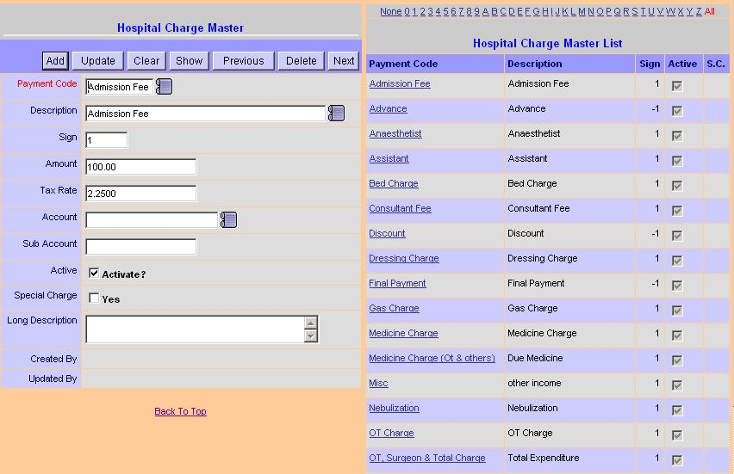
“Charges”
Notes:
A physician or hospital will set prices for services based on an analysis of operating expenses and expected income. The price set by a hospital or physician for their services is referred to as charges or billed charges. The charges by a hospital or physician represent the “retail price” and are usually compiled in a price listing known as the Chargemaster.
The actual payment received from an insurer, net of any discount, is referred to as net revenue

Slide 10
Payment for Healthcare Receivables
Fee-for Service
Cost-based reimbursement
Charge-based reimbursement
Capitation
Prospective payment
DRG - Hospital
Bundled payment - hospital and physician
Per procedure
RBRVS - physicians
Case rate - hospital or physician
APC - Hospital or ambulatory care facility
Per diem - hospital
Notes:
There are two broad categories of payment for healthcare services. They are fee-for-service and capitation. Each type of payment may have different methods of structuring the payment to the provider. Each variation in the way a provider is reimbursed creates different business incentives and risks for both providers and health plans. The figure on the slide summarizes methods of payment within each category.
The oldest and simplest fee-for-service reimbursement mechanism is charge-based reimbursement. This payment system was widely used in the early days of commercial insurance. The hospital or physician is paid based on billed charges or a percentage discount of charges.
In circumstances where charge-based fees are used, health plans are now calling for the amount to be paid to be defined in a part of the contract known as the fee schedule and for charge increases to be limited by contract.

Slide 11
Prospective Payment Systems (PPS)
Diagnostic Related Groups (DRGs
Ambulatory Payment Classifications (APCs)
Resource-Based Relative Value Scale (RBRVS)
Primary Procedure Rate
Notes:
In response to the open-ended nature of healthcare payments through the 1960s and 1970s, insurers increased premiums until consumers began to call for insurers to limit increases in payments to providers. This led to the implementation of prospective payment methods to hospitals and physicians. There are four main types of prospective payment commonly used in today’s healthcare market.
There are four main types of prospective payment commonly used in today’s healthcare market.
A payment based on the patient’s diagnosis is known as a diagnosis-related group (DRG) payment. DRGs are most widely used in payments to hospitals. A DRG is a classification of a disease or injury into one of approximately 750 different categories. . In an effort to simplify the payment structure for hospitals and physicians, a per procedure payment mechanism may be preferable.
Two per-procedure payment approaches are used. Hospitals are paid based on the Ambulatory Payment Classification (APC), which is similar to the inpatient DRG in that the amount paid is based on the specific procedure or service provided to the patient. . Physicians are paid in a similar manner using the Resource-Based Relative Value Scale (RBRVS). Under the RBRVS, the physician payment per procedure or service varies based on the amount of resources (usually time and effort) needed by the physician.
If a patient receives multiple procedures during one occasion of service, then the patient record is analyzed to determine the primary procedure that was performed, and that procedure is paid at the full per-procedure rate.

Slide 12
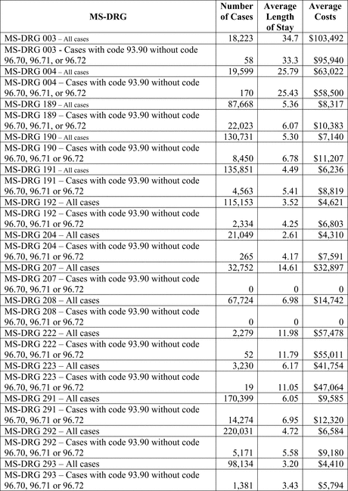
Per Diem Payment
Notes:
An even simpler method of prospective payment is known as the per diem or “per day” payment system, which is used primarily for reimbursement to hospitals or long-term care facilities. As the name implies, the health plan reimburses a facility a fixed amount per day for care to a patient.
As with the per-procedure method, the per diem payment is administratively easy for the health plan and provides a predictable payment rate that is useful in setting competitive premium rates

Slide 13
Payment Under the ACA
Value-Based Payment
Bundled Payment
Notes:
The incentive for the hospital is to limit services, while the incentive for the physician is to provide more services. The advent of value-based payment is a step toward aligning the incentives of hospitals and physicians and reducing the sources of this conflict. One form of value-based payment is bundled payment, in which the health plan pays a single prospective rate for all services provided by both the physician and hospital, and the provider entities then equitably divide the payment amongst themselves

Slide 14

Capitation
Notes:
The other common type of reimbursement is known as capitation. In many respects, capitation is the exact opposite of fee-for-service payment. Capitation pays a fixed amount per person per month to a provider in advance as payment for all services necessary to the patient. A capitation payment amount is normally expressed as an amount per member per month, or PMPM. Capitation is most common in relationships between primary care physicians and managed care plans such as health maintenance organizations. However, capitation is also used for services from specialty physicians and some facilities.
capitation is sometimes referred to as a risk transfer mechanism, where the cost of care to a select group of patients is transferred from the health plan to the provider entity

Slide 15
Summary of Reimbursement Risks and Incentives
 |  | Provider incentive to increase volume of services |  |  |  |  | Provider incentive to decrease volume of services
 |  | Provider incentive to maximize costs |  |  |  |  |  |  |  | Provider incentive to minimize costs
 |  | Cost Based | Charge Based | DRG |  |  | Per-Procedure | Per Diem |  | Bundled Payment | Capitation
Providers |  | Lowest financial risk |  |  |  |  |  |  | Lowest financial risk
Payers |  | Highest financial risk |  |  |  |  |  |  | Lowest financial risk
Consumers |  | Risk of overtreatment |  |  |  |  |  |  | Risk of under treatment
Employers |  | Risk of high costs from inefficiency |  |  |  |  |  |  | Risk of high costs from under treatment
Notes:
Generally speaking, prospective payment methods or capitation create risk for physicians or hospitals. These methods also change some of the ways that a health plan would manage the risk of healthcare costs. A summary of the incentives and risks of the types of reimbursement is shown in Figure 1. As long as both parties have a solid understanding of the risks they undertake with prospective payment arrangements, a business relationship based on this type of payment can be mutually beneficial, yielding a reasonable income to both health plan and provider

Slide 16
Billing and Collecting Processes in Health Care
Revenue Cycle
Pre-Visit Activities
During Visit Activities
Post-Visit Activities
Notes:
The processes for billing and collection are often combined into one overall description known as the revenue cycle. The revenue cycle in health care can be broken into three different phases that cross between the provider and health plan/insurer entities. The overall concept of the revenue cycle is illustrated in the diagram
Each phase consists of several steps, beginning with activities prior to the patient visit, activities during the patient visit when the patient receives care, and activities that occur after the patient receives services

Slide 17
Pre-Visit Revenue Cycle Activities
Pre-Visit Activities
Patient scheduling
Eligibility verification & Pre-certification
Registration
Point-of-service collections
Notes:
These pre-visit activities are intended to facilitate the gathering of information necessary for serving the patient during the visit and for billing and collection for services after the visit
Approximately 60% of all of the information needed to serve the patient during the visit and bill for services is collected before services are provided. It is essential that managers pay particular attention to the accuracy of data gathering and processing at these early stages of a patient visit.
Pre Visit
patient scheduling -During the scheduling transaction, basic demographic data about the patient and his or her payment resources is collected. This data should be recorded as part of creating the patient account when the visit is scheduled
Since data on the patient’s payment resources is collected when the visit is scheduled, the provider can then contact the patient’s health plan and complete an essential step – eligibility verification, or verifying the patient's eligibility for health benefits with the health plan
The eligibility verification step can also advise the provider of any out-of-pocket amounts to be collected from the patient when the patient comes for registration at the time of service. If the patient has a deductible, copayment, or coinsurance amount payable in accordance with their contract with the health plan, the provider should collect that amount at the time of service. This is known as a point-of-service collection. It is far more difficult to collect these amounts from the patient after services have been rendered, so it is essential to make an effort to collect from the patient at this point.

Slide 18
Revenue Cycle Activities
During the Patient Visit
During the Patient Visit
Provide care to patient
Document care to patient
Utilization review
Charge capture
Discharge
Medical record completion
Notes:
Once the patient is registered, a medical record should be prepared for documenting the services provided to the patient and the findings regarding the patient’s medical condition.
Data from the medical record can also be used to support any additional utilization review requirements of the health plan, such as certification of additional days or demonstration of the need for an additional surgical procedure. At the same time, documenting services in the medical record may assist staff in completing charge capture – where the individual items making up the total charges on a patient account are compiled.
The items added to a patient account at charge capture are recorded at the Chargemaster price so that the compiled claim is prepared using billed charges. It is good practice to verify the charges on the patient account against data in the medical record to verify that the items claimed for payment were documented as provided to the patient. Ideally this would be done at the time the patient visit ends, at discharge. Also any information needed for medical record completion would be gathered in the final phase of this process.

Slide 19
Post-Patient Visit
Revenue Cycle Activities
Post-Visit
Medical record analysis and coding
Billing
Payment processing by health plan (claims adjudication)
  Claim logging
  Eligibility
  Adjudication
  Remittance
Notes:
Once the patient has been discharged from the physician’s or hospital’s care, the process goes from gathering data to using that data to compile a claim for reimbursement. The time between discharge of the patient and submission of that claim to a health plan is known as the Discharged but Not Final Billed or DNFB Ideally, the medical record should be completed at the time of discharge or as quickly as possible thereafter, depending on the nature of services provided to the patient. review all documentation contained in the medical record to prepare a final summary of care provided to the patient for use in the billing process. Preparation of this document, known as the discharge summary, is a common point of delay in the timely completion of this process.
Once complete, the medical record is analyzed by a professional trained in the assignment of procedure and diagnosis codes to a patient record to classify the services provided and for use in billing. This process is known as coding. The coding process analyzes the medical record to assign codes that describe the diagnosis of the patient's condition and the procedures performed during the patient visit.
The billing step entails compiling charge, diagnosis, and procedure data from the medical record along with demographic and payment information into a formal claim for reimbursement to be sent to the health plan
Once the claim is submitted to the health plan, a series of steps are required by the health plan in order to process the claim for payment to the provider, collectively referred to as claims adjudication. Upon receipt of the claim, the health plan will record the claim in its inventory of claims pending processing in a step known as claim logging. It is customary with the use of electronic billing for the health plan to send an electronic acknowledgment of the claim to the provider
As the claim is being adjudicated, the first step is to verify that the patient was eligible for coverage by the health plan on the date of service recorded on the claim. This is important because a patient's eligibility for coverage may change, and record-keeping by the health plan may lag behind the actual transaction. Once the claim has been determined to be on behalf of a patient who is eligible for coverage, it is then screened for accuracy and for description of services covered by the contract between the patient and the health plan.
After determination that the service is covered and provided to a person who is eligible for coverage, the adjudication process moves into calculation of the payment due. The payment amount is governed by the agreement between the provider and health plan in the contract. Once the payment amount has been determined, the remittance is prepared and queued for release on a specified future date. Normally, the payment is made through electronic funds transfer to the bank of the physician or hospital submitting the claim. When the payment is sent, the 835 record remittance advice is also sent.

Slide 20
Post-Patient Visit
Revenue Cycle Activities (cont.)
Post Visit (cont.)
Denial management
Payment posting and follow up
Account closure
Notes:
A claim that has all such information is known as a clean claim. Most states and the federal government have requirements for health plans to pay a clean claim within a specified time after receipt. However, if a physician or hospital does not send a clean claim, payment will be delayed while the health plan seeks additional information. In such a circumstance it is more likely that the claim will be denied.
While some denials are unavoidable (such as in the case of a patient providing false or inaccurate information at the time of service), most denials are a result of an error in an earlier phases of this process. Avoiding errors before a claim is submitted eliminates or reduces delays in payment from a health plan. A best practice in denial management is to create a log of all denials received and determine trends and look for underlying causes for those denial
Payment posting, when accomplished through electronic billing and electronic funds transfer, is usually a straightforward process, where the total payment on a remittance advice is compared to the total payment posted
. Once the total payments received from the health plan and patient equal the amount specified in the contract with the health plan, the hospital or physician office can close the account

Slide 21
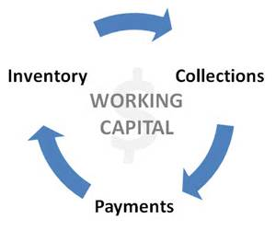
Working Capital Management
Notes:
It is also critical for attention to be paid to the amount of cash on hand and the use of cash while the provider awaits reimbursement for services.
The difference between current assets (cash, receivables, and inventory) and current liabilities (salaries payable and accounts payable) is referred to as working capital
Essentially, working capital management entails collecting receivables as quickly as possible while making payments for salaries and other expenses on the day due, and not before
A common metric for monitoring inventory levels is the days in inventory ratio. Hospitals use this ratio frequently, as do large physician clinics. It may not be relevant to a small physician office or a health plan that maintains only a minimum inventory.
days in payables ratio is also an important tool. The health plan has a large amount of payables on hand in terms of claims awaiting adjudication. Health plan managers must be sure that they are timely paying invoices presented for payment. This is equally true for a physician clinic or hospital purchasing supplies on trade credit. Timely payments are essential to maintain access to trade credit, which allows the hospital or clinic to finance supplies used to provide care.

Slide 22
Additional Financial Resources
Short-Term
Accounts payable
Line of credit
Longer Term
Mortgage or bond issuance
Lease
Notes:
Short-term sources of financing entail different forms of debt. The most common form of short-term debt in a healthcare organization is accounts payable. Accounts payable are a form of trade credit where a supplier delivers goods to a buyer but delays collection on those supplies for a short time, usually about 30 days. This delay in payment for supplies is a form of debt that can free up cash for other uses such as payment of salaries.
Some businesses acquire additional short-term debt through a line of credit with their bank. A line of credit is like a credit card, through which the organization can draw funds as needed to meet immediate cash needs.
Long-term debt is almost always secured with some asset of the business as collateral for the debt. This debt is usually in the form of a mortgage or a bond issue
A longer-term rental arrangement is referred to as a lease. A lease may be structured as either an operating lease or a capital lease. An operating lease is essentially a long-term rental of facilities or equipment . . A capital lease is similar in many respects to a mortgage in that the lessee makes a fixed monthly payment to the lessor for use of the asset

Slide 23


Slide 24
Thank You!

