Slide 1



North Carolina Health Insurance Institute
MedCost Presentation (Virtual)
April 2024

Slide 2


MedCost Mission
MISSION
PURPOSE
VALUES
We exist to provide exceptional value through high-quality, transformative health care solutions
Improve health, lower health care costs, and create a better health experience
Integrity, Compassion,
Collaboration, Inclusion, Learning, Excellence

Slide 3

Who We Are – What Does MedCost Do?
Offer a vast proprietary network of providers (professional, facility and ancillary) in North Carolina, South Carolina and Virginia.
Providing health and wellness benefits to self funded employers since 1983. Helping these employers balance the health care of their employees with the financial health of their company.
Through MedCost’s TPA, we serve more than 600 employers throughout the Carolinas and Virginia, including 49 hospitals. These companies rely on our strategic benefit plan design, flexibility in benefit administration, propriety provider network and customer-focused service. Including unmatched integrated clinical programs that combine member care with effective claims management.

Slide 4
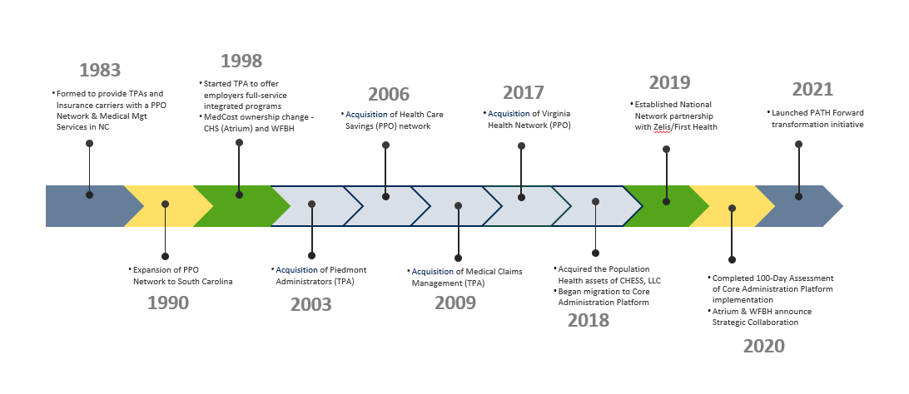
MedCost History

Slide 5

MedCost Today
Over 35 years of experience providing solutions to employers
Regional presence in NC, SC and VA
Over 400 employees; headquartered in Winston-Salem, NC
Strong provider network in the Carolinas and Virginia with over 100,000 participating providers
Provider-owned

Slide 6

MedCost Network
^{Network}
MedCost offers one of the largest, most effective networks in the Carolinas. It is comprised of more than 83,000 primary care and specialist providers, and more than 1,400 hospitals/facilities/ancillary providers.
^{Credentialing}
MedCost Network physicians and hospitals are required to meet URAC credentialing criteria. This includes but not limited to, education, certification, licensing, hospital privileges, practice history, criminal history, malpractice history, and other quality criteria.
^{Contracting}
MedCost’s Contracting team works hard to ensure we build and maintain strong provider relationships that position us competitively in the markets we serve.

Slide 7

MedCost Regional & National Network Solutions
Primary
Network
Ancillary
Network
Multi-State
North and South Carolina
Virginia
Progressive Contracting Strategies
Comprehensive Access
Pricing Transparency
Innovative Network Solutions
Strategic partnership with national network for coverage when members reside in other states or are traveling

Slide 8

























Our Clients

Slide 9

MedCost Administration
Navigating MedCost

Slide 10
MedCost Network
How to Find a Provider
With our online Provider Search Directory, you can quickly and easily find a MedCost network participating provider.
• Go to www.medcost.com
• Click on “Find a Doctor or Facility”
• Choose Network from drop down menu
• North or South Carolina residents:
- “MedCost and MedCost ULTRA”
• Virginia residents:
“Virginia Health Network (including Plus)”
Provider Name – search by physician last name, practice name or specialty (further narrow your results by entering the physician’s first name, city, and/or state).
Facility Name – search by facility/ancillary name or type (further narrow your results by entering a city and/or state).
Provider Radius – choose a specific provider specialty or facility type and search for providers or facilities within a certain mile radius of your zip code.
Create a Custom Directory – generate a custom PDF Directory of providers or facilities within a certain distance radius of your zip code or select statewide by a specific specialty or for all specialties.
You can find additional information in the “About This Directory” section of the web site or use the “Specialty Definitions” section to help identify the type of physician you need. You can also verify provider participation by calling 800-824-7406.

Slide 11
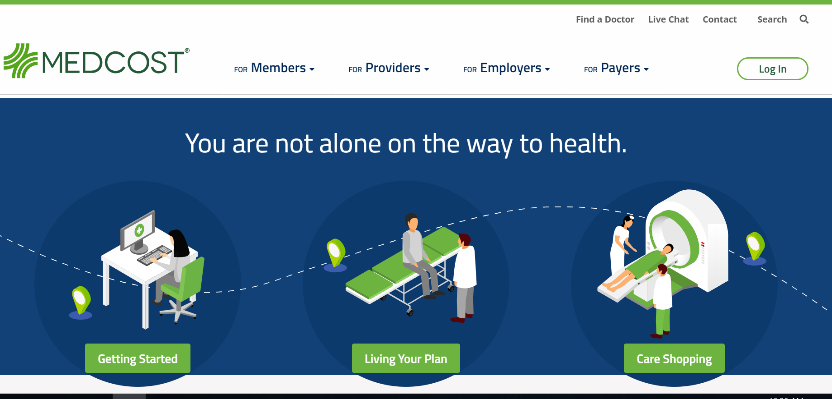
MedCost Website – Navigating MedCost

Slide 12
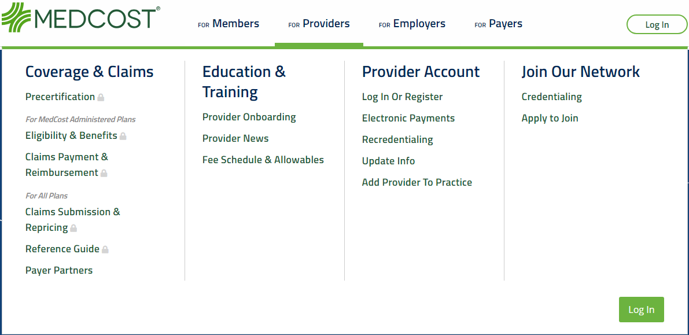
MedCost Website – Online Tools

Slide 13
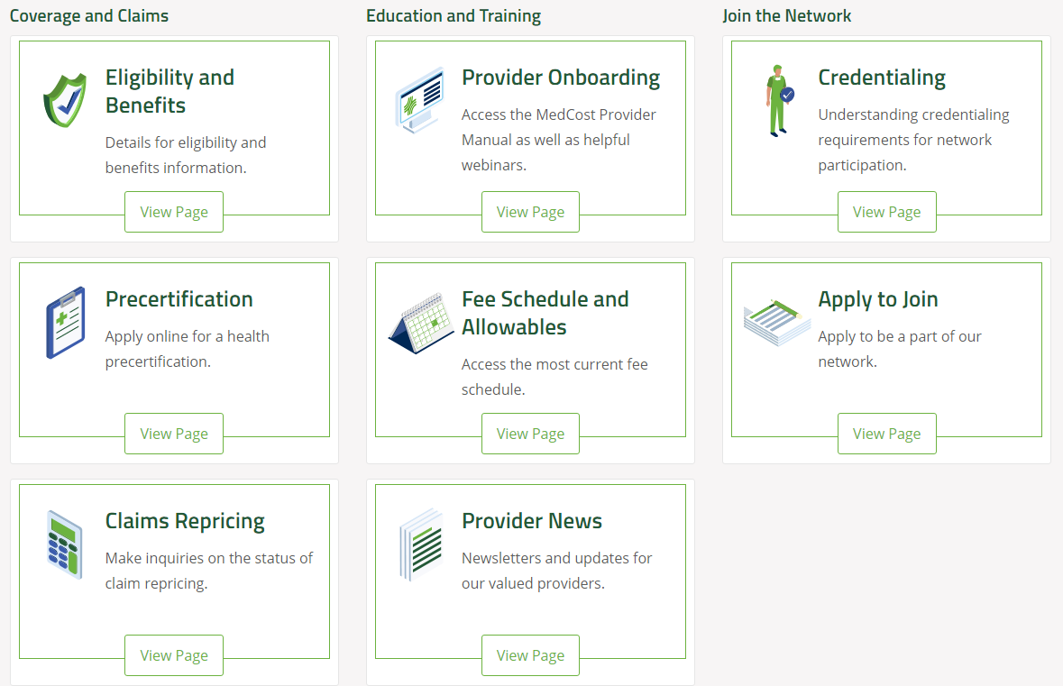
MedCost Website – Network Online Tools

Slide 14

MedCost Website – Online Tools
No registration/password required; all users have access to the following:
Locate a Provider
Provider Manual (part of your contract)
Update Demographics
Credentialing Information
Provider Education
Payers with Online Claim Status
News – register for eCommunications
www.MedCost.com

Slide 15

Staff Training Options: We offer a variety of training opportunities to help you gain a thorough understanding of MedCost procedures and available tools and resources. If you have questions about training options or want additional staff training, we can accommodate that request in a manner that is convenient for your team..

Slide 16
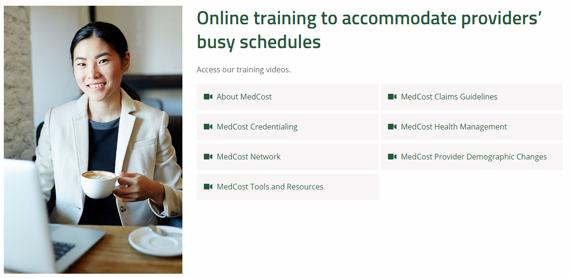
MedCost Website – Online Tools - Onboarding
Provider Onboarding: MedCost Manual and Webinars

Slide 17
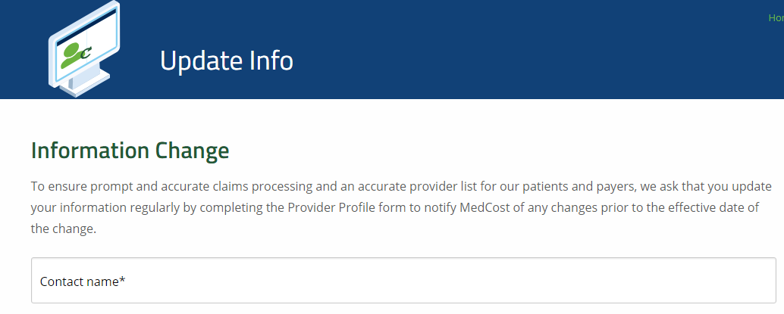
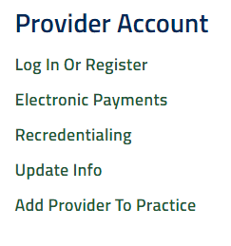
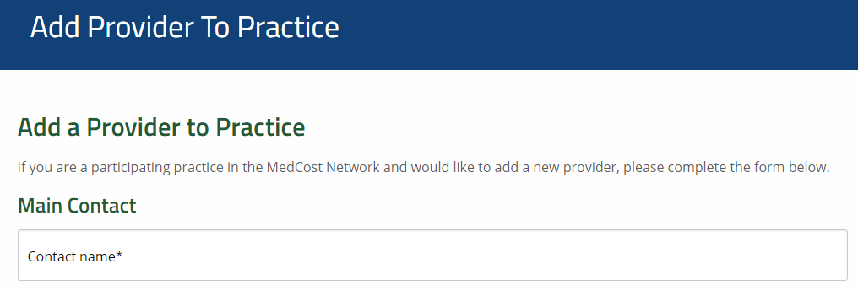
MedCost Website – Online Tools

Slide 18
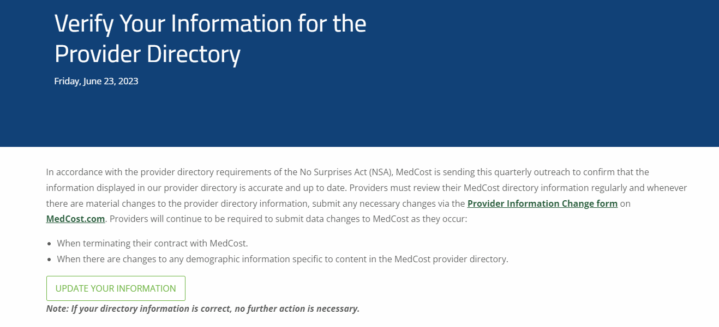

Slide 19
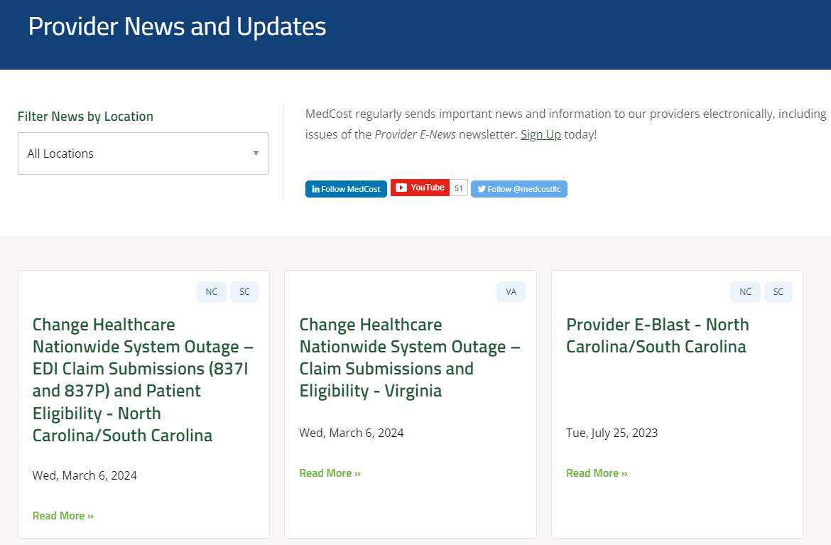

Slide 20
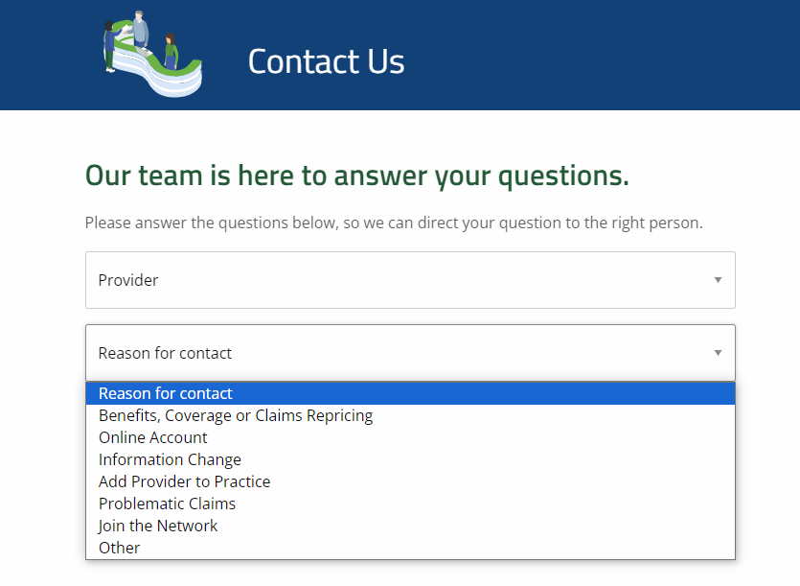

Slide 21


Slide 22
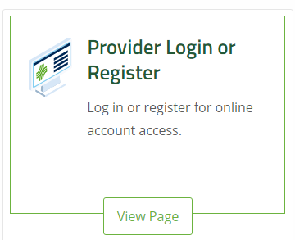
MedCost Website – Online Tools – Secure Portal
Under the Provider options - you can select from the following to obtain useful information:
Claims Repricing Inquiry
Reference Guides
Physician Claim Activity Report
Facility Claim Activity Report
Fee Allowables and Requests
Provider Roster Function
www.MedCost.com

Slide 23
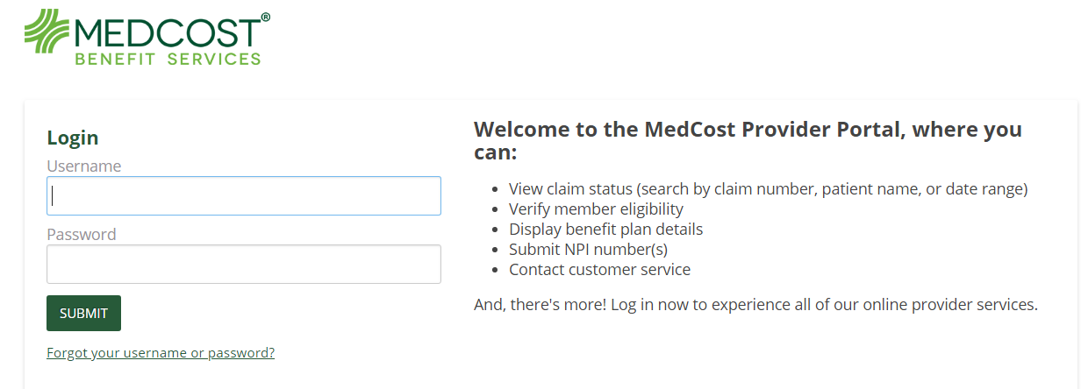
MedCost Website – Online Tools – Secure Portal
MedCost Benefit Services - TPA
Under MedCost Benefit Services, you can select from the following to obtain useful information:
View claim status (search by claim number, patient name or date range)
View member eligibility
Display benefit plan details
Submit NPI numbers
Contact customer service
www.MedCost.com

Slide 24
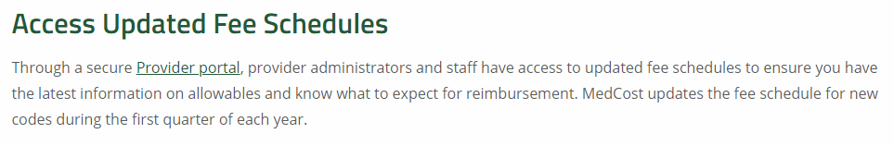
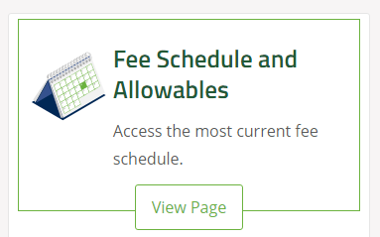

MedCost Website – Fee Schedule – Secure Portal
www.MedCost.com

Slide 25
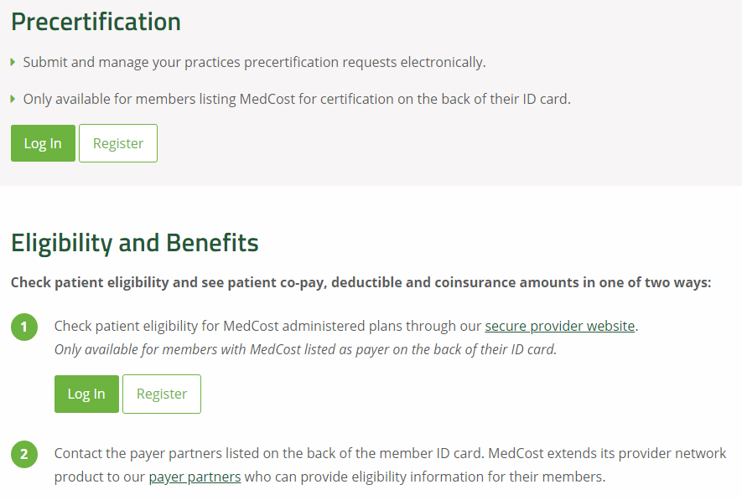
MedCost Website – Precertification/Eligibility & Benefits

Slide 26
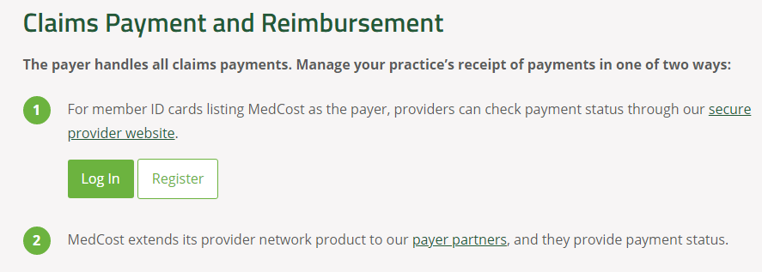
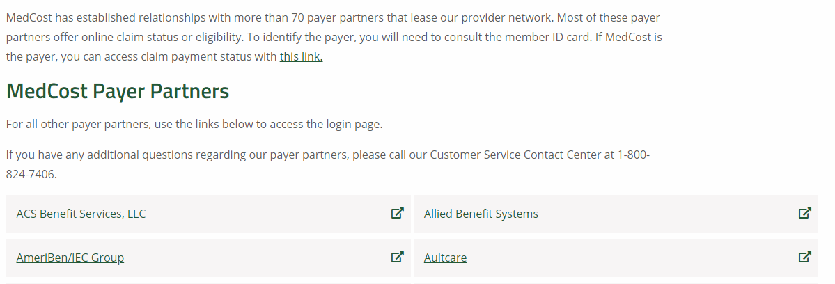
MedCost Website – Claims Payment & Reimbursement

Slide 27

Verification Of Benefits
Request for verification of benefits should be directed to the claim administrator as indicated on the member’s ID card. MedCost does not maintain member level eligibility.
Plan design will vary by each individual employer group.
Ensure you check benefits so that you may collect appropriate co-payment or co-insurance amounts at the time of service.
Provider may collect co-insurance amounts based on actual charge.
www.MedCost.com

Slide 28
Questions?
Customer Service Contact Center
1-800-824-7406
Monday - Friday, 8:30 a.m. to 5:00 p.m.
Visit our website at www.MedCost.com
Thank You For Participating!

