Slide 1
North Carolina Medicaid
News & Hot Topics
April 17, 2024
Serja Goram, MBA, Provider Relations Representative
Michael Herrera, Provider Relations Supervisor

Slide 2
AGENDA
NC Medicaid Expansion Update
License Accreditation Certification
LMC/MCO Consolidation Overview
New Sanction Questions Added to Enrollment Applications
Provider Reverification
MPEC Changes
PDM/CVO Update
Community and Provider Resources
NC Medicaid Provider Ombudsman
Links
Q & A

Slide 3
As of March 1, 2024; 369,203 adults have Medicaid thanks to expansion.
This is more than halfway to our two-year goal of adding 600,000 adults.
To receive information on beneficiary qualifications and help tools for providers, click here.
For the most up-to-date information on Medicaid expansion, you may refer to the Expansion dashboard here.

Slide 4
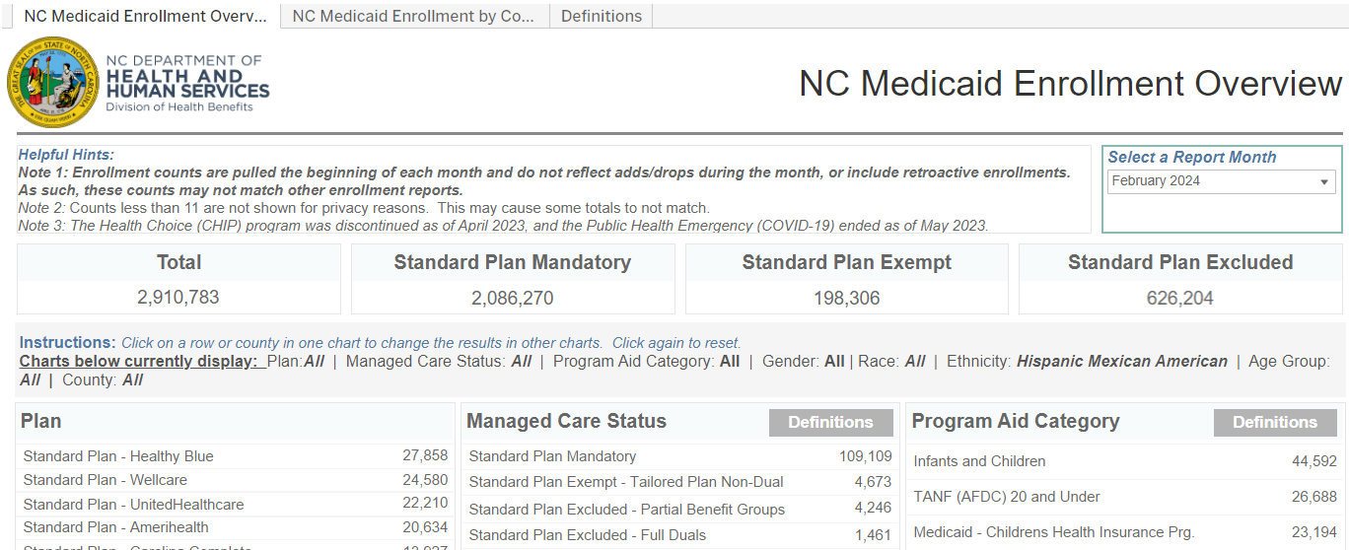
Medicaid Expansion Enrollment Dashboard
Tracks monthly enrollment for eligible individuals through expansion.
Offers detailed overview of trends in newly eligible adults
Reflects highest percentages of adults are in NC rural communities
Updated monthly
Track progress each month using this link: Medicaid Expansion Dashboard | NC Medicaid (ncdhhs.gov)

Slide 5
License Accreditation Certification
NC Tracks automated process scans records for expiring credentials
Letters are initiated to providers 60 days prior to expiration
Associated taxonomy codes will be suspended if no action taken
Suspension letter then sent to Message Center Inbox
Letter will remain for 60 days unless credential is renewed (lifting the suspension)
For more information, go to NCTracks License & Accreditation FAQs here.

Slide 6
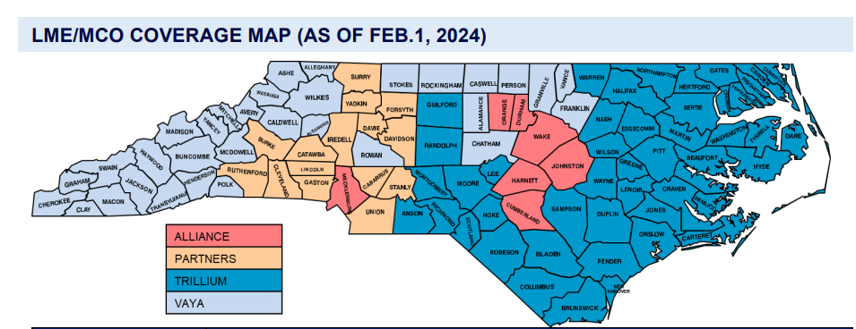
LME/MCO Consolidation Overview

Slide 7
LME/MCO Consolidation Overview
LME/MCO consolidation approved by
Secretary Kinsley and occurred on 2/1/24
Trillium responsible for nearly all Eastpointe and Sandhills counties in catchment area, now operating in 46 NC counties
Partners, Alliance, and Vaya each aligned with one additional county within the Sandhills and Eastpointe catchment area
Effective 2/1/24, providers contracted with Sandhills and/or Eastpointe automatically aligned with Trillium contracts
Contract changes reflected in NCTracks

Slide 8
New Questions Added to Enrollment Applications
Five new exclusion sanction questions added to provider enrollment applications effective January 28, 2024
Affirmative response – next steps
Failure to disclose documentation – results in denial
More information on requirements for supplemental documentation can be found here

Slide 9
Provider Request for Coverage Form
Providers and external stakeholders may formally submit a request for coverage of a procedure(s), product(s) and/or service(s) through the NC Medicaid website.
The requestor may fill out the form and email it to medicaid.coverage.request@dhhs.nc.gov. Submissions will only be processed if all required information is completed.
When submitting the Coverage Request form, please ensure your submission has sufficient evidence to support the request. There needs to be solid clinical evidence to support coverage of procedure(s), product(s) and/or service(s).
Will take up to nine weeks. The NC Medicaid team will review to confirm coverage for other Medicaid programs, commercial payers and Medicare.
If the request passes the initial review, the NC Medicaid team will review associated literature and consider coverage in other states.
If the request passes the detailed review, then the NC Medicaid team will initiate the formal policy modification process.
The NC Medicaid team has established the following estimated timeframes for review of submissions:
Initial Review
Detailed Review (up to 16 weeks)
Further Consider to Policy (up to 14 months)

Slide 10
PROVIDER REVERIFICATION
Reverification occurs every five years from initial enrollment
Any delay in responding may cause processing delays or adverse determinations
Notifications are sent to provider via the secure portal
Those who do not complete reverification will ultimately terminate from Medicaid
Provider’s credentials cannot expire within 30 days of requested effective date

Slide 11
Reverification: Avoid Delays, Withdrawals, Denials
Ensure OA name is correct and current. OA updates should be made using the Change Office Administrator Application.
Confirm active taxonomies and end-date taxonomies no longer in use.
End-date owners/managing employees no longer associated with your organization.
Confirm the provider’s license, accreditation, and certifications are not expiring within 30 days of application date.
When requested, submit supporting documentation on time to avoid suspension or termination.
Follow the Change in Ownership (CHOW) protocol.

Slide 12
2024 Increase in Federal Provider Enrollment Application Fee
The federal fee for Medicaid enrollment will increase from $688 to $709 for calendar year 2024.
Effective Jan 1, 2024, the fee will be required for Initial enrollment, re-enrollment, Managed Change Request (MCR) to add a new site location, and reverification.
Additional information can be found here.

Slide 13
Provider Name on Reverification Applications Must Match ALL Documentation
Provider's name listed on applications must match their legal name, name on the NPPES Registry and name on any license, certification, and/or accreditation
Providers can check how their names appear in the NPPES system at https://npiregistry.cms.hhs.gov/search
If name in NPPES system doesn't match, this must be corrected. Do NOT submit application. Instead, send an email to NCTracksprovider@nctracks.com with required documentation attached.
Refer to link for more information about required documentation: here

Slide 14
PDM/CVO
Update

Slide 16
User Acceptance Testing (UAT) Process
Reporting
Test Execution
Test Case Creation
Finalization
Review for Final Approval
Mitigate comments of test results
Final Review & Sign-off
Training
Define areas covered
Ensure testability
Understand test designs
Cycle #1
Cycle #2
Cycle #3
Planning
Prep
Readiness & Certification
Schedule
Send Calendar Invitations
Conduct Training
End of Training Survey
Creation
Internal Review
Tech Writing
QA
Updates
Finalize

Slide 17
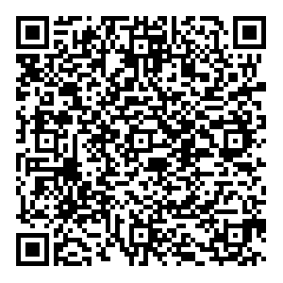
Express Your Interest in PDM/CVO User Acceptance Testing
Medicaid.pdmcvo.stakeholderengagement@dhhs.nc.gov

Slide 18
Medicaid Provider Ombudsman
Most important resource providers can use to resolve concerns with PHPs or anything regarding NC Medicaid
Represents interests of provider community by receiving and responding to inquiries and complaints regarding PHPs, NCTracks – Provider enrollment.
Ombudsman team meets daily to review and discuss provider enrollment cases
Medicaid.Providerombudsman@dhhs.nc.gov or 866-304-7062
Consists of DHB Provider Ombudsman Team and DHB Member Ops-Call Center Team

Slide 19
.
Provider Resources
Beneficiary Materials webpage
NC Medicaid Provider Webpage
Provider Playbook for Medicaid Managed Care
NC Medicaid Provider Bulletin
NC AHEC Medicaid Managed Care Webpage

Slide 20
Additional Links & Resources
Medicaid Expansion Fact Sheet
Tailored Plan Fact Sheets
Health Plan contacts and resources
2024 increase in federal provider enrollment application fee
What is the Process to Update a Name, DOB and/or SSN on a Provider's Record?
NCTracks Reverification Job Aid
NC Medicaid Provider Ombudsman
Medicaid.pdmcvo.stakeholderengagement@dhhs.nc.gov
NC Medicaid PDM/CVO webpage
PDM/CVO Fact Sheet
NC Medicaid Help Center

Slide 22
QUESTIONS

