Slide 1
Mackie Hicks
Tica B. Davis
WellCare of North Carolina
April 17, 2024
Confidential and Proprietary Information

Slide 2
Contents
01
The Presenters
02
WellCare of North Carolina Overview
03
WellCare of North Carolina Approach
04
Provider Reimbursement
05
Appeals / Grievances
06
Q&A

Slide 3
The Presenters

Slide 4
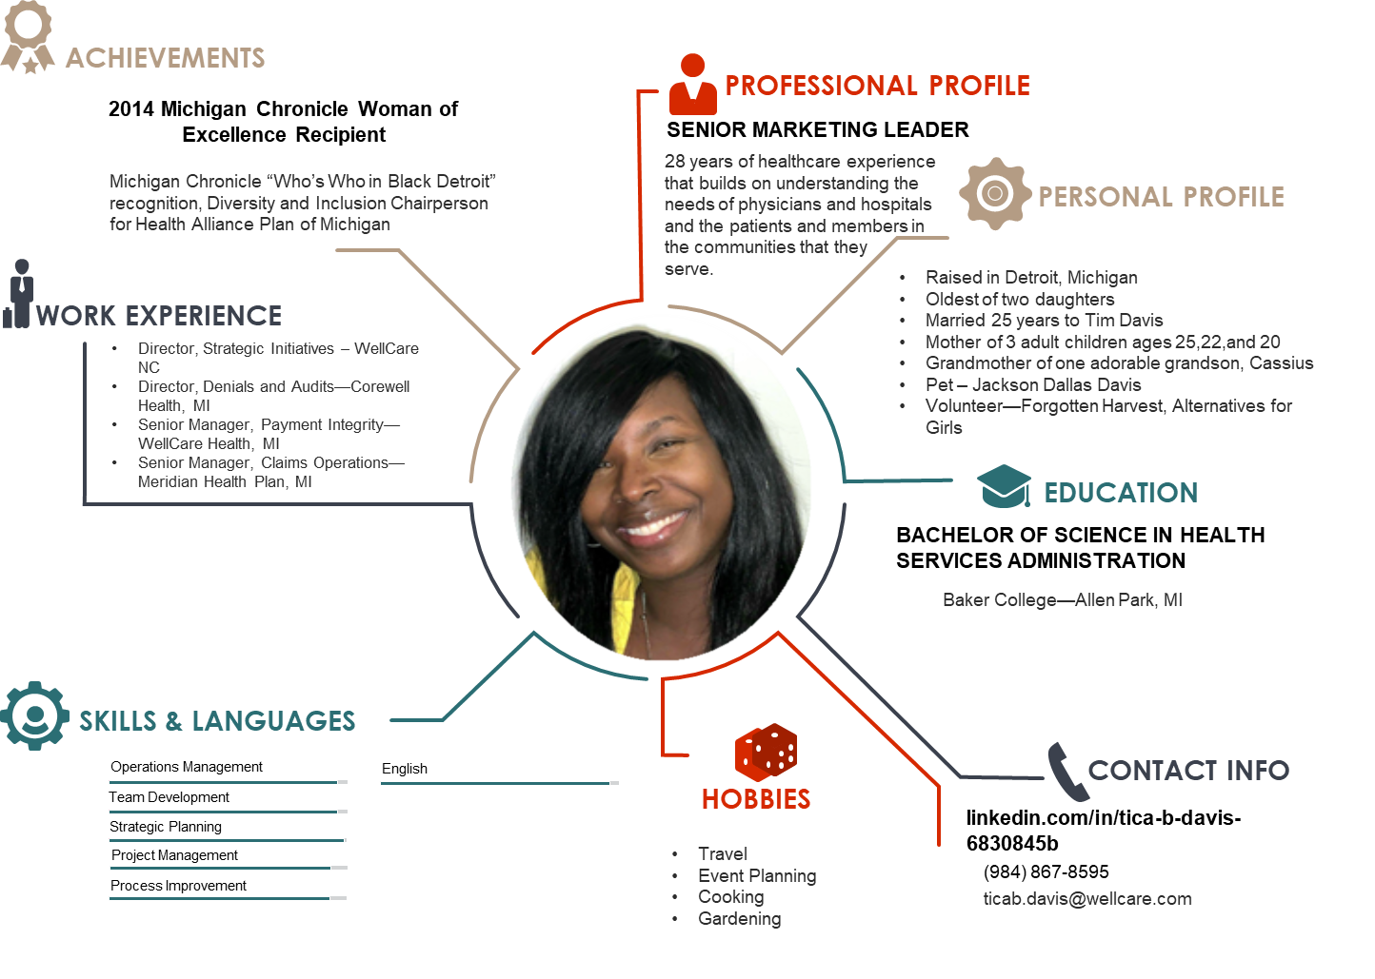
Tica B. Davis
Director, Strategic Initiatives

Slide 5
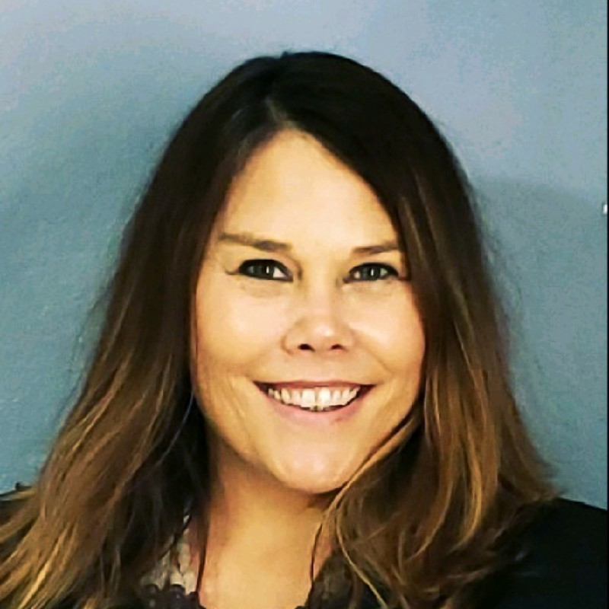
New Leaders
ACHIEVEMENTS
PROFESSIONAL PROFILE
National Diversity Council Leader of the Year, 2019
Lowered Turnover by 21% at Enlivant
Recently returned to WellCare working alongside a phenomenal team
25 years in the healthcare industry, encompassing areas including Community Mental Health, Addictions, and Nonprofits, and MCOs.
PERSONAL PROFILE
WORK EXPERIENCE
Born and raised in Tampa, FL, 4th generation Tampanian
Has a spouse and dog
Recently moved to Raleigh
Enlivant Senior Living
BCBS
WellCare
Turning Point of Tampa
Suncoast Center for Community Mental Health
Insert Photo Here
EDUCATION
Franklin Pierce College
University of South Florida
American Public University
SKILLS & LANGUAGES
Leadership
People Management
Simplifying complex issues
English
CONTACT INFO
HOBBIES
Traveling, spending times with friends, playing poker, music, and sports of all kinds.
984-296-5093

Slide 6
WellCare of North Carolina Overview

Slide 7




Our Reason for Being
WHO WE ARE
WellCare of North Carolina serves families, children, seniors, and individuals with complex medical needs. We partner with state and federal governments to coordinate managed care services for those eligible for Medicaid.
As a subsidiary of Centene Corporation, the largest Medicaid Managed Care company in the United States, we serve over 27 million members across 50 states.
OUR VISION
OUR VALUES
To be the leader in government-sponsored healthcare programs in North Carolina.
Serve Others First
OUR MISSION
Do the Right Thing
To ensure, through deep engagement with our members, providers, and government partners, that every WellCare of North Carolina member receives high-quality healthcare and has access to resources that help them live fuller, healthier lives.
Be Accountable
Act as One Team
Confidential and Proprietary Information

Slide 8
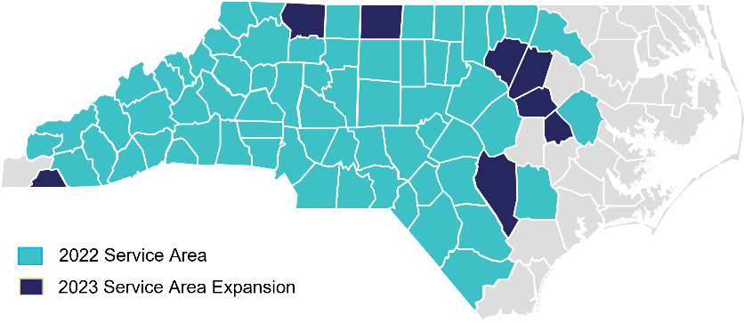












Our Footprint
MEDICAID
MEDICARE
MARKETPLACE
Columbus
Brunswick
Columbus
Brunswick
  2nd largest Medicaid health plan in the state
Offering MA/PDP products across NC since 2018
  The ACA plans are offered in the 2022 AEP
  100 Counties
  71 Counties for 2023
  8 counties expansion
  100 Counties
  402,972 Members*
  21.5% Market Share
  15,451 Members*
  1.4% Market Share
  Network-Multiplan
* Data as of March 2023
Confidential and Proprietary Information

Slide 9




at-a-glace
Centene offers affordable and high-quality products to nearly 1 in 15 individuals across the nation, including Medicaid and Medicare members (including Medicare Prescription Drug Plans) as well as individuals and families served by the Health Insurance Marketplace and the TRICARE program.
#60
#25
FORTUNE 500®
LIST (2023)
FORTUNE® Global 500 LIST (2023)
28.0 M
Largest Medicaid Managed Care Organization in the Country
MEMBERS
National leader in managed LTSS and managed care services for the foster care population
50 states
1 in 15
WITH GOVERNMENT-SPONSORED HEALTHCARE PROGRAMS
INDIVIDUALS ACROSS THE NATION
#1 carrier in the nation on the Health Insurance Marketplace
©2020 Fortune Media IP Limited. Used under license.
Centene Fact Sheet 2023 Q3
Confidential and Proprietary Information

Slide 10
WellCare of North Carolina Approach

Slide 11




Our Approach
At WellCare of North Carolina, we foster strong partnerships with providers, offer an integrated care model, establish trusting partnerships with our state and federal partners, and address barriers to care in our local communities.
The core elements below contribute to our value proposition:
PROVIDER ENGAGEMENT
INTEGRATED CARE MODEL
GOVERNMENT PARTNERSHIPS
COMMUNITY ENGAGEMENT
Fostering strong partnerships with select providers
Integrating medical, behavioral, social, and pharmacy operations
Establishing trust with our state and federal partners
Empowering members to reach optimal social health and independence
Confidential and Proprietary Information

Slide 12
Provider Engagement

Slide 13

Provider Engagement
VBC
Provider Contracting
Quality Advisor
Risk & Gap Closure
Population Health
Operations Account Rep
Pharmacy
Performance Analyst
Provider Engagement Reps own the provider relationship but count on support and deliverables from a range of local and corporate stakeholders.
Provider Engagement Lead
Confidential and Proprietary Information

Slide 14



Contact Us – Provider Lines
Provider Service Phone Numbers
1-866-799-5318
Provider Related Issue
Local PR Rep (see contact sheet)
NCProviderRelations@wellcare.com
Voice Mail; 984-867-8637
Fax: 813-283-3045
Interesting in Contracting
prosprovnc@wellcare.com
1-813-865-6503
Confidential and Proprietary Information

Slide 15
Key Responsibilities of Provider Relations
Let’s fix your issues quickly
To build an overall, encompassing relationship with the providers
Address claims and payment issues
To train providers on WellCare processes such as, authorizations, access and availability standards, and the use of www.WellCare.com
To collaborate with physicians and provider office staff on meeting quality goals
To maintain provider data
To assist in getting providers signed up for EFT
PR works to notify providers of important information regarding their participation with WellCare
Additional provider issues are addressed as they arise

Slide 16
Provider Relations Leadership
Provider Relations Managers
Region 1 & 5
Heidi Mason-Sotomayor
Phone: 808-545-3083
Email: heidi.m.masonsotomayor@wellcare
Region 2 & 6
Pamela Cane
Phone: 919-902-1187
Email: pamela.cane@wellcare.com
Region 3
Shamekia Pena
Phone: 910-391-3542
Email: shamekia.pena@wellcare.com
CCPN,
Provider Relations Managers
Region 4
Sarah Hooks
Phone: 404-314-5164
Email: sarah.hooks@wellcare.com
FQHC, DME, Home Health
OLyndria Branche
Phone: 704-591-9101
Email: lbranche@wellcare.com
Statewide
*This is not a comprehensive list
Confidential and Proprietary Information

Slide 17
Provider Relations Contacts
REGION 1
Serena Clark Phone: 336-409-0172 Email: Serena.Clark@wellcare.com Counties: Cherokee, Clay, Graham, Haywood, Jackson, Macon, Madison, Rutherford, Swain, Transylvania,
Jonathan Askew
Phone: 336-604-9362
Email: Todd.Askew@wellcare.com
Counties: Avery, Buncombe, Burke, Caldwell, Henderson, McDowell, Mitchell, Polk, Yancy
REGION 2
Cody Corbett Phone: 336-604-9362 Email: Cody.Corbett@wellcare.com Counties: Ashe, Davidson, Randolph, Rockingham, Guilford, Stokes, Watauga,
Imani Pinkney
Phone: 919-691-1149
Email: Imani.Pinkney@wellcare.com
Counties: Forsyth, Surry, Wilkes, Yadkin, Alleghany, Davie
REGION 3
Sean Calderon
Phone: 7047701988
Email: Sean.Calderon@wellcare.com
Counties: Alexander, Anson, Catawba, Cleveland, Iredell
Randi Allen
Phone: 704-560-7559
Email: randi.allen@wellcare.com
Counties: Cabarrus, Gaston, Lincoln, Rowan, Stanly, Union
Kisha Brandyburg
Phone: 803-397-0928
Email: Kisha.Brandyburg@wellcare.com
Mecklenburg by Zip Code: 28031, 28036, 28078,28105, 28134, 28202, 28203, 28204, 28205, 28206, 28207, 28208, 28209, 28210, 28211
Open
Phone:
Email:
Mecklenburg by Zip Code 28212, 28213, 28214, 28215, 28216, 28217, 28226, 28227, 28244, 28246, 28260, 28262, 28270, 28273, 28277, 28278, 28280, 28289
Team mailbox: NCProviderRelations@WellCare.com
Confidential and Proprietary Information

Slide 18
Provider Relations Contacts
REGION 4
Tawanda Lewis
Phone: 919-440-0833
Email: tawanda.lewis@wellcare.com
Counties: Warren, Franklin, Johnston, Wilson
Shawn Dyson
Phone: 919- 444-5113
Email: Kwasi.Dyson@wellcare.com
Counties: Alamance, Person, Vance, Chatham, Nash
Shakirah Joyner
Phone: 252-375-9259
Email: shakirah.joyner@wellcare.com
Counties: Wake
Eboni Alston
Phone: 980-254-0984
Email: eboni.alston@wellcare.com
Counties: Caswell, Durham, Granville, Orange
REGION 5
Elease Belser
Phone: 910-734-5363
Email: Elease.d.Belser@wellcare.com
Counties: Columbus, Robeson, Moore, Lee, Harnett, Montgomery, Richmond, Hoke
Jennifer Berumen
Phone: 910-301-5169
Email: Jennifer.Berumen@wellcare.com
Counties: Sampson, Scotland, Cumberland,
Pender, Brunswick, New Hanover, Bladen
REGION 6
Michele Phillips
Phone: 919-886-8369
Email: michele.Phillips@wellcare.com
Counties: Wayne, Halifax, Lenoir, Edgecombe, Bertie,
Martin, Greene, Pitt, Carteret, Halifax, Hertford, North Hampton, Pasquotank, Perquimans, Tyrell
Jonathan Turner
Phone: 313-820-1580
Email: Johnathan.Turner@wellcare.com Counties: Washington,, Craven, Duplin, Jones, Onslow, Pamlico, Beaufort, Hyde, Gates, Dare, Currituck, Chowan, Camden
Confidential and Proprietary Information

Slide 19
Provider Relations Contacts
Network Performance Advisors*
Marti Skelly - Region 1 & 2
Phone: 762-230-1324
Email: marti.skelly@wellcare.com
DLP, Moses H Cone, Mission, Appalachian
Thomas Corbett – Region 3
Phone: 980-279-9487
Email: Thomas.Corbett@wellcare.com
Atrium, Novant, Caromont, Kintegra
Ioulia (Julie) Hardin – Region 4
Phone: 910-409-1328
Email: Ioulia.hardin@wellcare.com
UNC, Duke, WakeMed, Harnett Health,
Network Performance Advisors*
Cody McAlhaney – Region 5
Phone: 828-772-4721
Email: cody.mcalhaney@wellcare.com
Cape Fear,
Tawanda Lewis – Region 6
Phone: 919-440-0833
Email: Tawanda.Lewis@wellcare.com
First Health, ECU, Vidant
FQHC, DME
Milton Howard
Phone: 980-254-0872
Email: Milton.howard@wellcare.com
Statewide FQHC
Miesha Stanley-Lindsay
Phone: 314-296-8246
Email: Miesha.stanley-lindsay@wellcare.com
Statewide DME
*This is not a comprehensive list
Confidential and Proprietary Information

Slide 20
Integrated Model of Care

Slide 21
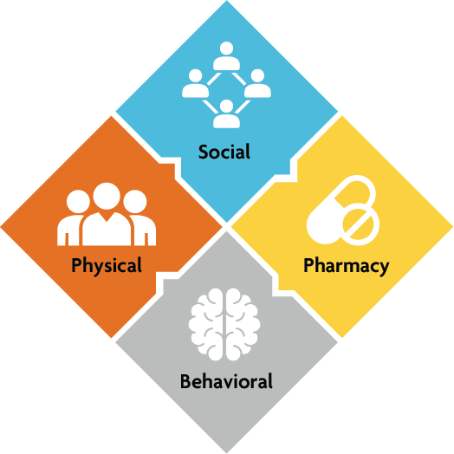
Integrated Model of Care
WellCare of North Carolina uses a holistic, customized approach to care for our members based on their unique physical, behavioral, pharmaceutical, and social needs.
  WellCare of North Carolina uses a proprietary clinical platform to identify and stratify member needs into four areas, which improves care coordination and appropriate utilization.
  Addressing members’ social needs is an important part of the solution. When members are connected to services like job, education, and utility assistance, we see:
    Improved medication adherence rates
    Increased independence
    Lower hospital admissions
    Improved physical and behavioral health outcomes
Confidential and Proprietary Information

Slide 22
Government Partnerships

Slide 23

Government Partnerships
  WellCare of North Carolina serves families, children, seniors, and individuals with complex medical needs as a leader in government-sponsored managed care. We build strong partnerships with state agencies, local governments, and elected officials.
  WellCare of North Carolina’s hyperlocal model aligns with North Carolina’s vision for Medicaid Transformation across all 100 counties:
“To improve the health of North Carolinians through an innovative, whole-person centered, and well-coordinated system of care which address both medical and non-medical drivers of health.”*
* Quote copied from DHHS presentations to the legislature on the implementation/future of Transformation
Confidential and Proprietary Information

Slide 24
Community Engagement

Slide 25





Community Engagement
WellCare of North Carolina has multiple avenues for supporting our members and the community around Social Determinants of Health, including forming collaborative community partnerships with local organizations and connecting with beneficiaries in the community where they reside. Our Community Engagement includes two teams across all six regions, as well as resources and tools to support DHHS objectives around social service delivery and community partnerships.
A Community Connections Help Line (CCHL) for member and non-members that assist with needs that fall outside the benefit structure.
Meeting members where they are to support them in removing social barriers to improve health outcomes.
Integrate socio-economic solutions into the whole-person care model.
Integration and participation with NCCARE360 and Healthy Opportunities Pilots.
Share Medicaid, Redetermination and expansion information in community.
Bring wellness opportunities and health care interventions to the community through events and partnerships.
Fund SDOH and Health equity initiatives in the community
Support community partners in preparing for more formal integration into the healthcare system.
Assistance with 68 additional categories of social need.
Confidential and Proprietary Information

Slide 26

SDOH Resource Coordination
Community Connections Helpline:
  If a member need assistance with recourses such as food, rent and more, call our Community Connections Helpline at 1-888-860-1605 (TTY: 711) Monday through Saturday, 7 a.m. to 6 p.m., Eastern time.
Healthy Opportunities (HOP) Helpline:
  A member should never have to pick between food and medicine. Healthy Opportunities offers ways to help members get the resources needed to live a healthier life. For more information about the HOP program benefits, services, or resources call our Healthy Opportunities Helpline at 1-844-901-3800 (TTY: 711) Monday through Saturday, 7 a.m. to 6 p.m., Eastern time. Or visit WellCareNC.com/HealthyOpps to learn more
Confidential and Proprietary Information

Slide 27
Utilization
Management

Slide 28
WellCare of North Carolina
Medical Management
Some examples of services that require prior authorization:
Some DME
Genetic Testing*
Hi-Tech Radiology*
Home Health
Elective Inpatient Services
Out of Network – except for Emergency Services
Pain Management*
NOTE: This list is not all inclusive. Please visit https://www.wellcare.com/North-Carolina/Providers/Authorization-Lookup
Sleep Studies
Therapies (PT, OT, ST)*
Transplants
Non-Emergent Medical Transportation*
Services provided by a non-participating provider
Quantitative Drug Screening
Some Outpatient Surgeries and Procedure
*Services Managed by a Vendor
Confidential and Proprietary Information

Slide 29
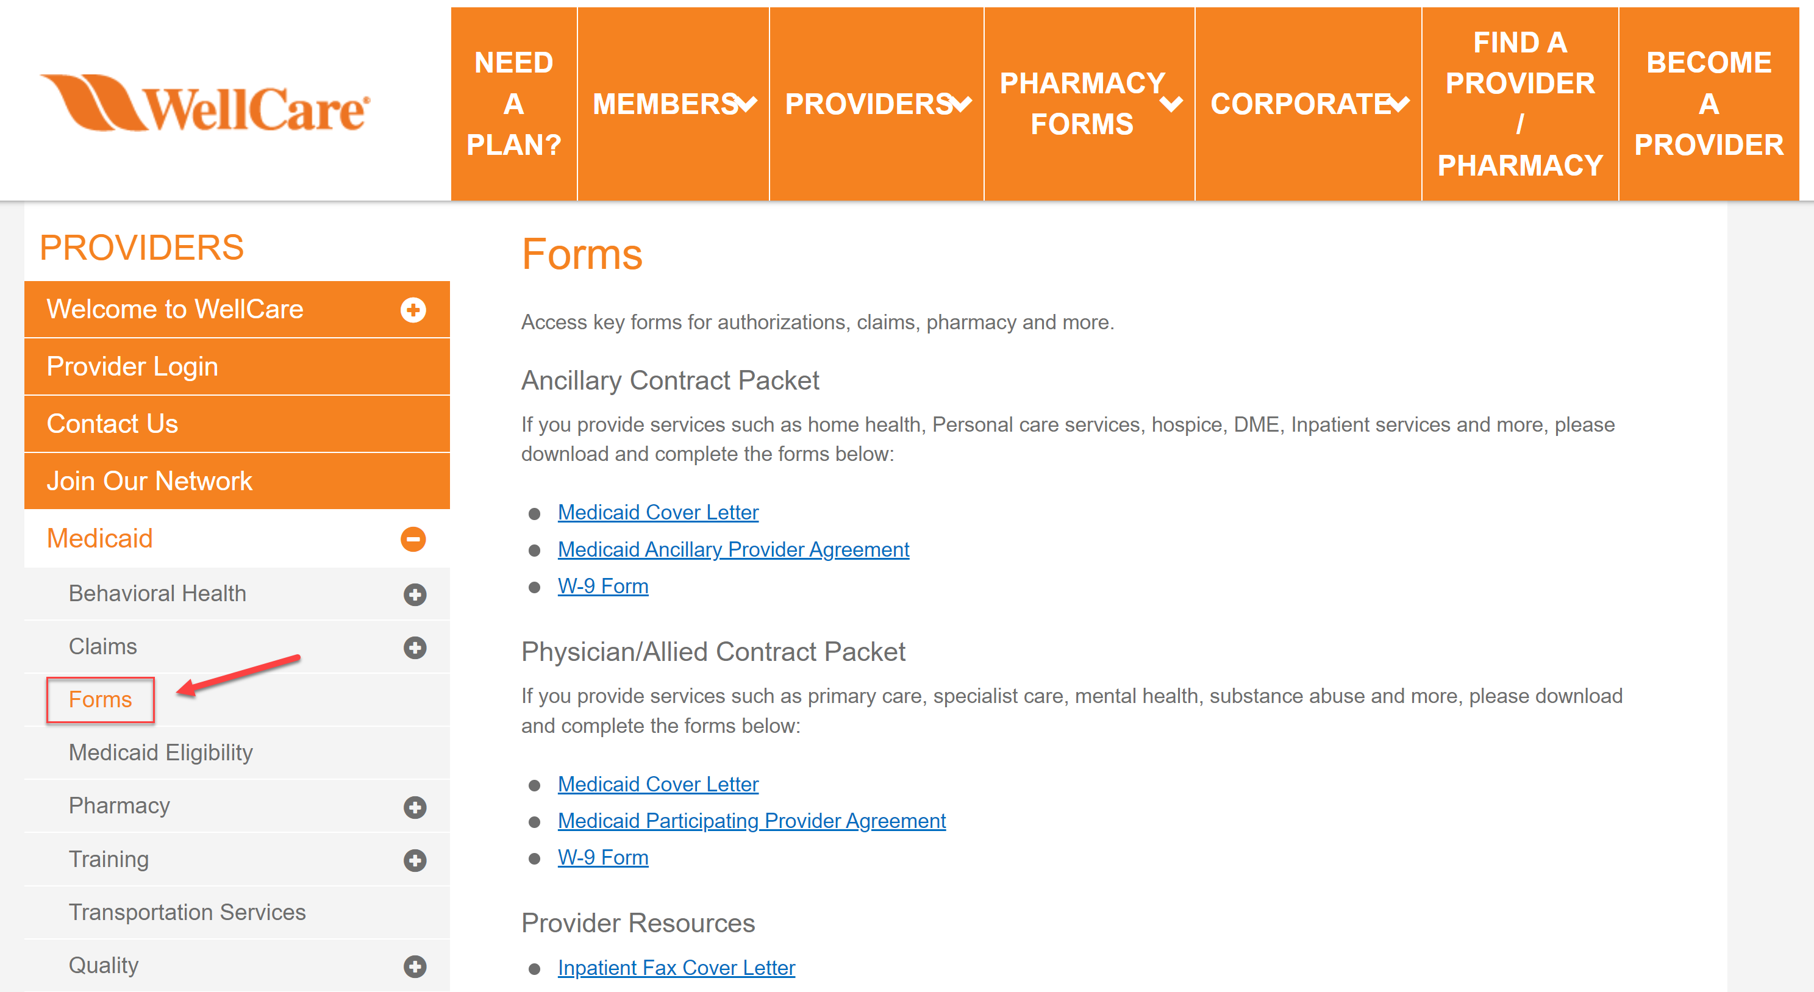
Authorizations
To Submit an Authorization Visit:
https://www.WellCareNC.com/providers/medicaid/forms.html
Confidential and Proprietary Information

Slide 30

WellCare of North Carolina
Medical Management
24 Hour Nurse Line
The 24-hour nurse line is a toll-free phone line through which callers can reach Registered Nurses.
The nurse triage service provides access to a broad range of health-related services including: medical triage for health issues, health education, linkage to transportation for treatment and crisis interventions (as applicable).
Members can reach the 24-hour nurse line by calling
1-800-919-8807
Services Include:
Nurse Triage and Crisis Management
Member Support and Health Education
Confidential and Proprietary Information

Slide 31
Provider Reimbursement

Slide 32
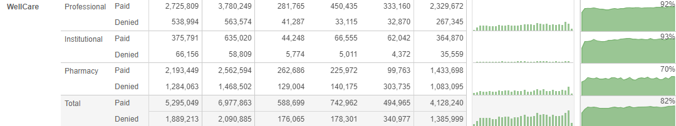
Provider Reimbursement

Slide 33
Average Turnaround Time for Claims Processed
We continue to analyze our opportunities to improve the timeliness of claims processing and provider reimbursements.
2023 AVG: 5.3
2024 AVG: 5.0

Slide 34
Auto Adjudication Rates
Careful monitoring of claim activity allows us to better understand opportunities and/or risk for system issues.

Slide 35
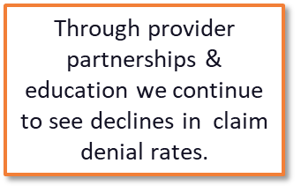
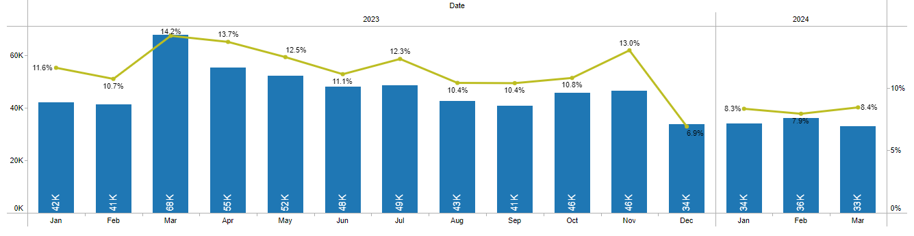

Slide 36
Claim Denials - Institutional

Slide 37
Claim Denials - Professional

Slide 38


Common Causes/Solutions of Denials
TPL / EOB
Medicaid is the last payer. At the time of the appointment, the member should present their primary payer insurance card and the claim should be submitted to the primary payer first. If the primary payer is no longer effective, the proof of term from primary payer or denial letter/EOB from the TPL with the claim should be submitted to WellCare of North Carolina.
  Coding Denials
  Typically related to CMS NCCI billing guidelines. WellCare of North Carolina may override a denial if the provider submits appropriate documentation, and medical review of the claim verifies that the service or item was coded correctly, that it was medically necessary, and that payment is not included in the payment for some other service or item.
  CMS NCCI Initiative
  CMS Medicaid NCCI Policies
  ICD-10 Billing Guide
Confidential and Proprietary Information

Slide 39


Common Causes/Solutions of Denials
Continue
Prior Authorization Denial
  Please utilize WellCare of North Carolina’s auth look up tool to determine if an authorization is required. This website also houses tutorials for requesting authorizations as well as provider portal training and our Quick Reference Guide
Exact Duplicate
  If corrected billing is needed, a replacement bill type (UB04 Bill Type ‘xx7’) or resubmission code of 7 on CMS1500 should be utilized. This will allow us to deny the first-time claim billed and process the corrected claim for payment.
  Vaccines denying as duplicate services due to being provided in other settings such as the hospital/ER or physician’s office.
Confidential and Proprietary Information

Slide 40

Common Causes/Solutions of Denials
Continue
Timely Filing
  First time claims must be received within 180 days from the date of service (or discharge date).
  Corrected claims and claim disputes/reconsiderations must be received within 180 days from the original date of notification of payment or denial.
  Appeals must be received within 30 days from the original date of notification of payment or denial.
Confidential and Proprietary Information

Slide 41



Claims Resources / Billings Tips
WellCare of North Carolina
  www.WellCareNC.com
WellCare Provider Manual
WellCare Quick Reference Guide
Confidential and Proprietary Information

Slide 42
Optum Relationship
Summary
Optum is a vendor that conducts prepay claim reviews to validate billing. The Health Plan has an obligation to our customers to ensure that each claim is paid correctly, according to member and provider contracts and industry standards for appropriate coding and billing. We currently review claims for coding and billing accuracy.
Providers can expect to receive correspondence from Optum on WellCare’s behalf:
In the letters the provider receives (Request for Medical Records, Review Determination, etc.) the Contact Number for the Optum PIRT is included.
Support activities include explaining why claims are denied for medical records, where to send Medical Records, Optum’s case status, and requests for copies of Optum-generated letters.
Additionally, Optum handles 1st level appeals and inquiries related to those appeals.
When a claim is selected for Medical Record review (prepayment) the provider receives a letter requesting these records be sent directly to Optum. Please find information on how to submit the records at the end of this document. After the records are received and the review is completed, the provider receives a letter with the results of the review. The claim is then processed to either pay or deny.

Slide 43
Optum FAQ’s
Frequently Asked Questions (FAQs)
Question |  | Answer
General Information
1 | Who is Optum? | Optum is a vendor hired to conduct prepay claim reviews to validate the providers’ billing activity
2 | Why is the health plan reviewing the claims? | The health plan has an obligation to our customers to ensure that each claim is paid correctly, according to member and provider contracts, national billing and coding published guidelines, and industry standards. The health plan is reviewing claims for coding and billing accuracy. We may ask providers to submit medical records for this coding and billing review. • Provider may reference Payment Policy: Optum Comprehensive Payment Integrity (CPI), Reference Number: CPP-136 NOTE Policies are posted on Markets Websites- Wellcare.com
3 | What are some reasons the claim would require review by Optum? | We currently review claims for coding and billing accuracy. We may ask providers to submit medical records for a coding and billing review. This can include review for NCCI (National Correct Coding Initiative) and applicable Market/LOB payment or coding policies.
4 | How long does this take? | Optum’s review can take up to 7 business days from when Medical Records are received. Note: Optum sends a response to the health plan but the adjustment may require additional time to process.
Medical Record Submission & Receipt
8 | The provider is calling to ask why Medical Records were requested for Personal Care Services (i.e. T-codes) | The medical documentation being requested is an activity log and timesheets. These two documents are needed to review the claim.

Slide 44
14 | Provider received a denial from Optum because Optum did not receive medical records for the claim. Provider wants to know if they can still send in records | Yes, the provider can send records to Optum for up to 365 days after the date that Optum selected the claim for review, and Optum will review the records. Please have them send records to the Optum address below and in the provider letter
Claim Payment or Denial
15 | Provider received an Optum review determination letter and doesn’t know why. | Optum has completed a review on the medical records submitted and they have found a billing issue. Provider should review the reasons for the billing issue outlined in the letter. Provider may dispute the findings if they disagree and have additional information to supply. They should follow the dispute instructions in the letter. Provider may reach out to their Health Plan Provider Relations Representative.
16 | Provider wants to know how to get their payment for an Optum prepay claim in the review determination letter. | Provider may correct their billing issue found in the review and submit a corrected claim Or provider may dispute the findings if they have additional information to supply, by following the instructions in the review determination letter.
17 | What does “no findings” mean? | When Optum performs a review and determines a claim line is allowable, Optum documents “No Findings” in the provider letter. This means the Optum review found the provider followed the appropriate documentation billing guidelines when coding their claim line.
18 | How can a provider submit a dispute if they don’t agree with the finding? | They may submit a 1st level dispute per the instructions on the Initial Review Findings letter they received from Optum if the provider has additional information to provide. If the 1st level dispute was upheld, provider may submit a 2nd level dispute to the address noted on the Optum Appeal Response letter.
19 | How can a provider submit a corrected claim? | Providers are advised that they are to follow the process for corrected claims outlined in their provider manual.

Slide 45
Optum Contact and Communication Details

Slide 46
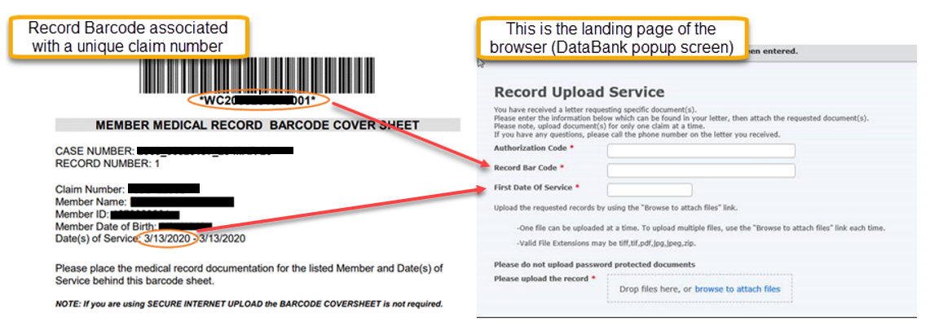
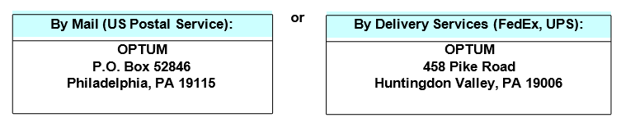
Optum Contact and Communication Details
HARD COPY (i.e. paper copy) using one of the following addresses:
    Mail (US Postal Service): OPTUM P.O. Box 52846 Philadelphia, PA 19115
Delivery Services (FedEx, UPS): OPTUM 458 Pike Road Huntingdon Valley, PA 19006

Slide 47
Optum Contact and Communication Details
On a CD/DVD
If submitting files on a CD/DVD, please use the following additional instructions –

Slide 48
More News
Overlapping Coverage Issue:
Multiple Copays: Edwin
Time Off Requests: Flex time, update calendar, emergent call in
Additional Training Documents: Provider website updates, provider abrasion
Optum Updates: New log being created
Winter Contracts:
Contract Assessments:

Slide 49
Appeals / Grievances

Slide 50

Appeals vs. Dispute
  Appeal: Review of denied prior authorization or claim denial for lack of prior authorization, services exceeding the authorization, insufficient supporting documentation or medical necessity. Appeal must be submitted within 30 days of the date on the EOP.
  Dispute: Claim disputes/reconsiderations for issues related to untimely filing, incidental procedures, unlisted procedure codes, non-covered codes, etc. Claim disputes must be submitted within 180 calendar days of the date on the EOP.
Confidential and Proprietary Information

Slide 51

Appeals/Grievances
  Providers may file an appeal on behalf of the member with the member’s written consent. Providers may also seek an appeal through the Appeals Department within 30 calendar days of a claims denial for lack of prior authorization, services exceeding the authorization, insufficient supporting documentation or late notification.
Confidential and Proprietary Information

Slide 52
Q&A

Slide 53
Provider Relations Contacts

Slide 54
Provider Relations Contacts
REGION 1
OPEN PNS I Phone: Email: Counties: Cherokee, Clay, Graham, Haywood, Jackson, Macon, Madison, Rutherford, Swain, Transylvania, Yancey
Sean Calderon
Phone: 980-408-9219
Email: Sean.Calderon@wellcare.com
Counties: Avery, Buncombe, Burke, Caldwell, Henderson, McDowell, Mitchell, Polk
REGION 2
Cody Corbett Phone: 336-604-9362 Email: Cody.Corbett@wellcare.com Counties: Davidson, Randolph, Rockingham, Guilford
Imani Pinkney
Phone: 919-691-1149
Email: Imani.Pinkney@wellcare.com
Counties: Forsyth, Surry, Wilkes, Yadkin
Todd Askew
Phone: 336-962-1367
Email: jonathan.t.askew@wellcare.com
Counties: Stokes, Watauga, Alleghany, Ashe, Davie
REGION 3
Milton Howard
Phone: 980-254-0872
Email: milton.howard@wellcare.com
Counties: Alexander, Anson, Catawba, Cleveland, Iredell
Randi Allen
Phone: 704-560-7559
Email: randi.allen@wellcare.com
Counties: Cabarrus, Gaston, Lincoln, Rowan, Stanly, Union
Kisha Brandyburg
Phone: 803-397-0928
Email: Kisha.Brandyburg@wellcare.com
Mecklenburg by Zip Code: 28031, 28036, 28078,28105, 28134, 28202, 28203, 28204, 28205, 28206, 28207, 28208, 28209, 28210, 28211
Jedlevia Lewis
Phone: 980-257-0016
Email: Jedlevvia.N.Lewis@wellcare.com
Mecklenburg by Zip Code 28212, 28213, 28214, 28215, 28216, 28217, 28226, 28227, 28244, 28246, 28260, 28262, 28270, 28273, 28277, 28278, 28280, 28289
Team mailbox: NCProviderRelations@WellCare.com
Confidential and Proprietary Information

Slide 55
Provider Relations Contacts
REGION 4
Tawanda Lewis
Phone: 919-440-0833
Email: tawanda.lewis@wellcare.com
Counties: Warren, Franklin, Johnston, Wilson
Miesha Stanley-Lindsay
Phone: 314-296-8246
Email: miesha.stanley-lindsay@wellcare.com
Counties: Alamance, Person, Vance, Chatham, Nash
Shakirah Joyner
Phone: 252-375-9259
Email: shakirah.joyner@wellcare.com
Counties: Wake
Eboni Alston
Phone: 980-254-0984
Email: eboni.alston@wellcare.com
Counties: Caswell, Durham, Granville, Orange
REGION 5
Danielle Oxendine
Phone: 910-303-2456
Email: Danielle.Oxendine@wellcare.com
Counties: Columbus, Robeson, Pender, Brunswick, New Hanover, Bladen
Elease Belser
Phone: 910-734-5363
Email: Elease.d.Belser@wellcare.com
Counties: Moore, Lee, Harnett, Montgomery, Richmond, Hoke
Jennifer Berumen
Phone: 910-301-5169
Email: Jennifer.Berumen@wellcare.com
Counties: Sampson, Scotland, Cumberland
REGION 6
Michele Phillips
Phone: 919-886-8369
Email: michele.Phillips@wellcare.com
Counties: Wayne, Halifax, Lenoir, Edgecombe, Bertie,
Martin, Greene, Pitt
Kimberly Hedrick
Phone: 919-922-5739
Email: Kimberly.Hedrick2@wellcare.com Counties: Carteret, Craven, Duplin, Jones, Onslow, Pamlico, Beaufort, Hyde
Open PNS I
Phone:
Email:
Counties: Camden, Chowan, Currituck, Dare, Gates, Halifax, Hertford, North Hampton, Pasquotank, Perquimans, Tyrell
Confidential and Proprietary Information

Slide 56
Provider Relations Contacts
Network Performance Advisors*
Marti Skelly - Region 1 & 2
Phone: 762-230-1324
Email: marti.skelly@wellcare.com
DLP, Moses H Cone, Mission, Appalachian
Thomas Corbett – Region 3
Phone: 980-279-9487
Email: Thomas.Corbett@wellcare.com
Atrium, Novant, Caromont, Kintegra
Ioulia (Julie) Hardin – Region 4
Phone: 910-409-1328
Email: Ioulia.hardin@wellcare.com
UNC, Duke, WakeMed, Harnett Health, Cape Fear
Cody McAlhaney – Region 5 & 6
Phone: 828-772-4721
Email: cody.mcalhaney@wellcare.com
First Health, ECU, Vidant
CCNC
Shamekia Pena
Phone: 910-391-3542
Email: shamekia.pena@wellcare.com
FQHC / RHC
OLyndria Branche
Phone: 704-591-9101
Email: lbranche@wellcare.com
Statewide
*This is not a comprehensive list
Confidential and Proprietary Information

Slide 57


