Slide 1
Your
Presentation
Title
Name, Title,
Date

Slide 2
Today’s Presentation
Industry overview
HFMA initiatives
Organizational overview
Benefits and resources
Get involved
Healthcare Financial Management Association

Slide 3
Today’s Presentation
Industry overview
HFMA initiatives
Organizational overview
Benefits and resources
Get involved
Healthcare Financial Management Association

Slide 4




With you today
4 people featured
Name Here
Title Here
Name Here
Title Here
Name Here
Title Here
Name Here
Title Here

Slide 5
With you today
3 people featured
Name Here
Title Here
Name Here
Title Here
Name Here
Title Here

Slide 6
With you today
2 people featured
Name Here
Title Here
Name Here
Title Here

Slide 7
Speaker Name
SUBHEAD
Copy here to come

Slide 8
Speaker Name
SUBHEAD
Copy here

Slide 9
Speaker Name
About HFMA
SUBHEAD
Speaker bio
The Healthcare Financial Management Association (HFMA) equips its members nationwide to navigate a complex healthcare landscape. Finance professionals in the full range of work settings, including hospitals, health systems, physician practices and health plans, trust HFMA to provide the guidance and tools to help them lead their organizations, and the industry, forward. HFMA is a not-for-profit, nonpartisan organization that advances healthcare by collaborating with other key stakeholders to address industry challenges and providing guidance, education, practical tools and solutions, and thought leadership. We lead the financial management of healthcare.

Slide 10
Copy here to come
Title here to come
Copy here to come
Subtitle
This slide can be used to showcase main points or presentation categories.
Copy here to come

Slide 11
Title here to come
Subtitle
Copy here
Copy here
Copy here
Copy here
Copy here
This slide can be used to showcase main points or presentation categories.

Slide 12
Title here to come
Subtitle
Copy here
Copy here
Copy here
Copy here
This slide can be used to showcase main points or presentation categories.

Slide 13
Headline
goes
here
Subhead – photo/image on right

Slide 14
Headline
goes
here
Copy here to come
Subhead – text on right

Slide 15

Slide Title
Copy on the left. Circle on the right is intended to be used for an image. Images, like member photography, can be pulled from the Appendix.

Slide 16
Slide Title
Copy on the left. Circle on the right is intended to be used for an image. Images, like member photography, can be pulled from the Appendix.

Slide 17
Title here to come
Subtitle here to come
20
CPE CREDITS
70+
EDUCATIONAL
SESSIONS
300+
SOLUTION
PROVIDERS
Copy here if needed
Copy here if needed
Copy here if needed
Notes:
Please do not make edits to this slide.

Slide 18
Title here to come
Subtitle here to come
Text or Data
Text or Data
Text or Data
Copy here if needed
Copy here if needed
Copy here if needed

Slide 19
Title here to come
Subtitle here to come
Copy here to come

Slide 20
Title here to come
Subtitle here or statement.
Copy here to come.

Slide 21
Title to come
Subtitle here to come if needed
This is the standard copy slide with text and no images.
Bullet
  Indent 1

Slide 22
Title to come
This is the standard copy slide with text and no images.
Bullet
  Indent 1

Slide 23
Title to come
Subtitle here to come
This is the standard copy slide with a visual. Looking for an icon or photo to relay a point or showcase community? Check the appendix.
Bullet
  Indent 1

Slide 24
“
If your actions inspire others to dream more, learn more, do more and become more, you are a leader. Font is Georgia.”
john Quincy Adams,
U.S. President, 1797-1801

Slide 25
“
If your actions inspire others to dream more, learn more, do more and become more, you are a leader. Font is Georgia.”
john Quincy Adams,
U.S. President, 1797-1801

Slide 26

Section break
SUBHEAD
Copy here if needed

Slide 27
Section break
SUBHEAD
Copy here if needed

Slide 28
Title to come
Subtitle here to come
Phase 1
Phase 2
Phase 3
Phase 4
Phase 5
Copy here to come
Copy here to come
Copy here to come
Copy here to come
Copy here to come

Slide 29
Title to come
Subtitle here to come
Phase 1
Phase 2
Phase 3
Phase 4
Phase 5
Copy here to come
Copy here to come
Copy here to come
Copy here to come

Slide 30
Title to come
Subtitle here to come
Phase 1
Phase 2
Phase 3
Phase 4
Phase 5
Copy here to come
Copy here to come
Copy here to come

Slide 31
Title here to come
Subtitle here or statement.
Right click on the graph, select Edit Data

Slide 32
Title here to come
Subtitle here if needed
Right click on the graph, select Edit Data
Right click on the graph, select Edit Data

Slide 33
Title here to come
Subtitle here if needed
Right click on the graph, select Edit Data

Slide 34
#YOUBELONGHERE
Mission
Impact
Community
To realize the full health potential of every human, everywhere.
To realize the full health potential of every human, everywhere.
To realize the full health potential of every human, everywhere.

Slide 35
#YOUBELONGHERE
Vision
Mission
To realize the full health potential of every human, everywhere.
Reform the global health ecosystem through the power of information and technology.

Slide 36
Mission
Impact
Community

Slide 37
Thank you.
Questions?

Slide 38
Questions?
Your NAME
Your title
youremailaddress@hfma.org
Notes:
Create this template

Slide 39
Appendix

Slide 40
Approved Typeface System
Primary Typeface
Aptos is the primary typeface for all HFMA presentations. It reflects a modern, approachable, and professional tone while supporting readability in both digital and live presentation environments.
Alternate Typeface
Arial is the approved alternate typeface when Aptos is unavailable. It may be used without modification and must follow the same hierarchy, sizing, and usage standards.
No additional typefaces are permitted in HFMA presentations.

Slide 41
Font Size Standards
Title Sizes
Titles use a three-tier scale based on slide importance and content density.
Font Weights: Aptos Black, Black Italic, ExtraBold, ExtraBold italic, Bold, Bold Italic
Large Title: 48 pt
Standard Title: 44 pt
Compact Title: 36 pt

Slide 42
Font Size Standards
Subhead Sizes
Subheads follow a supporting scale that maintains clear hierarchy beneath titles.
Font Weights: Bold, Bold Italic, SemiBold, SemiBold Italic
Large Subhead: 28 pt
Standard Subhead: 24 pt
Compact Subhead: 20 pt or 18 pt

Slide 43
Font Size Standards
Body and Bullet Sizes
Body copy and bullets use a legible, accessibility-first scale appropriate for presentation viewing distances.
Font Weights: Regular, Italic, Light, Light Italic
Large Body & Bullets: 28 pt
Standard Body & Bullets: 24 pt
Secondary Body & Bullets: 20 or 18 pt
Small Body & Bullets: 16 pt

Slide 44
Font Size Standards
“
Quotes
Large quotes should be in the font Georgia.
Font Weight: Italic
Large Quote: 44 pt
Who said the quote and their title : 20 pt Aptos
ALL CAP BOLD
Quote text styling sample…”
john Quincy Adams,
U.S. President, 1797-1801

Slide 45



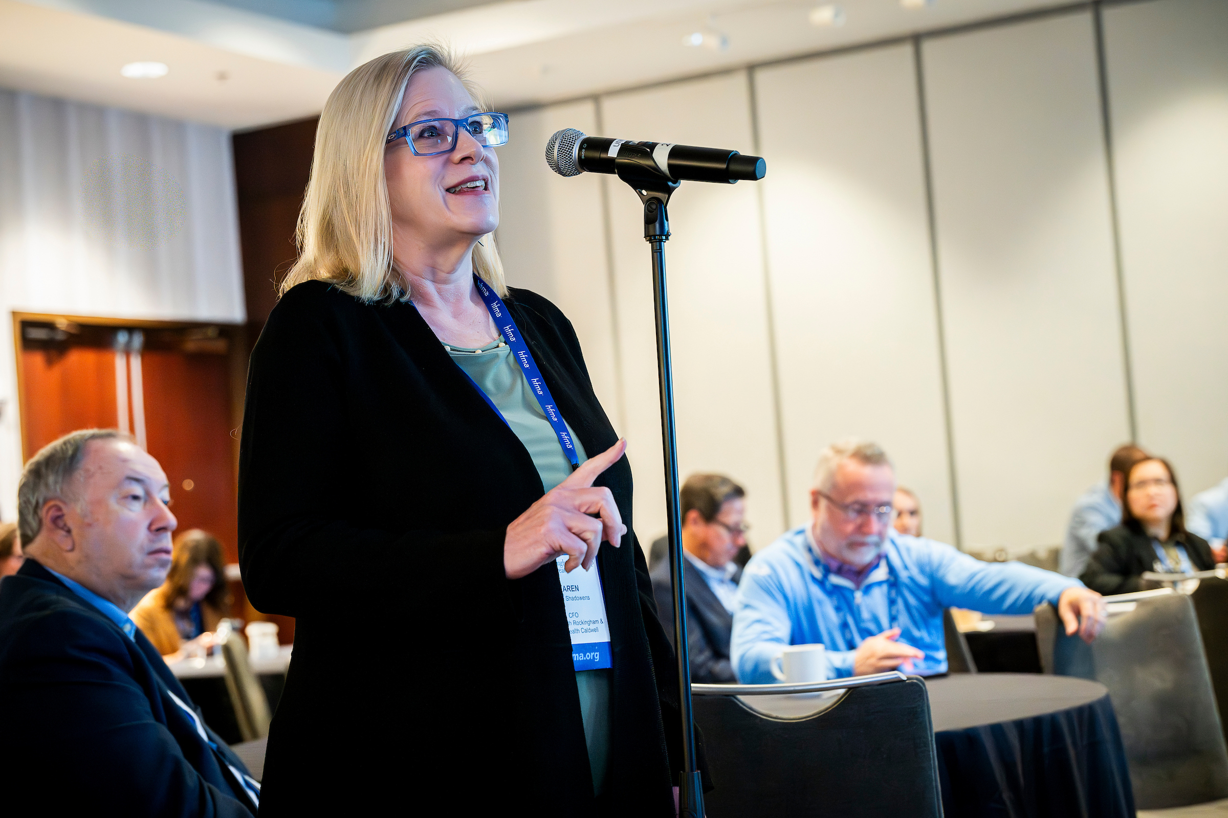



Photography
Copy & Paste from the selected membership photography
Healthcare Financial Management Association

Slide 46




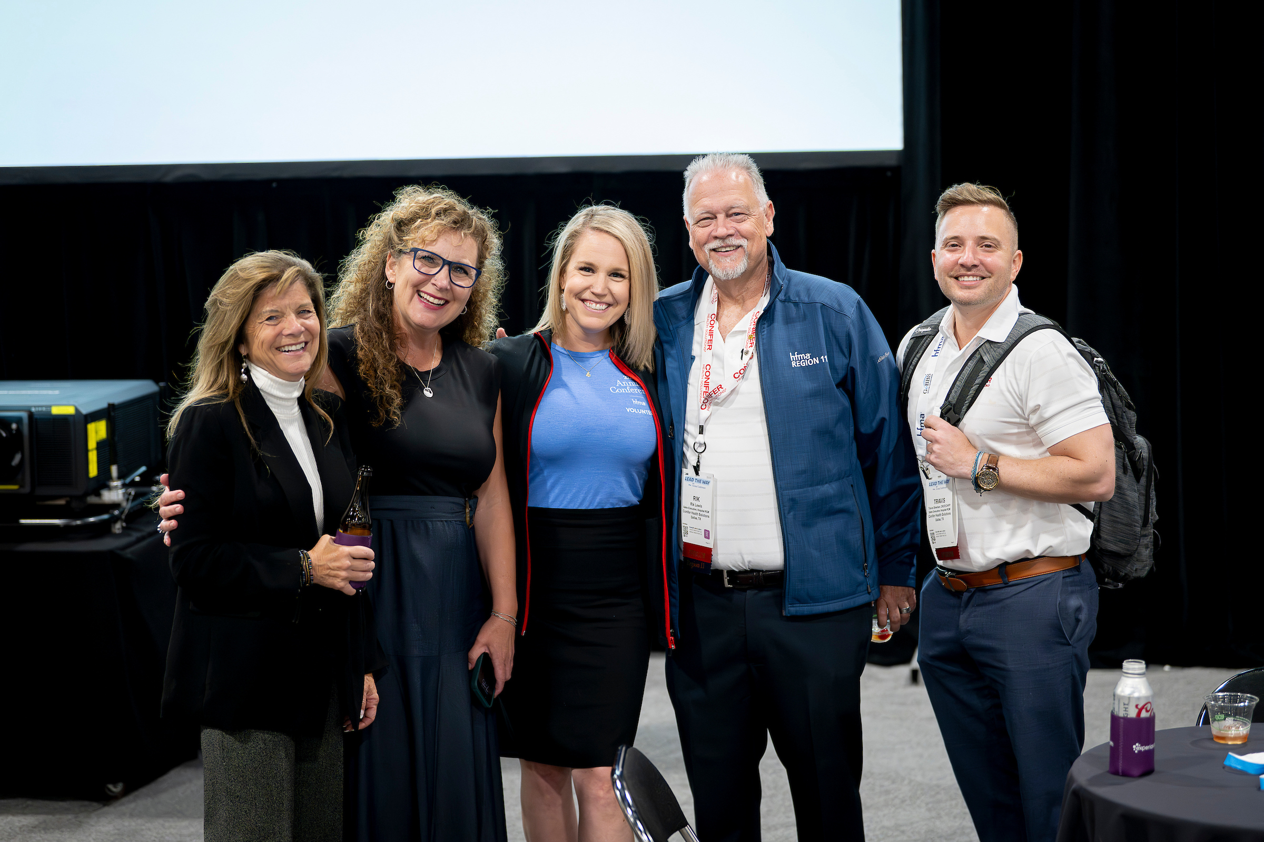



Photography
Copy & Paste from the selected membership photography
Healthcare Financial Management Association

Slide 47

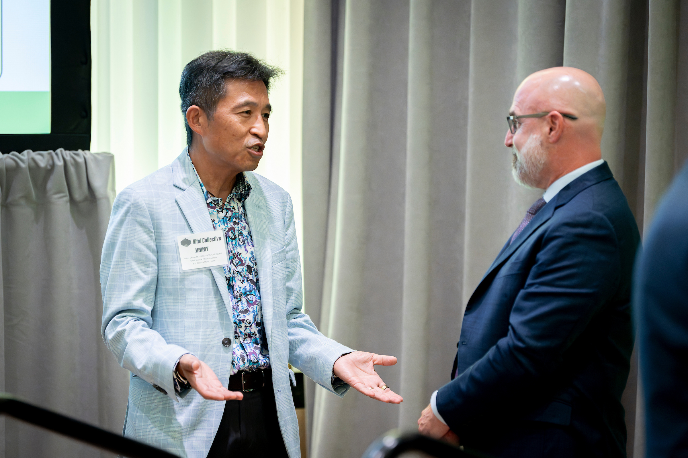






Photography
Copy & Paste from the selected membership photography

Slide 48
Icon Set
Additional icons can be found by going to “Insert > Icons…”
There are hundreds of options that can be customized with a brand color, and placed onto a circle.

