Slide 1
Leading Healthcare
Finance Forward
Name, Title,
Date

Slide 2

About HFMA
Leading Healthcare Finance Forward
HFMA supports more than 145,000 healthcare finance professionals with guidance, education, and tools to navigate a complex healthcare landscape.
Leading Healthcare
Finance Forward
Learn more about HFMA
hfma.org/about
Notes:
Please add QR codes

Slide 3
#YOUBELONGHERE
Vision
Mission
HFMA will bring value to the industry as the leading organization for healthcare finance.
Leading the financial management of health care.
Learn more about HFMA
hfma.org/about

Slide 4

About HFMA Membership
Where healthcare finance leaders learn, connect, and belong.
Tools, insights, and connections that advance your career and improve financial performance.
Membership for you + your organization
hfma.org/membership

Slide 5
Review the benefits of belonging

Slide 6



80 Years.
One Community. Endless Impact.
80 years of progress doesn't happen by accident. It happens because people like you choose to invest in this community, this profession, and each other.
Explore our history and be part of what comes next
hfma.org/history

Slide 7
About HFMA Membership
Demographics
91.6
8.4
%
%
145,000+
Member count as of April 2026
Enterprise membership as of December 2025
Individual membership as of December 2025

Slide 8
Provider Organizations (Hospitals/Systems) Make Up Majority of Membership Base
10%
21%
17%
Total
Members
Individual
Members
Enterprise
Members
27%
90%
52%
83%
As of December 2025
Individual
Enterprise
Hospitals/Health Systems
Business Partners
Other

Slide 9
Primary Member Job Functions
Revenue Cycle
Accounting/Finance
Administration And Operations
Health Information/Medical Records
Payer Reimbursement/Revenue Integrity
Decision Support/Bi/Analytics
Clinical/Patient Care
Legal Compliance/Internal Audit
Strategy/Business Development/Marketing
Customer Service/Patient Experience
Other Responsibilities
As of December 2025

Slide 10
Member Profiles Vary by Membership Category
14%
59%
34%
13%
15%
5%
Individual
Members
Enterprise
Members
36%
23%
As of December 2025
Executive Level
Director/Mid-Level
Professional Level
Other

Slide 11
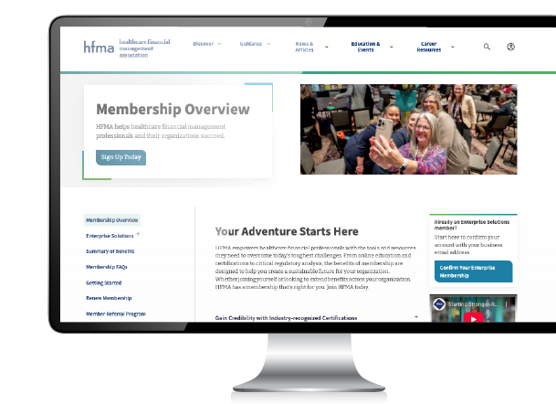
Turning Knowledge into Action
Advance your career, strengthen your team, improve financial performance.
Connect with a national community, stay ahead of regulatory and industry change, and build capabilities that drive better results for your organization.
Explore HFMA membership
hfma.org/membership

Slide 12


HFMA’s Local Reach
Local connections that keep you informed and engaged
Tap into chapter and regional events to learn, share solutions, and grow your professional network. Included with membership.
Find your Chapter
hfma.org/chapters
Access Local Event Calendar
hfma.org/events

Slide 13


Online
Community
Collaborate with peers anytime, anywhere
Connect with peers, ask questions, and share real-world solutions in topic and role-based groups.
Find answers in the online community.
hfma.org/community

Slide 14


E-Learning
Self-paced learning to stay current and earn CPE
Access online education to stay current and maintain your credentials, with opportunities to earn CPE.
Power your career with HFMA
e-learning. hfma.org/elearning

Slide 15

It’s here!
The new HFMA Learning Center
is live!
Find the right courses.
Stay engaged.
Build skills with confidence.
Get started
hfma.org/learn

Slide 16
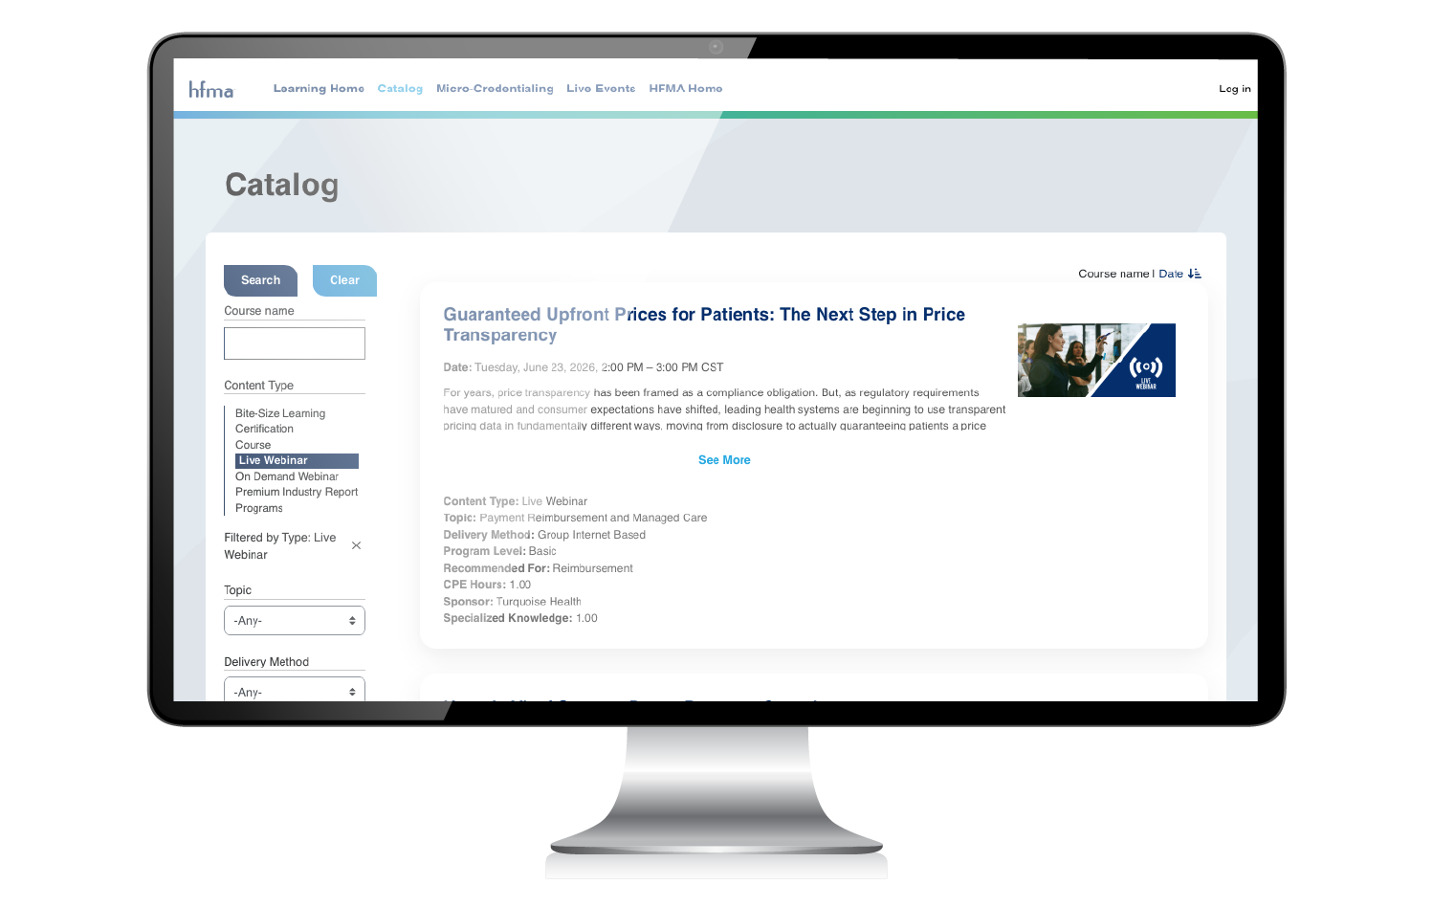

Webinars
Timely, convenient learning on today’s top issues
HFMA webinars deliver live and on-demand education on key healthcare finance topics.
Access the webinar catalog
hfma.org/webinars

Slide 17


Certifications
Show your expertise with recognized HFMA credentials
Validate your expertise, elevate your profile, and grow your earning potential when you earn HFMA certifications – most included with membership.
Get Certified. Get Recognized.
hfma.org/certifications

Slide 18




HFMA Events
The biggest opportunities to learn and network in person
HFMA events bring healthcare finance professionals together to learn, share strategies, and build meaningful connections.
March 9-12, 2027
Orlando, FL
April 18-20, 2027
Atlanta, GA
June 27-30, 2027
Denver, CO
See upcoming events and access member-only savings at registration.
hfma.org/events

Slide 19




Coming March 2027!
HFMA Revenue Cycle Conference
March 9-12 | Orlando, FL
Four days of focused education, peer connection, and practical insights. Built specifically for revenue cycle leaders.
Save your spot!
Sign up for RCC 2027 updates
hfma.org/rccnotify
Notes:
Coming March 2027!
HFMA Revenue
Cycle Conference
March 9-12 | Orlando, FL

Slide 20




Coming April 2027!
HFMA Leadership Summit
April 18-20 | Atlanta, GA
Three days of immersive leadership development, strategic conversation, and peer connection. Designed for the healthcare finance leaders shaping what's next.
Be the first to know when registration opens.
hfma.org/summitnotify
Notes:
Coming April 2027!
HFMA Leadership Summit
April 18-20 | Atlanta, GA

Slide 21



Coming June 2027!
AC27
NEXT STOP
June 27-30 2027 | Denver, CO
Four days of bold ideas, practical learning, and meaningful connection. Built for healthcare finance leaders ready to solve what’s next.
Sign up for updates and be first in line for AC27
hfma.org/acnotify

Slide 22



hfm
Practical insights from healthcare finance leaders
Gain practical, proven insights with your subscription to hfm, HFMA’s member-only magazine–available in print, online, and through the hfm digital app.
Access the latest issue
hfma.org/hfm

Slide 23
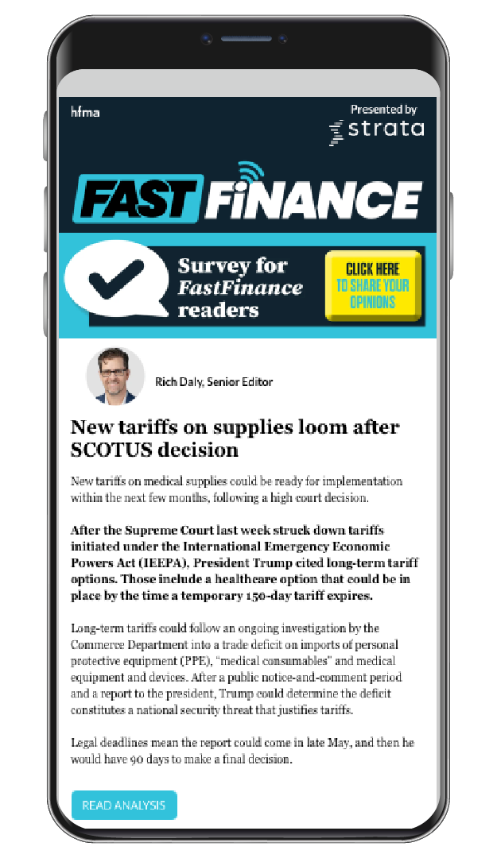



CFO-level intelligence at the speed leadership demands
HFMA’s weekly briefing delivering concise payment and reimbursement analysis, candid interviews, and a curated regulatory calendar.
Learn more and opt-in.
hfma.org/ff
Healthcare Financial Management Association
© 2026

Slide 24
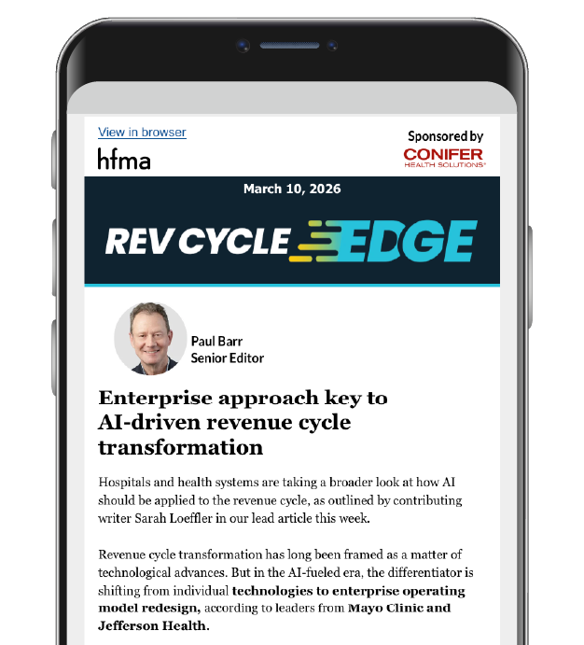



Revenue cycle insights, delivered to your inbox
HFMA’s member-only e-news delivers exclusive insights on revenue cycle trends, strategies, and tools.
(Log in required)
hfma.org/preferences
Healthcare Financial Management Association
© 2026

Slide 25



Voices in Healthcare Finance
Award-winning stories from the front lines of healthcare finance
HFMA’s award-winning podcast featuring in-depth news and stories across the healthcare landscape with a clear focus on the role of finance.
Listen in
hfma.org/podcast
Healthcare Financial Management Association
© 2026

Slide 26


THE C-SUITE
OF THE FUTURE
Insights for leading through transformation
Exploring how unsustainable costs, rapid technological change, and AI are reshaping healthcare leadership.
Access the C-Suite of the Future report
hfma.org/CSuiteFuture

Slide 27


REVENUE CYCLE
OF THE FUTURE
Navigating acceleration of rev cycle change
From workflow redesigns to workforce concerns, healthcare leaders grapple with challenges and opportunities that AI and technology bring.
Access the Revenue Cycle of the Future report
hfma.org/RevCycleFuture

Slide 28


PART 1
HOSPITAL OF THE FUTURE
Healthcare leaders face uncertainty, urgency
As high-tech care meets old-school constraints, the hospital of the future is not necessarily a building, but new models of care delivery.
Access the Hospital of the Future report
hfma.org/HospitalFuture

Slide 29


Data + Insights
Transform performance with trusted healthcare analytics
Research, benchmarks, and analytics tools that help you measure performance, solve business challenges, and improve outcomes.
Dive into data
hfma.org/data

Slide 30
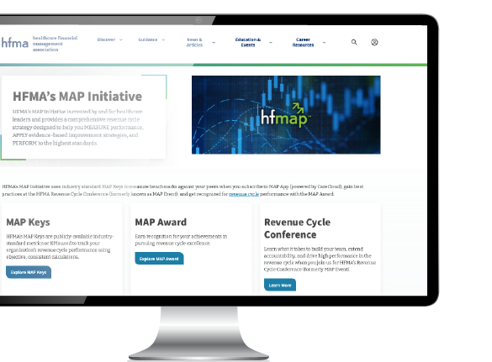

MAP Initiative
A complete strategy to measure, improve, and perform in revenue cycle
Gives hospitals and healthcare providers a comprehensive revenue cycle strategy to Measure performance, Apply evidence-based improvements, and Perform at the highest standards.
Learn more about the MAP Initiative
hfma.org/map

Slide 31



MAP App, powered by
Optimize Every Step of Your Revenue Cycle
MAP App empowers your team with data, benchmarks, and guidance designed to elevate revenue cycle outcomes.
hfma.org/mapapp

Slide 32


Celebrate Revenue Cycle Excellence
Earn a MAP Award for High Performance in Revenue Cycle
hfma.org/mapaward
Recognizes organizations whose innovative and effective strategies have enabled them to achieve excellence in revenue cycle performance.

Slide 33


Salary + Compensation Data
See how your compensation compares.
Analyze salary ranges across healthcare finance roles and see how your compensation compares to peers.
Access compensation benchmarks
hfma.org/salary

Slide 34


Peer Review
See what solutions healthcare finance leaders trust
Products and services on THE SHORT LIST have earned the “Peer Reviewed by HFMA” designation based on user evaluation of quality, support, service, and value.
Start your product or service search here.
hfma.org/peerreview

Slide 35
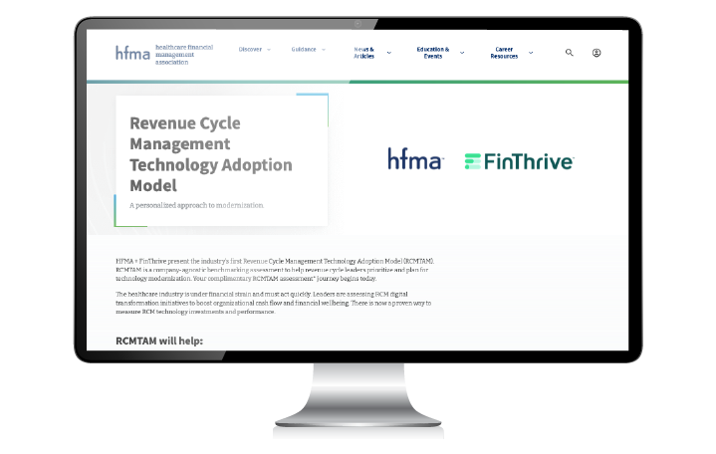
RCM Technology Adoption Model
A personalized approach to modernization.
A company-agnostic benchmarking assessment to help revenue cycle leaders prioritize and plan for technology modernization.
Start Your Assessment
hfma.org/rcmtam

Slide 36


Turquoise Health
Price transparency and contract intelligence for stronger negotiations
Benchmark your prices against industry peers, uncover revenue opportunities, and stay compliant with Turquoise Health’s pricing and contract intelligence platform.
Unlock price transparency data
hfma.org/turquoise

Slide 37


Starset Analytics
Strategic pricing intelligence from transparency data
Turns messy price-transparency files into clean, defensible rate insights by market, code, and care setting–so you can protect premium rates, fix outliers, and negotiate with evidence.
Access strategic pricing intelligence
hfma.org/starset

Slide 38


Equity Quotient
Turn community health and SDoH data into actionable insight
Access robust community health metrics by ZIP to flag social determinants of health risks, sharpen CHNAs, and track your markets progress over time.
Access the health equity dashboard
hfma.org/eq

Slide 39

Volunteer – The Why
Enhance your career, grow your network, give back
Volunteering with HFMA helps you:
Develop leadership and communication skills
Gain experience that shows your commitment to the profession
Expand your network and build relationships.
Increase your visibility with leaders, hiring managers, and recruiters.
Strengthen your resume and demonstrate your impact.
Explore opportunities
hfma.org/volunteer

Slide 40
Volunteer – The How
Turn involvement into influence and impact
Volunteer opportunities:
Share insights: write, speak, and present.
Lead locally through chapter roles.
Connect and mentor in the online community.
Shape strategy on national councils and boards.
Explore opportunities
hfma.org/volunteer

Slide 41


Lower costs and healthier lives
Convening diverse stakeholders in the pursuit of affordability, better outcomes and financial sustainability in U.S. healthcare.
Join the Movement
hfma.org/vitalic
Notes:
Please add QR code

Slide 42






CONNECT WITH HFMA

