Slide 1
Today’s Presentation
[Introduction,
add chapter logos]
Date

Slide 2
HFMA Student Membership
Student Membership Benefits
Requirements
How to Apply
Healthcare Financial Management Association
Notes:
Please note this is just a suggested template and you should customize accordingly

Slide 3
HFMA Student Membership Benefits
[Add Subtitle if desired]
Leadership and Volunteering
Networking and Career Exposure
Industry Content Access
Free Membership
Resume-Building Experience
Be on a committee
Meet industry experts and leaders
All articles and information is available with your membership
One year of membership from the time the code is entered
Have leaders review your resume

Slide 4
Must have a .edu email address
Student Requirements
[The only HFMA requirement is a .edu email- the rest you can fill in with suggestions from the notes based on what applies to your chapter]
.
Notes:
Program Overview – Ideas for Student Involvement:
1. Board Meeting Attendance:
• Schedule and coordinate student participation in a board meeting.
2. Networking/Live Event Participation:
• Identify relevant events for students to attend.
• Organize opportunities for student volunteers at events.
3. Social Media Engagement:
• Create guidelines for students to post events on their personal social media.
• Encourage active participation in HFMA social media channels.
4. Committee Involvement:
• Develop a system for students to serve on committees.
For other ideas on micro-volunteering, check out the Volunteer Recruitment & Engagement page in the Chapter Resource Center, specifically the section entitled “Management Tools”. You’ll see some great ideas from the Central Ohio chapter.

Slide 5
How to Apply the Discount
[Add your Region's Discount Code here (or provide after student emails you)]
Confirm your eligibility with the email address
Have the Code from the Chapter
Start here: Join | HFMA
Apply the Discount at checkout
Now you are ready to become an active member of your HFMA chapter!
Notes:
Please note, the Association does not need to be part of the “approval” process as you select students to give these memberships to. This is your program to manage and we trust you to give out the discount codes in alignment with the intent of the program. The goal is to increase student involvement and also recruit more volunteers for your chapters.

Slide 6
Upcoming Chapter Events
[use this slide to add upcoming events your Chapter & Region have planned]
Text
Text
Text
Text
Text

Slide 7
Connect with Us!
[Insert Chapter Social Media, QR codes for registration, etc.]
[Add text]

Slide 8
Thank you.
Questions?

Slide 9
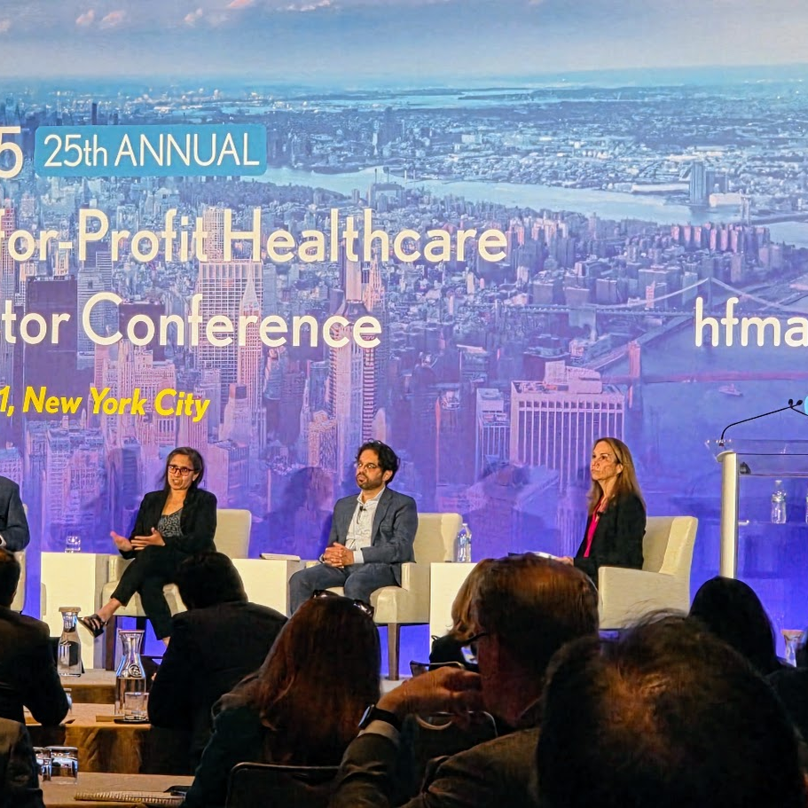
Slide Title
More slides to use

Slide 10
Title here to come
Subtitle here to come
Copy here to come

